Slide 1


Slide 2

The Landscape

Slide 3



The Landscape
NEARLY
1 IN 4 PEOPLE
in America have
a disability

Slide 4

The Landscape
MORE THAN
1 IN 3 HOUSEHOLDS
in America have a
member that identifies
with a disability

Slide 5
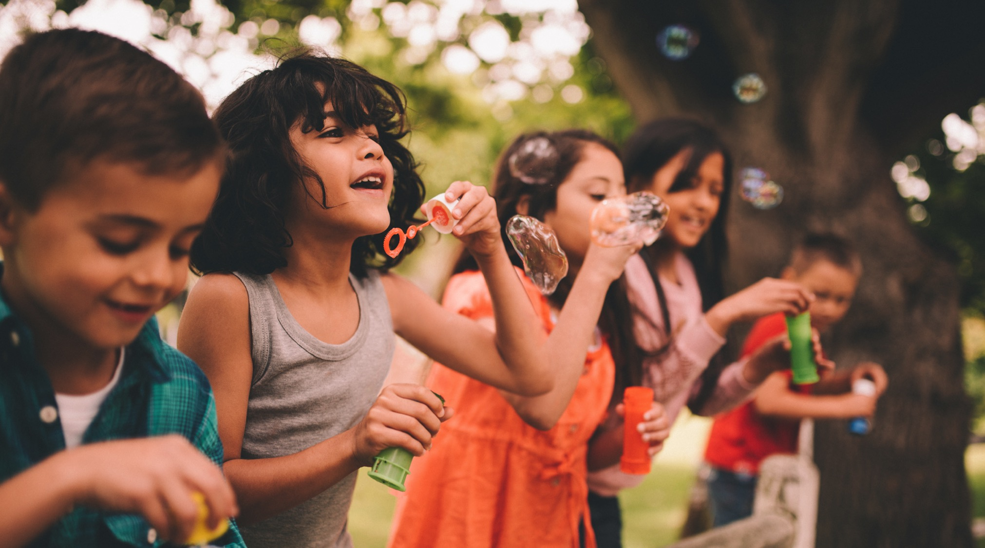
The Landscape
61M
Children and adults in America today live
with a disability

Slide 6
The #1 Issue on People’s Minds
At one point in our lives,
one way or another,
disability will touch every
single American

Slide 7
Easterseals
Overview

Slide 8

Our Purpose
To lead the way to 100% equity, inclusion, and access
for people with disabilities, families and communities.

Slide 9

Who We Serve
We serve approximately
1.5 MILLION
individuals and families annually

Slide 10
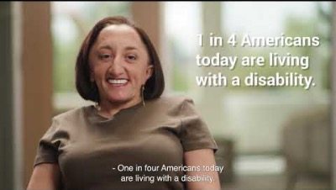
That’s My Easterseals
PSA Series

Slide 11

Leading the way to 100% equity, inclusion, and access by:
Enriching education
Enhancing health
Expanding employment
Elevating community

Slide 12
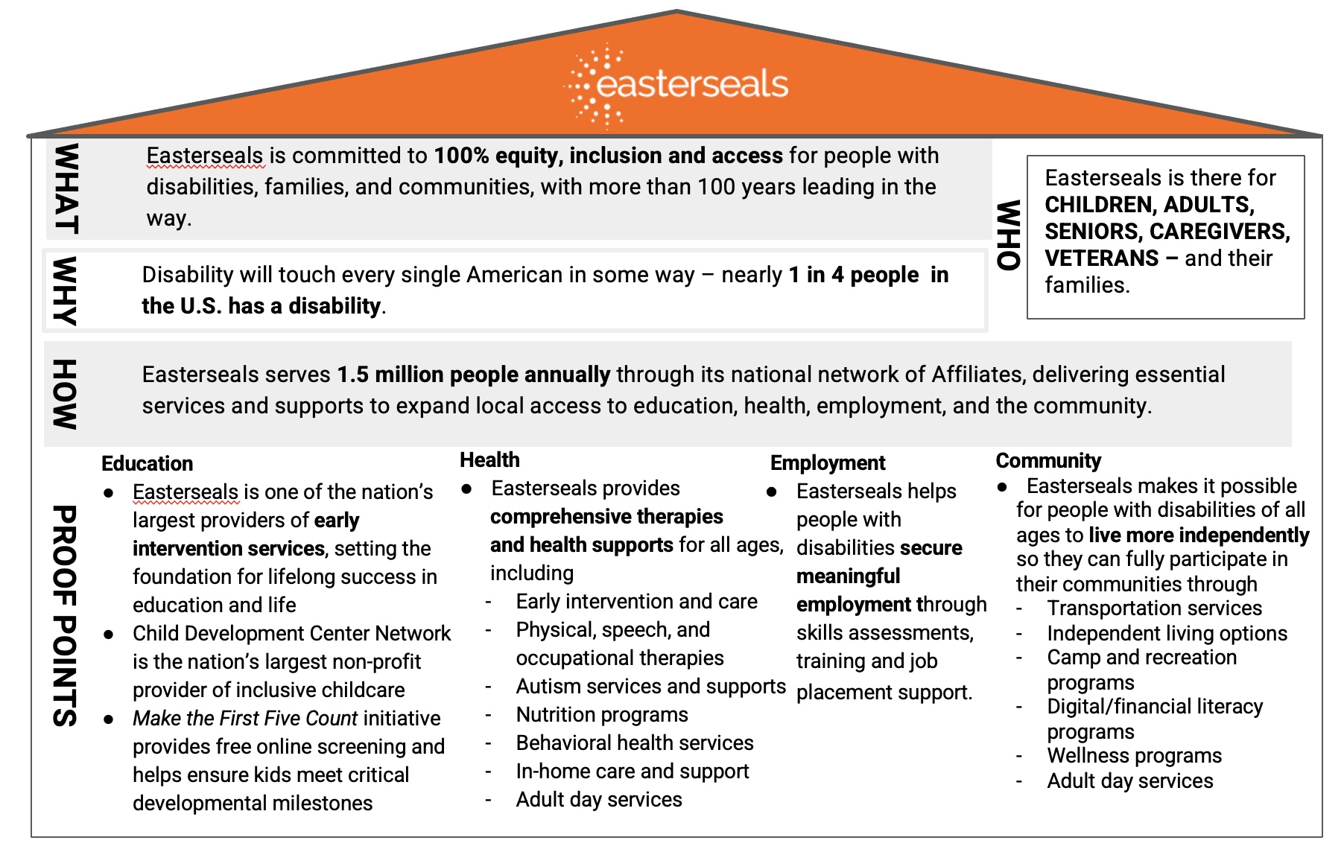
Message House

Slide 13
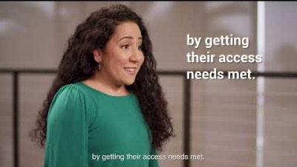
That’s My Easterseals
Enriching Education

Slide 14
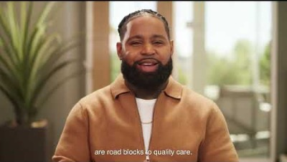
That’s My Easterseals
Enhancing
Health

Slide 15

That’s My Easterseals
Expanding
Employment

Slide 16
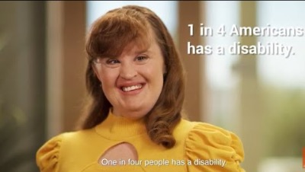
That’s My Easterseals
Elevating Community

Slide 17
Our History
For more than 100 years, Easterseals has worked tirelessly with our partners and our communities to enhance quality of life and expand local access to healthcare, education and employment opportunities for the 1 in 4 Americans living with disability today.
And we won’t rest until every one of us is valued, respected, and accepted.

Slide 18

Our Promise to America
    We believe
    that every person should have EQUAL ACCESS to healthcare, education and employment – and live a life of their choosing.
    Easterseals
    is there for
    CHILDREN,
    ADULTS, SENIORS, CAREGIVERS, VETERANS – and their families.
    We are in
    THOUSANDS OF COMMUNITIES
    across the country, providing personalized services through home and community-based services.

Slide 19
Our Societal Impact
    We help people of all abilities realize their potential, strengthening families and communities nationwide.
    Our services impact the lives of individuals throughout the lifespan –
    and the lives of their families,
    their communities and
    society at large.
    A commitment to people with disabilities promises loyalty that can activate the $22B+ in buying power of consumers with disabilities and their families.

Slide 20


Scorecard
    Delivering services and supports to children and adults with disabilities, families, and communities
    for more than 100 years
    Advancing public policy and advocacy to positively shape perceptions – and to address the urgent and evolving needs of people living with disabilities today.

Slide 21
Easterseals Network
Overview

Slide 22

The Power of the
Easterseals Network
    67
    Easterseals
    Affiliate Network
    1.5M
    Participants and their families
    35K
    Volunteers
    Nationwide
    32K
    Staff
    Members
    550+
    Service Sites and Locations with Community Partners
    1000s
    More Touchpoints Nationwide
Notes:
Just a topline on our early intervention services for children…

Slide 23
Collective Budget
MORE THAN
of Easterseals’ revenue supports services in
the area where funds are raised
90%

Slide 24
Our Areas of Impact: Children and Their Families

Slide 25

Easterseals Early Intervention
We help young children of all abilities achieve their goals in cognitive, social/emotional, communicative, adaptive and physical development.
Our early intervention services take place in the home or, in the case of working parents, at our community-based childcare centers. Services include occupational, physical and speech therapies; autism supports; evaluation, training, resources and referrals; and nutrition programs.
Notes:
Just a topline on our early intervention services for children…

Slide 26

Easterseals Child
Development Centers
Our Child Development Center Network is the largest nonprofit provider of inclusive childcare in the United States.
Easterseals serves thousands of young children
and their families in an inclusive setting where children of all abilities can learn and play together, and children with disabilities and special
needs represent 25% of enrollment.
Notes:
Easterseals Child Development Center Network responds to the needs and concerns of parents with children of all abilities. Our Centers are designed to provide young children with the optimal setting for successful learning and development.

Slide 27
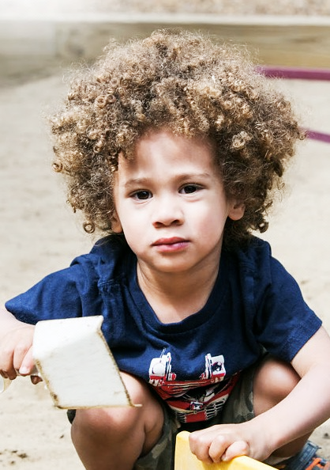
Easterseals Make the First Five Count Program
Through Easterseals Make the First Five Count, we provide resources to help parents and caregivers of infants and toddlers to learn about the five key growth areas during the early, critical years before kindergarten.
We provide a free, online screening tool for those caring for infants and toddlers to assure the kids for whom they care are developing appropriately, reaching developmental milestones on both physical and social-emotional levels throughout their first five years of life so they can be school-ready – and what to do if they’re not. Available in English and Spanish at http://www.easterseals.com/mtffc/
Notes:
We have developed vast resources like First Five Count…and the ASQ (Ages and Stages) screen tool...
Every year in America, more than one million young children with unidentified disabilities enter school with learning and health issues that put them far behind their peers and have a lasting, negative effect on their ability to meet their full potential.
That’s why it’s important for children at risk of developmental delays, autism or other disabilities to get the treatment and therapy they need before the age of five.

Slide 28
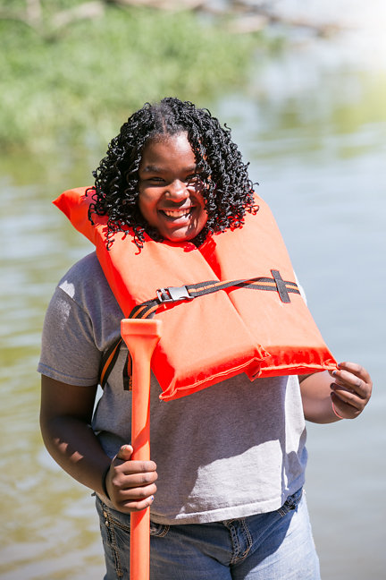
Easterseals Camping Programs
Easterseals knows the benefits of play and sport that empower children with disabilities to become more independent while living healthier and happier lives!
Our camp and recreation programs across the country provide the opportunity for kids and adults with disabilities to experience the joy of camp with their peers, often building lifelong friendships.
Given that obesity is prevalent among adults with disabilities – 38.2% vs 26.2% among non-disabled adults – our camping programs encourage movement and exercise so that these critical components of wellbeing become part of their lives early.
Virtual camping programs have been offered throughout our Network during the pandemic – and a National Virtual Camp is underdevelopment for kids of all abilities throughout the world.
Notes:
We have developed vast resources like First Five Count…and the ASQ (Ages and Stages) screen tool...
Every year in America, more than one million young children with unidentified disabilities enter school with learning and health issues that put them far behind their peers and have a lasting, negative effect on their ability to meet their full potential.
That’s why it’s important for children at risk of developmental delays, autism or other disabilities to get the treatment and therapy they need before the age of five.

Slide 29
Our Areas of Impact: Adults & Seniors

Slide 30

Easterseals Services for
Young Adults
We provide services for young adults transitioning from adulthood including employment training, coaching and placement; transportation; in-home care; and camping and recreation.
Individually tailored, our services are designed to help young adults reach for and realize their full potential.
Notes:
Whether looking for the next step after graduation; seeking employment; or making friends and having fun in a social setting, Easterseals offers a variety of robust, supportive, and exciting programs to help young adults reach for and realize their full potential.
Programs for young adults include: In-Home Care, Camping and Recreation, Employment and Medical Support Services

Slide 31
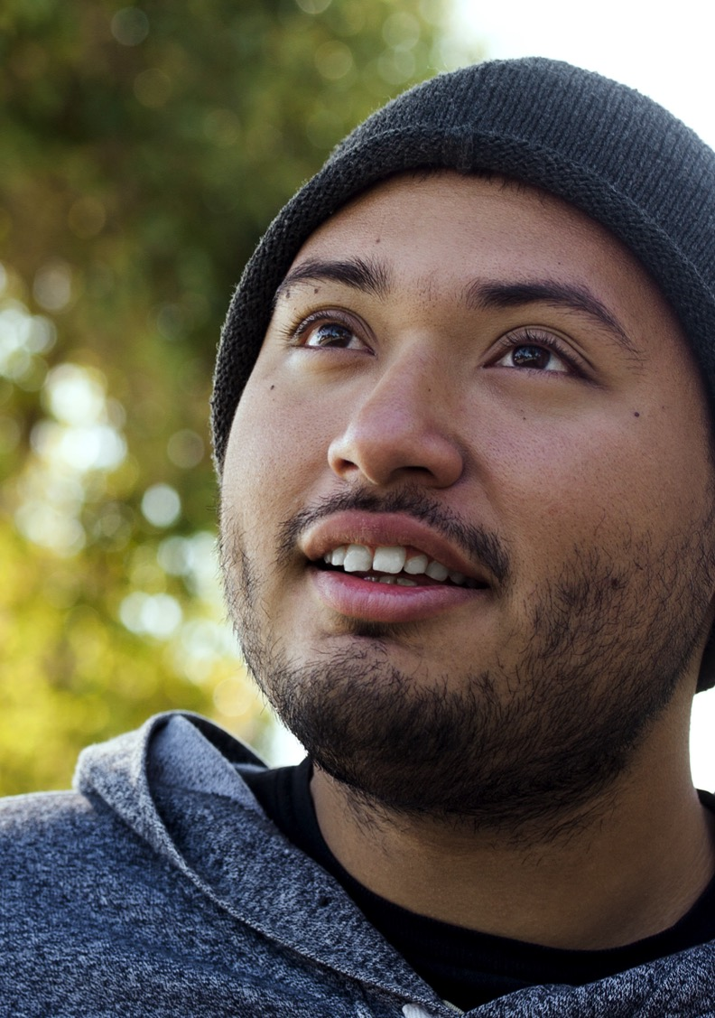
Easterseals Services for Adults
Easterseals provides a variety of home and community-based services which afford adults
and seniors with access to healthcare, education and employment opportunities so they can more fully participate in their communities and in society.
Employment training and job placement; transportation; residential living options; and assistive technology – as well as health care services including medical rehabilitation and behavioral health – are among services offered.
Notes:
For decades, Easterseals' Adult Day Care Services have put hope within reach for thousands of adults. Services for adults include:
Older Adult Services
In-Home Services
Caregiver Services

Slide 32
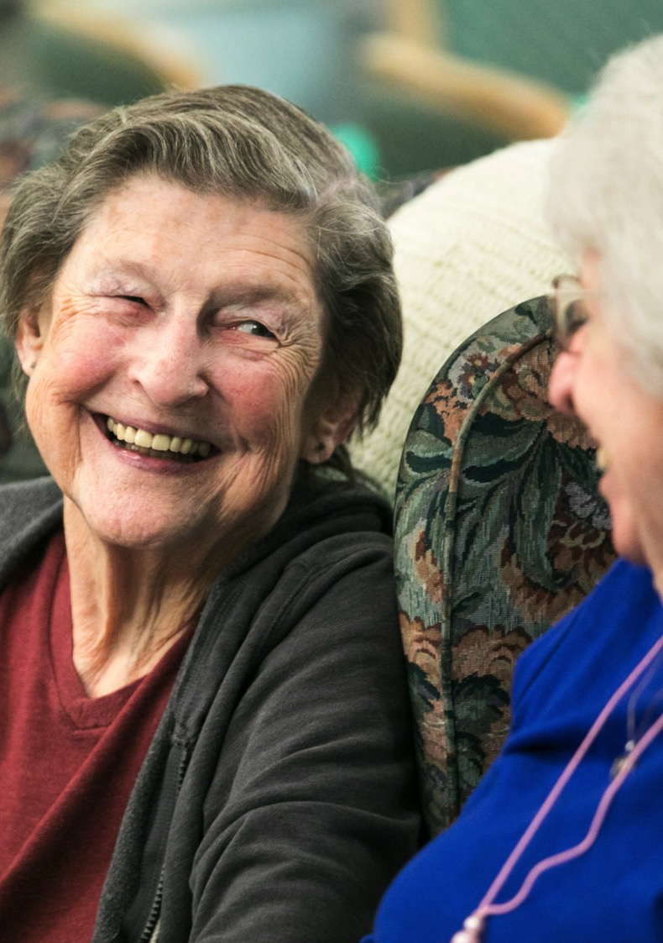
Easterseals Services for Seniors
Easterseals adult day services, in-home supports and care, community mobility options, behavioral health, wellness programs and support for family caregivers help people live as independently as possible for as long as possible.
Our services help manage activities of daily living that may be limited as a result of aging and are designed for the growing number of older Americans and their caregivers.
Notes:
In the next decade, over 71 million Americans will be 65 years of age and older. With the increasing numbers of older persons and persons with life-long disabilities living longer, we will see a broader demand for home and community-based services. These services will help manage activities of daily living that may be limited as a result of acute or chronic conditions, and will keep people integrated in their communities.
The Easterseals family of services is ever expanding to meet the needs and help promote wellness, independence and connectivity among the growing number of older Americans.

Slide 33
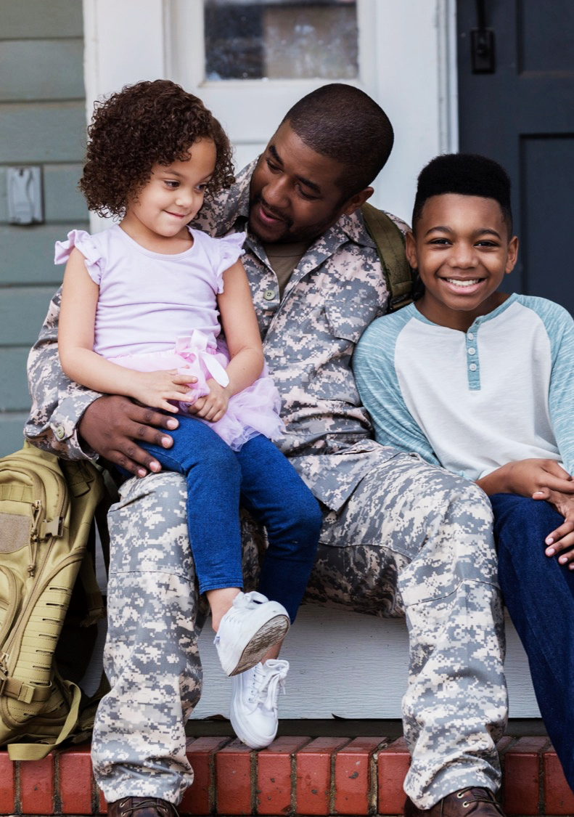
Easterseals Services for
Military & Veterans
The needs of veterans and military families are evolving, not disappearing. We work to make solutions easily accessible in local communities.
Easterseals specializes in identifying the needs of veterans and military families, particularly with employment, job training, behavioral health programs, and support for military families including respite and childcare.
Notes:
Our mission is to ensure that it's possible for veterans and military families to live their lives to the fullest in every community. We work to break down barriers, engage organizations and communities, and connect veterans and military families with what they need for meaningful employment, education and overall wellness. Our grassroots outreach – through 72 local affiliates in communities nationwide– provide unmatched, accessible, and indispensable resources and support for veterans and military families.
Easterseals Military and Veterans Services include:
Advocacy & Education
Employment Programs and Job Training
Military and Veterans Caregiver Services
Veteran Community Services & Support
Health and Wellness Programs

Slide 34
Thank You

