Slide 1
PSA Series Rollout, Messaging & Marketing Plan
March 16, 2022
OUR APPROACH:

Slide 2
Tell Easterseals’ Story...
Authentically through the eyes of the disability community, whether by the families and individuals served or the influencers, actors, and ambassadors who champion Easterseals and its commitment to full equity, access and inclusion for people with disabilities, families, and communities nationwide. We'll team with them to bring the testimonial-type PSAs and additional videos/photos to life through earned media strategies to increase awareness of our work and our impact for heightened engagement with national and local funders, donors, strategic partners, legislators, media, the disability community, and other influencers.

Slide 3
Brand PSA
"That's My Easterseals"
Featuring Nicole Evans, an actor, filmmaker and passionate disability inclusion champion who can genuinely speak to Easterseals’ impact in her own life, what the organization means to her as well as to others who've benefited from Easterseals’ work. The spot showcases the organization's ethos - it's why - bringing to life its important purpose. We filmed Nicole at Easterseals Southern California's Irvine headquarters, taking advantage of its many beautifully branded and visually interesting, mission-forward backdrops. Easterseals’ b-roll was used to bring to life our purpose and focused areas of service delivered in communities nationwide.

Slide 4
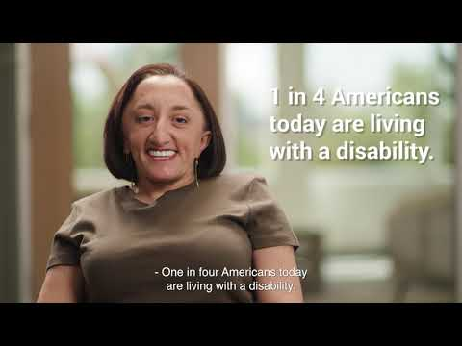
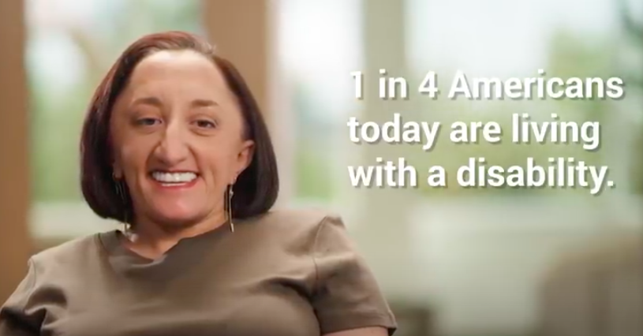
That’s My
Easterseals
PSAs

Slide 5
Service-Focused PSAs
Carried through the concept and series approach of "That's My Easterseals" in each of Easterseals’ four service-focused pillars to express detail on the "how and WOW" of the organization's critical work. Involved additional disability influencers to share first-person testimonials which highlight our commitment to Enriching Education, Enhancing Health, Expanding Employment and Elevating Community.

Slide 6
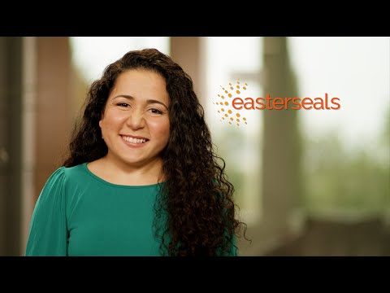
That’s My Easterseals PSAs:
Enriching Education

Slide 7
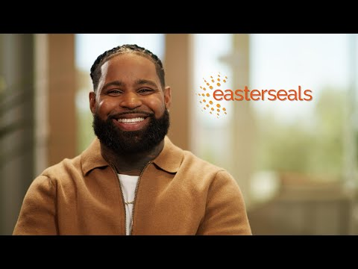
That’s My Easterseals PSAs:
Enhancing Health

Slide 8
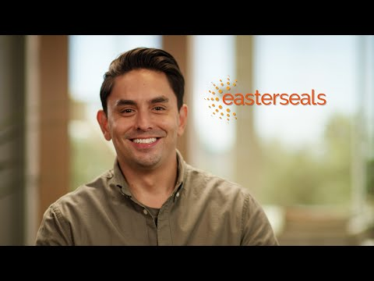
That’s My Easterseals PSAs:
Expanding Employment

Slide 9
That’s My Easterseals PSAs:
Elevating Community

Slide 10
Marketing Plan
Focus PSA roll-out and communications activities to showcase the campaign, engage talent and Affiliates, secure placements, garner greater attention, awareness and media coverage.

Slide 11
Talent
Social & Digital
Thought Leadership
Broadcast, Radio & Digital
PR & MEDIA
DEI&A
& All In for Disability Inclusion
"That's My Easterseals" Primary Distribution Efforts & Focus
Affiliates

Slide 12
Talent Engagement
Deepen Talent’s Relationships with Easterseals, Elevate Awareness of Support and and Value the Organization Provides, Tap Into Their Personal Networks and Reach with Compelling Messages/Content, and Celebrate Personal Successes.
Social Media
Blogs/Articles
Open Letter
PERSONALIZED KITS
ONE-ON-ONES WITH TALENT
TIE TO MEDIA OUTREACH
Develop personalized social tool kits for all talent
Include key dates for promotions, hashtags, images, easy links to all PSAs/theirs, suggested post scripts and behind the scene photos, links to Easterseals national website
Map roll-out of their PSA launch to encourage their sharing
Craft Q&A blogs to run on Easterseals channels, one for each of all talent and crew
Produce a Zoom event with talent where they speak to why they got involved in the PSAs, their personal ties to issue areas
Align drop of the articles to when each PSA goes live
Craft "open letter" from PSA cast and crew to encourage inclusion of people with disabilities; synch to "All In" and showcase that 70% of the production team included people with disabilities; make ask of our leaders, companies, government to think differently; show what's possible
Pitch as an OpEd to increase awareness of Easterseals’ commitment to full equity, inclusion, and access for people with disabilities, families and communities.; secure placement and support of talent/crew

Slide 13
PR & Media
Pitch/Angle - Celebrate Easterseals New PSAs and Campaign Created by Majority Cast and Crew with Disabilities; a First of its Kind; Proof of Inclusion and Encourages Communities to Take this Lead and Think Differently about Equity, Inclusion & Access; Offer Up Talent as Easterseals’ Spokespeople.
Press Release
Outreach & Targets/Priority Media
Open Letter
LAUNCH
PRIORITY MEDIA
OPED PLACEMENT
Finalize press release
Craft pitch variations
Build media list
Secure talent for media, if available/interested
Distribute via PRNewswire and Cision, Wednesday, March 23
Offer template version of release for Affiliate localization
Provide sample pitch for Affiliates to use with local media
Entertainment Industry - studios, networks, top-down approach (aka NBCUniversal, Disney, Hulu, DE&I leaders, etc.)
Major news networks & programs, emphasis on morning shows and afternoon talk shows, general interest
Entertainment media (Access, Extra, Variety, People, PopSugar, Bustle, Ellen, Kelly, etc.)
Disability media & trades, business, nonprofit, women's, advocacy/DC-based, parenting
Key Affiliate markets, including talent's home town DMAs - NY, MO, SCA and NCA
Pitch "Open Letter" as an OpEd for national publication/placement
Focus on New York Times, USA Today, WaPo, Forbes, Politico, Variety, Parade and LA Times
Follow up with individualized OpEds based on issue area (Employment OpEd for Sept/October, Back to School for August, ADA and community for July, Health as ties to policy efforts, etc ) and to integrate into year-round opps

Slide 14
Broadcast, Radio & Digital
Easterseals will distribute PSAs nationally to TV and radio stations nationwide to secure at least 101+ million in reach and $3.2M in donated media value, targeting topical message to area services when possible, reporting monthly results and conducting two key waves of outreach in April and October, for 6-month campaigns while maintaining master brand spot year-round. Will also leverage Comcast NBCU partnership in November and December to secure additional placement and media value ($3.1M in 2021).
Broadcast
Radio
Digital
APRIL - SEPT; OCT - MARCH
APRIL 2022 - MARCH 2023
FOCUS ON MOMS & FAMILIES
Sigma encode & monthly reports
Create Electronic PSA Kit™ with campaign background, graphics, embedded video, audio files, live links, scripts, PSA cover letter, 501c3 certificate, etc
April push to 1,900 TV stations (Brand, Education & Community) with a refresh in Oct to 1,900 TV stations (Brand, Employment & Health)
Similar to TV, national push to radio stations of the Brand PSA (first spot)
Reach to 9,100 radio stations in April, with a refresh push in Oct
One :30 video for targeted distribution on top streaming channels through a consumers’ Smart TV or over-the-top (OTT) device such as Roku, Apple TV, Amazon Fire, Xbox, PlayStation, HGTV, Discovery, etc
Runs for two two-month periods with switch up of spot
Total views btwn 900K - 925K for promo period

Slide 15
Thought Leadership, DEI&A/All In
Using PSAs and campaign, further tap into DEI&A space to drive new opportunities for Easterseals; Position Easterseals as the thought leader, consistently showcasing its important POV on a number of issues surrounding education, employment, health and community for all; National Office exploring entries, timing and mapping out opportunities for the year;
Extend All In for Disability Inclusion efforts, building content and awareness of this resource.
Industry Awards
Speaking Engagements
Talent
TARGETS
TARGETS
TARGETS
PRWeek Purpose & Brand Film
PRSA & Ragan
Campaign US
AdWeek & AdAge
Webby's
Classy's
Canne
AMA's Nonprofit Marketing
Others, TBD
Education: EdWeek, NEA, US Dept of Ed, etc.
HR: SHRM & HCRI
PR & Marketing (in front of brands)
Nonprofit: Upswell, Independent Sector, Ford Foundation, Disability & Philanthropy, National Health Council
Disability orgs - AUCD, DisabilityIN
Chicago Ideas
Aspen Ideas
Forbes, Fortune, Fast Company, The Atlantic
Grow ES relationships with PSA talent
Continue to showcase their personal successes, offer ES platform to celebrate and elevate their presence and work
Collaborate alongside each for Variety Special Report

Slide 16
Affiliates & Social/Digital
Support Affiliate outreach and use of the PSAs, creating turn-key campaign and templated assets to encourage wide use and further engagement, craft outreach materials to engage local media, donors, staff, families, and boards. Use PSAs as a key tool for helping to socialize Easterseals' new brand language and experience.
BMC/Spokespeople
Social/Digital
Leverage PSAs Locally
LAUNCH
TOOLKITS
PITCHING
March 16 BMC overview & message training
Provide templated materials and guidance for using PSAs locally, beyond media outreach
Create deck about the full campaign to share with stakeholders including legislators, potential funders and strategic partners, board members, staff, families, donors
Social kits with images, suggested posts, emails and other ways to share PSAs
Blank end-slated versions to tailor PSAs to local markets available to Affiliates on brand microsite
Provide templated media materials and recommendations for how to use spots and make introductions to PA and News Directors locally
Support with media contacts, if needed
Templated press release, pitch, OpEd and other digital content

Slide 17
PSA Roll-Out: Phase 1
MARCH
APRIL
MAY, ONGOING
March 16 BMC presentation and delivery of 1st wave of assets (focus on brand, education & community)
All assets for Affiliates on brand microsite by 3/30
Open Letter and OpEd finalized
March 23 national press release & pitching begins
Connect360 launch for education & community, continued brand PSA
Open letter drops on ES.com
Social launch begins, email, blog and website, pitching, continues
April 5 EdWeek event (early childhood)
Comcast Newsmakers segment airs all month (EI + MtFFC)
Continued Roll-out
Thought leadership applications, securing speaking opps
Spokespeople/ambassadors engagement
Prepping 2nd Wave materials, social/media, etc.

Slide 18
Engage Stakeholders Beyond Media
Educate Board and staff leaders on new Easterseals messaging, leveraging the PSA as a timely tool
Encourage Board to connect with people in their circles of influence to consider Easterseals as a disability inclusion resource and potential strategic partner
Reach out to prospects including companies and strategic partners; ask for a “deskside” meeting to share PSAs and how Easterseals can help them achieve their goals

Slide 19
Message House
Easterseals is committed to 100% equity, inclusion and access for people with disabilities, families, and communities, with more than 100 years leading in the way.
Easterseals is there for CHILDREN, ADULTS, SENIORS, CAREGIVERS, VETERANS – and their families.
WHAT
WHO
Disability will touch every single American in some way – nearly 1 in 4 people in the U.S. has a disability.
WHY
Easterseals serves 1.5 million people annually through its national network of Affiliates, delivering essential services and supports to expand local access to education, health, employment, and the community.
HOW
Education
Easterseals is one of the nation’s largest providers of early intervention services, setting the foundation for lifelong success in education and life
Child Development Center Network
is the nation’s largest non-profit provider of inclusive childcare
Make the First Five Count initiative provides free online screening and helps ensure kids meet critical developmental milestones
Health
Easterseals provides comprehensive therapies and health supports for all ages, including
Early intervention and care
Physical, speech, and occupational therapies
Autism services and supports
Nutrition programs
Behavioral health services
In-home care and support
Adult day services
Employment
Easterseals helps people with disabilities secure meaningful employment through skills assessments, training and job placement support.
Community
Easterseals makes it possible for people with disabilities of all ages to live more independently so they can fully participate in their communities through
Transportation services
Independent living options
Camp and recreation programs
Digital/financial literacy programs
Wellness programs
Adult day services
PROOF POINTS
Notes:
C4B

Slide 20
Messaging Already in Action…
Notes:
Pass to Yolanda & Erin

Slide 21
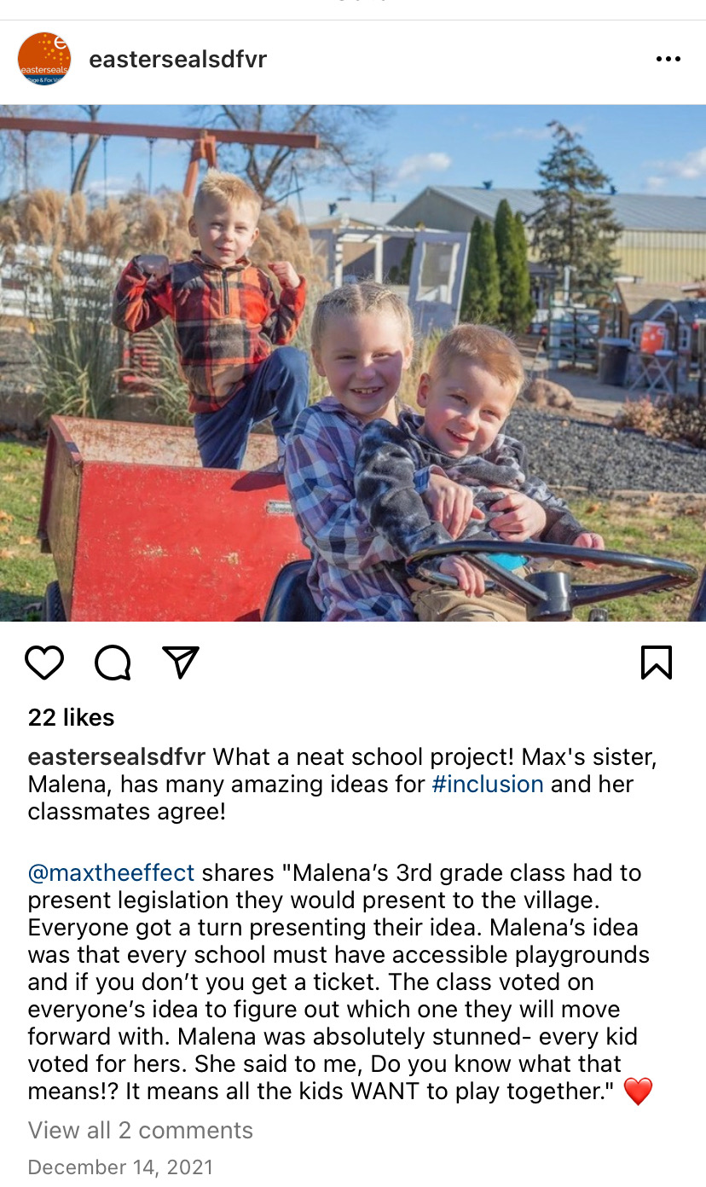

Slide 22
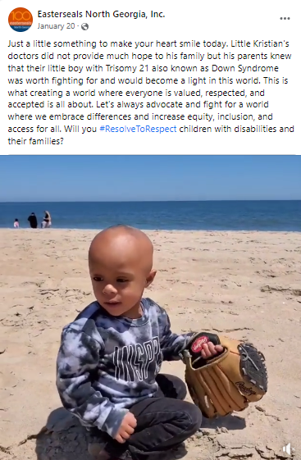
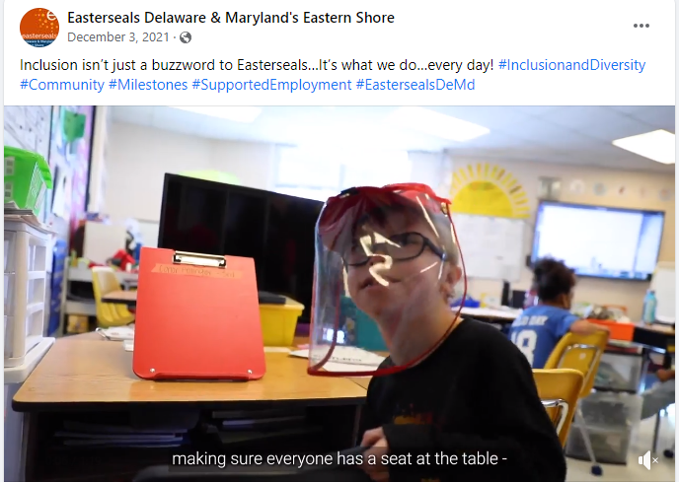

Slide 23
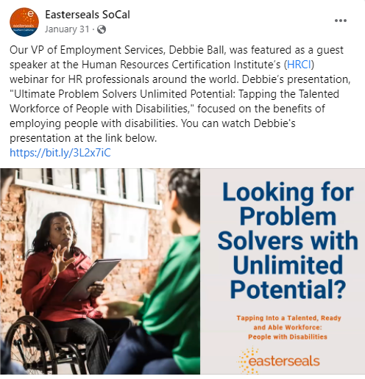
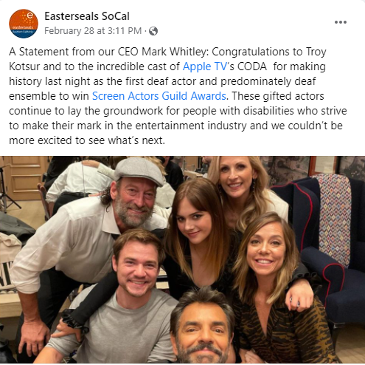
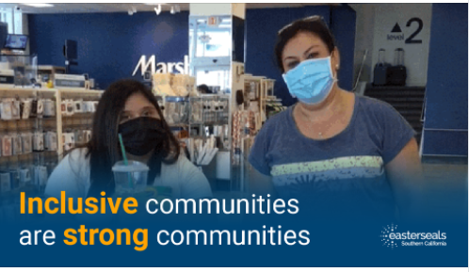
Notes:
Talking points: Making incredible progress in disability inclusion + employment (in an historically tough industry)
Proving disability inclusion and representation makes for good business
Entertainment industry is taking note and implementing real changes
How?
Entertainment has the ability to influence, inspire and shift people’s perceptions to advance social change. Easterseals works across the industry to expand disability representation through a number of meaningful initiatives (EDFC, Media Access, Easterseals in Entertainment, and more) to:
Advance disability representation
Bring tangible employment opportunities to people with disabilities
Increase the volume of stories being shared
Applaud those who are doing the best work
Opportunities abound to bring this same model to myriad companies, other industries, funders… build upon this effective approach.

Slide 24
Thank you to Easterseals Greater Houston CEO Elise Hough and her board for providing the resources needed to produce this PSA series and other creative assets so the entire Easterseals Network can increase awareness of our services, advocacy, and impact nationwide!

Slide 25
Easterseals Q&A
Visit Easterseals Brand Microsite at www.eastersealsbrand.com on April 1st to leverage these creative assets.

