Slide 1


Easterseals Training Series:
Video Content on a Shoestring Budget
November 18, 2021
Notes:
For Discussion Today:
The Landscape of our Network
Highlights of what we’ve been up to lately (Corporate Partnerships, All In: The Plan for Disability Equity; Network Advancement; Thought Leadership; Advocacy)
Lessons from the Past & A Look Ahead (to the Strategic Plan)
PLEASE SIGN UP FOR OUR BI-WEEKLY NEWSLETTERS
Invite a volunteer to serve on our National Board Standing Committees

Slide 2
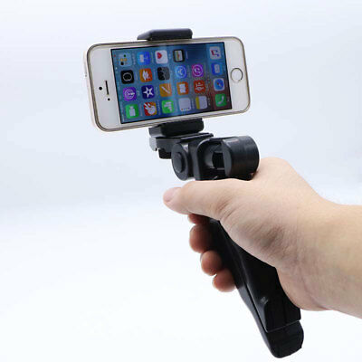
Why Video?
Video marketers earn 66% of their qualified leads through video
93% of businesses gain a new customer as a result of posting a video on social media
Companies that use video achieve a growing revenue of 49% faster compared to non-video users
88% of marketers who use video content are satisfied with their ROI

Slide 3
WE’LL COVER:
PLANNING AND PRE-PRODUCTION
CRAFTING A STORY
SHOOTING: BEST PRACTICES
AUDIO: BEST PRACTICES
HOW TO CONDUCT AN INTERVIEW
EDITING: BEST PRACTICES
EDITING: THE TECHNICAL SIDE
PRACTICE PRACTICE PRACTICE
Notes:
September 25, 2020 Symposium Goals & Participation
The Easterseals Network Public Policy Symposium goals:
Discuss, debate, and agree on top public policy priorities for the next Congress
Discuss, debate, and agree on a recommendation for the Easterseals’ official position on mandatory immunizations
Discuss, debate and agree on a recommendation for the Easterseals’ official position on 14[c]
What We Recommend – Mandatory Immunizations
Easterseals National supports a policy of mandatory, evidence-based immunizations with the affiliate network being given flexibility to establish their own position consistent with state laws.
What We Recommend – Subminimum Wage (14(c))
Easterseals National position should be:
(1) Easterseals National recognizes the contribution 14(c) made;
(2) Easterseals National supports transitioning away from subminimum wage programs with the right infrastructure supports needed to secure a success.

Slide 4
But First – Safety!
Always ask permission
Video can live forever
Integrity
Notes:
September 25, 2020 Symposium Goals & Participation
The Easterseals Network Public Policy Symposium goals:
Discuss, debate, and agree on top public policy priorities for the next Congress
Discuss, debate, and agree on a recommendation for the Easterseals’ official position on mandatory immunizations
Discuss, debate and agree on a recommendation for the Easterseals’ official position on 14[c]
What We Recommend – Mandatory Immunizations
Easterseals National supports a policy of mandatory, evidence-based immunizations with the affiliate network being given flexibility to establish their own position consistent with state laws.
What We Recommend – Subminimum Wage (14(c))
Easterseals National position should be:
(1) Easterseals National recognizes the contribution 14(c) made;
(2) Easterseals National supports transitioning away from subminimum wage programs with the right infrastructure supports needed to secure a success.

Slide 5
                PLANNING AND PRE-PRODUCTION
What kind of video are you creating? A montage? An Interview with b-roll footage on top? A vlog style video where you are talking into the camera with jump cuts?
Figure out what your location is, who will be involved, and make sure you have everyone’s permission.
If you are doing an interview, make sure you are well prepared with well thought-out questions.
Make a shot list to help keep yourself organized and so that you don't forget what you want to shoot.
Make sure you are as prepared as possible so you can have fun.
Notes:
Another tactic we’re employing to get exposure on national television and radio stations is the distribution of our national brand PSA which, as you can see, in one month was picked up by stations throughout the country and helped us reach nearly 12M people with media value of $330K –
All donated airtime in one month to build awareness of Easterseals – which will continue throughout the year..

Slide 6
                CRAFTING A STORY
Story in its simplest forms is something that has a beginning, middle and end.
It is the telling of an event, either true or make believe.
When someone asks you, “How was school today” or “How did you play in the soccer match?” you likely respond with some sort of story.
There is a lot that goes into story structure and this course will cover the basics.
Behind every story is a message and we would like you to think about what it is that you want to say.
What message do you want to convey to the world?
Notes:
Another tactic we’re employing to get exposure on national television and radio stations is the distribution of our national brand PSA which, as you can see, in one month was picked up by stations throughout the country and helped us reach nearly 12M people with media value of $330K –
All donated airtime in one month to build awareness of Easterseals – which will continue throughout the year..

Slide 7
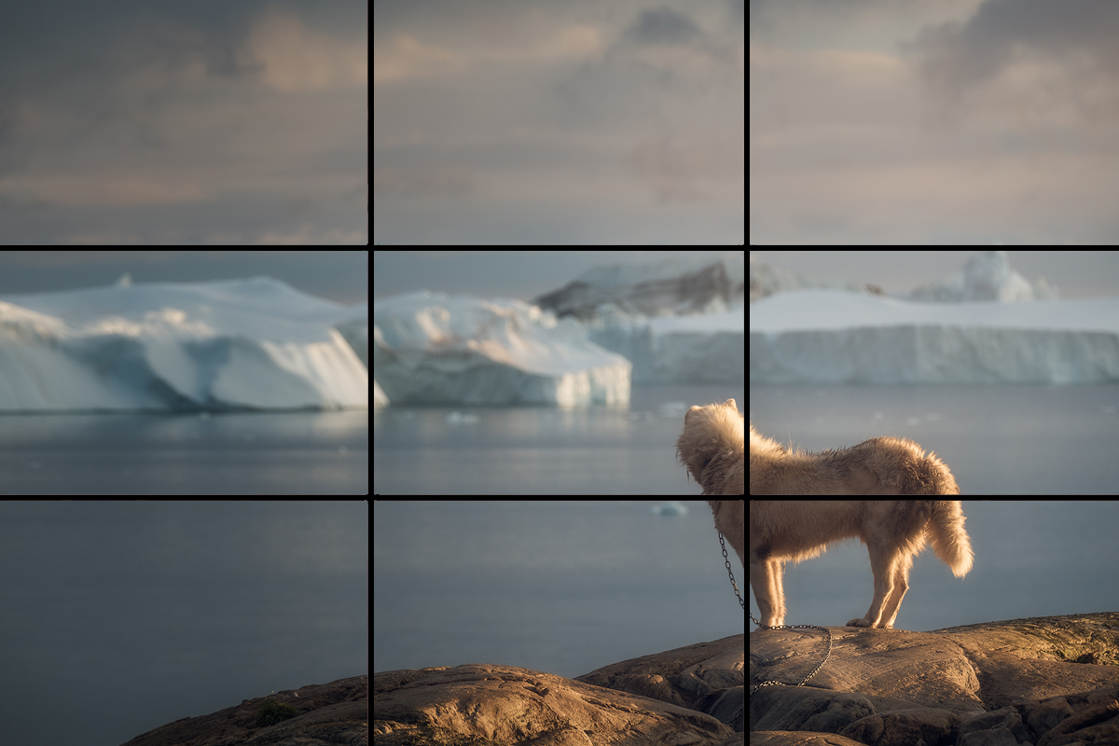
                SHOOTING: BEST PRACTICES
Enable Airplane mode/flight mode when shooting to prevent phone calls and texts from messing up your interview/shot.
Make sure the camera lens is clean and not greasy. If so wipe off the lens with a soft cloth or T-shirt.
Make sure you have enough free space on your phone to shoot the video you are about to create.
Always hold phone in horizontal mode, so that the image is wide screen.
Make sure your finger will not cover the lens or microphone at any point.
Make sure your subject is in focus. Tap on your subject’s face, or the main aspect of what you are shooting if it is not a person, this will make the camera focus on them.
Follow the rule of thirds and place your subject on the open third of the frame.
Notes:
Another tactic we’re employing to get exposure on national television and radio stations is the distribution of our national brand PSA which, as you can see, in one month was picked up by stations throughout the country and helped us reach nearly 12M people with media value of $330K –
All donated airtime in one month to build awareness of Easterseals – which will continue throughout the year..

Slide 8
                SHOOTING: BEST PRACTICES
Tapping the screen where you want your focus to be will also set the brightness levels of the automatic camera on your phone. Depending on the year and model of your phone, you can slide your finger up or down to adjust the brightness of the image.
Always try to have a well-balanced shot, all sun or all shade, not mixed light. Try to make sure the light on your subject is the same intensity as the background, but always prioritize for your subject.
Always test your shot. Take a sample shot to test the visuals as well as the audio.
Try to use a tripod when possible.
If you don't have a tripod, try to hold the camera as stable as possible or rest it on something to prevent shake.
Try to keep the camera at eye level, or slightly pointed down at your subject.
Notes:
Another tactic we’re employing to get exposure on national television and radio stations is the distribution of our national brand PSA which, as you can see, in one month was picked up by stations throughout the country and helped us reach nearly 12M people with media value of $330K –
All donated airtime in one month to build awareness of Easterseals – which will continue throughout the year..

Slide 9
                AUDIO: BEST PRACTICES
For the best audio use a microphone designed for a smartphone, if no microphone is available, you can still follow the next few steps to optimize your audio.
Put your subject as close as possible to the phone (without messing up the shot). If they are too close the visual will be unusable, if they are too far away we won’t be able to hear them, find the middle ground and test the shot and audio to make sure it looks and sounds good.
Try to shoot in a place where there is little to no ambient noise. Meaning avoid shooting near a busy street or in a loud environment. If you hear a loud bang or if a car drives by in the middle of your shoot and you intend on using the audio, make sure to shoot it again. If it was part of an interview, ask them to repeat their answer.
Notes:
Another tactic we’re employing to get exposure on national television and radio stations is the distribution of our national brand PSA which, as you can see, in one month was picked up by stations throughout the country and helped us reach nearly 12M people with media value of $330K –
All donated airtime in one month to build awareness of Easterseals – which will continue throughout the year..

Slide 10
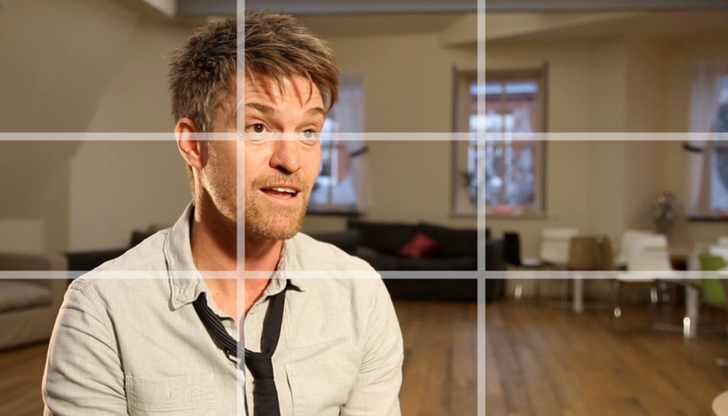
                HOW TO CONDUCT AN INTERVIEW
Follow the rule of thirds and make sure your subject is placed on the open third of your frame.
Subject can speak just to the side of the camera or right into the lens. Sometimes it’s more impactful to look into the lens if you are sending a message, however the eyeline (where the subject is looking) is usually just off the lens.
make sure to prepare for your interview by coming up with a list of well thought-out questions and try to find a location ahead of time.
If you have someone that can help you, have them sit in place of where you would like your subject to look, it often helps to have someone for your subject to connect to, if you are confident in your helping friend, they can even run the interview or the camera.
Notes:
Another tactic we’re employing to get exposure on national television and radio stations is the distribution of our national brand PSA which, as you can see, in one month was picked up by stations throughout the country and helped us reach nearly 12M people with media value of $330K –
All donated airtime in one month to build awareness of Easterseals – which will continue throughout the year..

Slide 11
                EDITING: BEST PRACTICES
Always start with the interview and cut up the selected soundbites to make that support the story you want to tell.
When cutting the clips, try to build a narrative using only the voice of the subject you interviewed. Sometimes, hearing the voice of the interviewer works, but try your best not to use the interviewers voice.
When putting together soundbites from the interview, try to also cut out long pauses and repetitive "ums" or "ahs."
This layer of soundbites is always on the bottom layer of your editing timeline. This is called the “A-Roll”
You might have seen a youtuber style of video where it is just an interview and it has jump cuts. This type of editing is called jump cut editing and it is totally ok for story telling purposes online.
Notes:
Another tactic we’re employing to get exposure on national television and radio stations is the distribution of our national brand PSA which, as you can see, in one month was picked up by stations throughout the country and helped us reach nearly 12M people with media value of $330K –
All donated airtime in one month to build awareness of Easterseals – which will continue throughout the year..

Slide 12
                EDITING: BEST PRACTICES
When creating a jump cut edit, you can cut out all of the parts that don’t need to be in there, all the gaps, um’s ahs and repetitive words, as well as anything that is not perfect.
Jump-cut videos are always best when you are using a tripod because the idea is to keep the framing the exact same, and the only thing that moves is the subject in the frame.
For a jump-cut edit, we recommend having the subject stare into the lens of the camera.
Another type of editing is with just music and footage. It can be from an event, a sports game, a fun day with your family etc. This is called a montage edit. The most important thing to remember when making a montage edit is… Always cut to the beat of the song. Every song has a beat, find the beat, and make sure your song cuts to that beat. That makes the visuals and audio flow together making an enjoyable experience for your audience. This also takes practice.
The last type of video we will learn about in this course is a documentary style video with a strong “A-ROLL” and then “B-ROLL” on top, on the next layer. So in this process we would go out and shoot the things that they talked about in the interview and place those videos on top of the “A-ROLL” layer. This helps the audience really understand your message and you can get a bit more creative when it comes to filmmaking.
Notes:
Another tactic we’re employing to get exposure on national television and radio stations is the distribution of our national brand PSA which, as you can see, in one month was picked up by stations throughout the country and helped us reach nearly 12M people with media value of $330K –
All donated airtime in one month to build awareness of Easterseals – which will continue throughout the year..

Slide 13

                EDITING: THE TECHNICAL SIDE
Shotcut is a free editing software and can be downloaded at www.shotcut.org
Here are the basics:
You always start transferring your footage from your phone to your computer with the necessary cable.
The next step is put all of your video files in a folder on the computer (or a hard drive) your footage into the project.
From there open Shotcut
Import your footage and place it into a folder called “Footage”
No need to use music for your first couple videos but If you want to use a song, import the song you have selected and put it into a folder called “Music”
When picking a song, try to pick something that does not have lyrics because that will compete with the person telling a story or being interviewed. We always prefer to use an instrumental song.
If you do use music, turn down the music so that you can hear the audio of the interview.
Notes:
Another tactic we’re employing to get exposure on national television and radio stations is the distribution of our national brand PSA which, as you can see, in one month was picked up by stations throughout the country and helped us reach nearly 12M people with media value of $330K –
All donated airtime in one month to build awareness of Easterseals – which will continue throughout the year..

Slide 14
                EDITING: THE TECHNICAL SIDE
The first step is always cutting up the interview.
Drop all of the interview video files on the “timeline” on layer one. The timeline is where all the footage goes.
Start to cut all the best soundbites, and delete your questions, long pauses and places where your subject messed up.
Assemble the soundbites into a story, be creative.
If you did a good job in the interview process and followed all of the instructions there, you should have more than enough content.
After you have cut up your interview, you can start to add the different shots you captured of them at their house or playing sports, or whatever you shot that looks nice on top of the interview.
Notes:
Another tactic we’re employing to get exposure on national television and radio stations is the distribution of our national brand PSA which, as you can see, in one month was picked up by stations throughout the country and helped us reach nearly 12M people with media value of $330K –
All donated airtime in one month to build awareness of Easterseals – which will continue throughout the year..

Slide 15
                EDITING: THE TECHNICAL SIDE
In a perfect world you will show what they are speaking about. So if they talk about growing up in a township, you will show township footage. If they are talking about their love for football, you will show a clip of them playing football or holding a football and smiling. You can even show a shot of a football rolling on the ground. Let your creativity come to the surface and really express the ideas you have in your head.
After you have created a story from your interview and added some footage on top, you can now add some soft music, you can add some opening titles, or some closing credits. You can also just export or encode your video meaning make it an actual movie file you can post online or send to friends and family.
The tutorial below will explain how to do that in detail but always make sure you have selected your in and out points, where the movie will start and where it will end.
There are different settings that work better for different platforms, so depending on where you are going to share it, do a little research and see if there is some best practices you can follow for that particular platform.
Practice and do research!
If you ever have a question type it into google and put the word “tutorial” at the end and the chances are that someone has created a video answering your question.
Be savvy, always learn, and don't be afraid to make mistakes. We learn the most when we make mistakes.
Notes:
Another tactic we’re employing to get exposure on national television and radio stations is the distribution of our national brand PSA which, as you can see, in one month was picked up by stations throughout the country and helped us reach nearly 12M people with media value of $330K –
All donated airtime in one month to build awareness of Easterseals – which will continue throughout the year..

Slide 16
                PRACTICE PRACTICE PRACTICE
Always remember that our mistakes will teach us more than our successes ever will.
And, please keep in mind that rules are made to be broken.
Practice, practice, practice, experiment, explore and discover your own unique voice through the very fun art form of filmmaking on your smartphone!
Notes:
Another tactic we’re employing to get exposure on national television and radio stations is the distribution of our national brand PSA which, as you can see, in one month was picked up by stations throughout the country and helped us reach nearly 12M people with media value of $330K –
All donated airtime in one month to build awareness of Easterseals – which will continue throughout the year..

Slide 17
Thank You!

