Slide 1

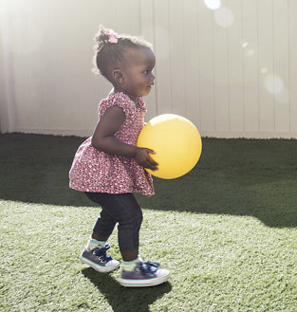
Easterseals Training Series:
Twitter and LinkedIn Basics
October 28, 2021
Notes:
For Discussion Today:
The Landscape of our Network
Highlights of what we’ve been up to lately (Corporate Partnerships, All In: The Plan for Disability Equity; Network Advancement; Thought Leadership; Advocacy)
Lessons from the Past & A Look Ahead (to the Strategic Plan)
PLEASE SIGN UP FOR OUR BI-WEEKLY NEWSLETTERS
Invite a volunteer to serve on our National Board Standing Committees

Slide 2
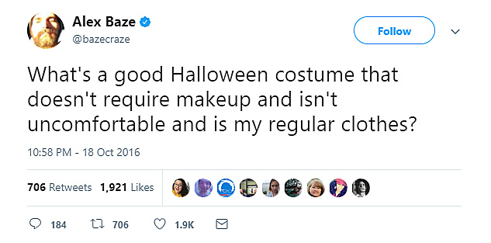
Notes:
September 25, 2020 Symposium Goals & Participation
The Easterseals Network Public Policy Symposium goals:
Discuss, debate, and agree on top public policy priorities for the next Congress
Discuss, debate, and agree on a recommendation for the Easterseals’ official position on mandatory immunizations
Discuss, debate and agree on a recommendation for the Easterseals’ official position on 14[c]
What We Recommend – Mandatory Immunizations
Easterseals National supports a policy of mandatory, evidence-based immunizations with the affiliate network being given flexibility to establish their own position consistent with state laws.
What We Recommend – Subminimum Wage (14(c))
Easterseals National position should be:
(1) Easterseals National recognizes the contribution 14(c) made;
(2) Easterseals National supports transitioning away from subminimum wage programs with the right infrastructure supports needed to secure a success.

Slide 3
Twitter: Getting Set Up
Notes:
September 25, 2020 Symposium Goals & Participation
The Easterseals Network Public Policy Symposium goals:
Discuss, debate, and agree on top public policy priorities for the next Congress
Discuss, debate, and agree on a recommendation for the Easterseals’ official position on mandatory immunizations
Discuss, debate and agree on a recommendation for the Easterseals’ official position on 14[c]
What We Recommend – Mandatory Immunizations
Easterseals National supports a policy of mandatory, evidence-based immunizations with the affiliate network being given flexibility to establish their own position consistent with state laws.
What We Recommend – Subminimum Wage (14(c))
Easterseals National position should be:
(1) Easterseals National recognizes the contribution 14(c) made;
(2) Easterseals National supports transitioning away from subminimum wage programs with the right infrastructure supports needed to secure a success.

Slide 4
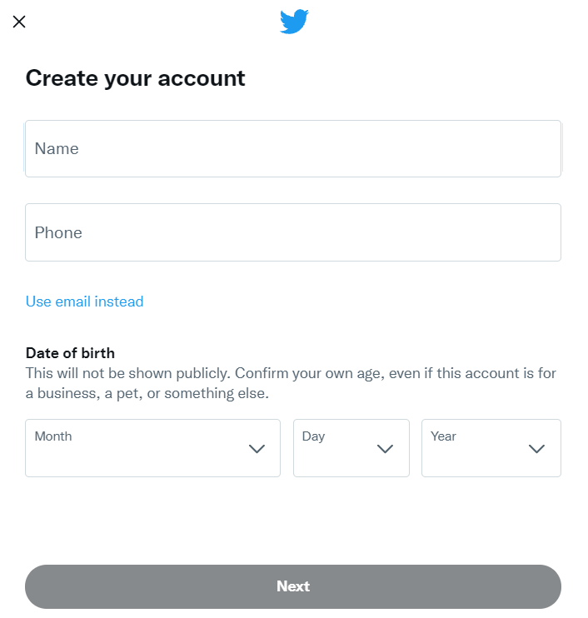
Facebook: Creating an Account
Go to twitter.com/signup.
Click the sign up button.
A Create your account pop up box will appear, and you’ll be guided through our sign up experience. You’ll be prompted to enter information such as your name and phone number or email address. You will be asked to verify these.
After entering your information, click Next.
In the Customize your experience pop up box, check whether you’d like to track where you see Twitter content across the web and click Next.
Customize your account.
Notes:
Another tactic we’re employing to get exposure on national television and radio stations is the distribution of our national brand PSA which, as you can see, in one month was picked up by stations throughout the country and helped us reach nearly 12M people with media value of $330K –
All donated airtime in one month to build awareness of Easterseals – which will continue throughout the year..

Slide 5
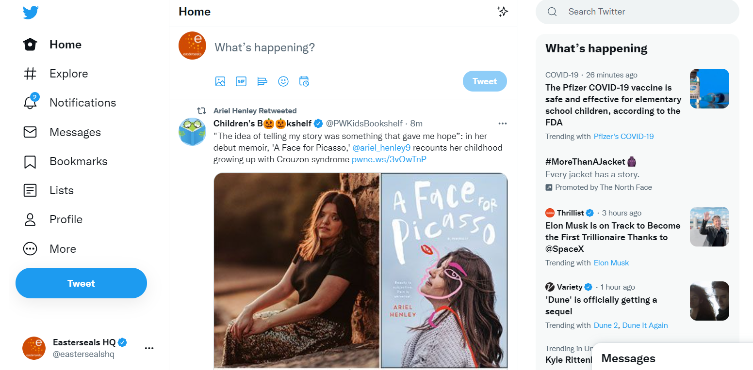
Facebook: Overview
Common Pages
Post Something
Trends
News Feed
Utility/Settings
Notes:
Another tactic we’re employing to get exposure on national television and radio stations is the distribution of our national brand PSA which, as you can see, in one month was picked up by stations throughout the country and helped us reach nearly 12M people with media value of $330K –
All donated airtime in one month to build awareness of Easterseals – which will continue throughout the year..

Slide 6
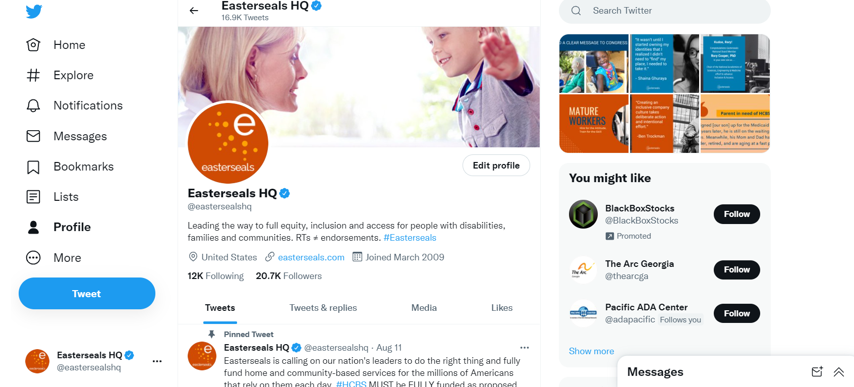
Facebook: Overview
Common Pages
Name
Handle
Profile Info
Suggestions
Post Something
YOUR content
Notes:
Another tactic we’re employing to get exposure on national television and radio stations is the distribution of our national brand PSA which, as you can see, in one month was picked up by stations throughout the country and helped us reach nearly 12M people with media value of $330K –
All donated airtime in one month to build awareness of Easterseals – which will continue throughout the year..

Slide 7
Twitter: Posting and Content
Notes:
September 25, 2020 Symposium Goals & Participation
The Easterseals Network Public Policy Symposium goals:
Discuss, debate, and agree on top public policy priorities for the next Congress
Discuss, debate, and agree on a recommendation for the Easterseals’ official position on mandatory immunizations
Discuss, debate and agree on a recommendation for the Easterseals’ official position on 14[c]
What We Recommend – Mandatory Immunizations
Easterseals National supports a policy of mandatory, evidence-based immunizations with the affiliate network being given flexibility to establish their own position consistent with state laws.
What We Recommend – Subminimum Wage (14(c))
Easterseals National position should be:
(1) Easterseals National recognizes the contribution 14(c) made;
(2) Easterseals National supports transitioning away from subminimum wage programs with the right infrastructure supports needed to secure a success.

Slide 8
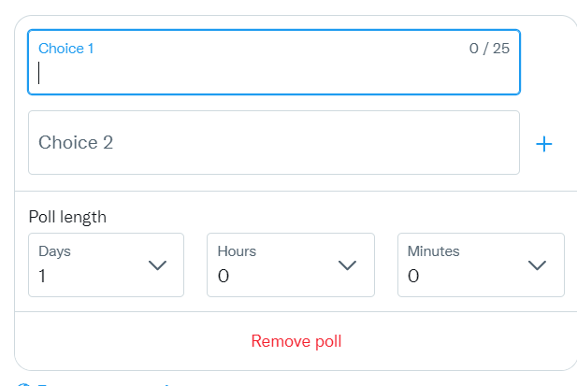
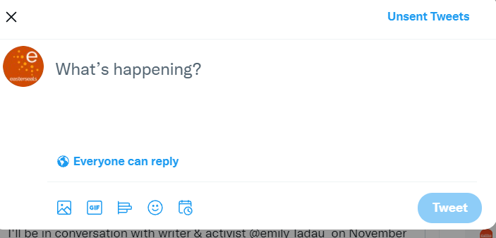
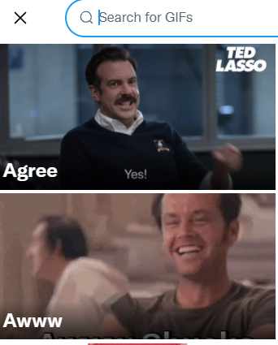
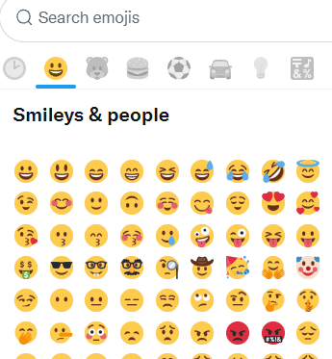
Twitter: How to Post
Options:
Photo/Video (short)
Gifts
Emojis
Polls
Scheduling
Who Can Reply?
Notes:
Another tactic we’re employing to get exposure on national television and radio stations is the distribution of our national brand PSA which, as you can see, in one month was picked up by stations throughout the country and helped us reach nearly 12M people with media value of $330K –
All donated airtime in one month to build awareness of Easterseals – which will continue throughout the year..

Slide 9
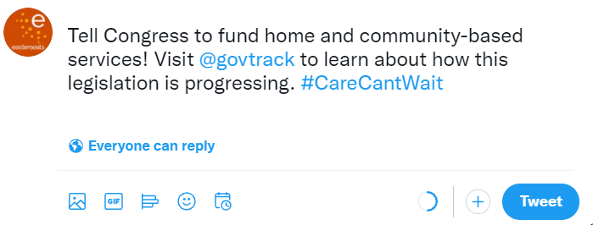
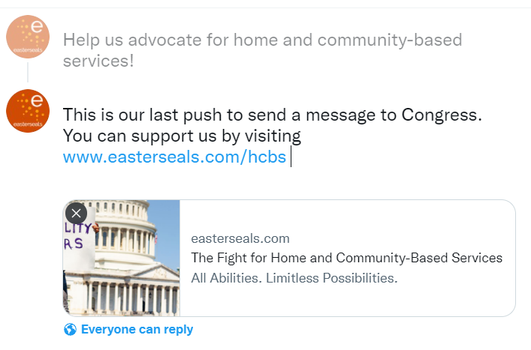
Twitter: How to Post
Elements:
Character Limit
Multiple Posts
Handles
Hashtags
Twitter Cards
Notes:
Another tactic we’re employing to get exposure on national television and radio stations is the distribution of our national brand PSA which, as you can see, in one month was picked up by stations throughout the country and helped us reach nearly 12M people with media value of $330K –
All donated airtime in one month to build awareness of Easterseals – which will continue throughout the year..

Slide 10
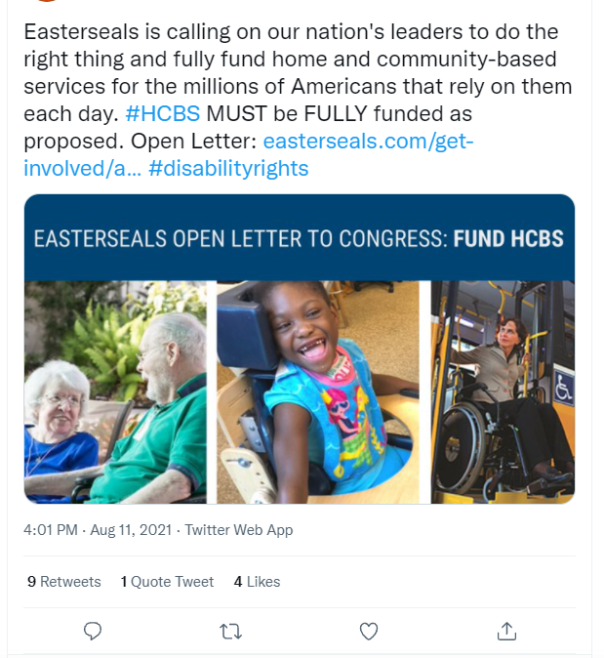
Twitter: Ways to Interact
Replying (speech bubble)
Retweeting / Quote tweet (arrows)
Like (heart)
Share (send a direct message with the tweet, copy a direct link to the tweet to send elsewhere, bookmark, or share in another app or platform)
Notes:
Another tactic we’re employing to get exposure on national television and radio stations is the distribution of our national brand PSA which, as you can see, in one month was picked up by stations throughout the country and helped us reach nearly 12M people with media value of $330K –
All donated airtime in one month to build awareness of Easterseals – which will continue throughout the year..

Slide 11

Twitter Content
Twitter Do’s:
Post helpful thoughts, tips and advice
Talk about important happenings
Find community
Engage with people
Look up hashtags (be aware of acronyms)
Use hashtags (but not too many)
Share/retweet content you like
Check your posts before you hit ‘tweet’!
Stay active
Twitter Don’ts:
Personal information
Aggressive/offensive content
Insulting others
Spam accounts or hashtags
Use hashtags that are unrelated to what you’re posting
Copy and pasting someone else’s content without giving credit
Flooding a tweet with tags
Notes:
Another tactic we’re employing to get exposure on national television and radio stations is the distribution of our national brand PSA which, as you can see, in one month was picked up by stations throughout the country and helped us reach nearly 12M people with media value of $330K –
All donated airtime in one month to build awareness of Easterseals – which will continue throughout the year..

Slide 12
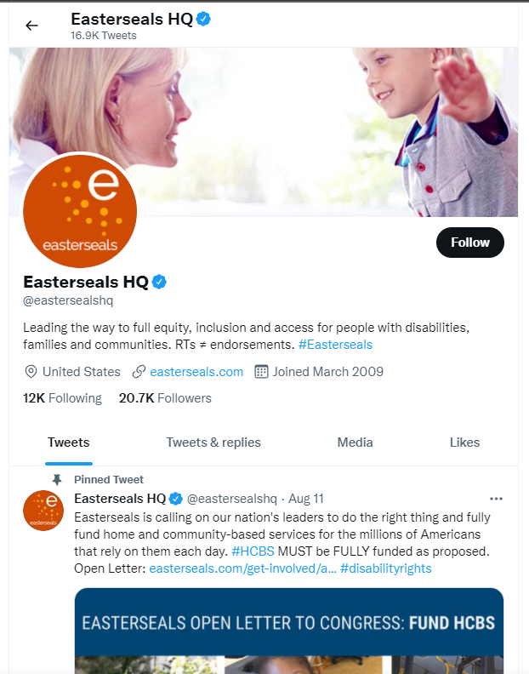
Easterseals on Twitter
Follow
  twitter.com/eastersealshq
  Look for your local affiliate page: https://www.easterseals.com/connect-locally/
Like and retweet
Reply
Use #Easterseals
Mention Easterseals in conversations around education, health, and employment for people with disabilities, families and communities.
Notes:
Another tactic we’re employing to get exposure on national television and radio stations is the distribution of our national brand PSA which, as you can see, in one month was picked up by stations throughout the country and helped us reach nearly 12M people with media value of $330K –
All donated airtime in one month to build awareness of Easterseals – which will continue throughout the year..

Slide 13




Easterseals on Twitter
Notes:
Another tactic we’re employing to get exposure on national television and radio stations is the distribution of our national brand PSA which, as you can see, in one month was picked up by stations throughout the country and helped us reach nearly 12M people with media value of $330K –
All donated airtime in one month to build awareness of Easterseals – which will continue throughout the year..

Slide 14

Twitter Resources
Definitions
Twitter (noun): The platform (also known as ‘the bird app’)
(a) Tweet (noun): A post on the platform (‘tweets’ plural)
(to) Tweet (verb): The act of posting something on the platform
Blue tick: Verified account
Mutuals: Two people that follow each other
Twittering: Not a word that is used.
Following and Retweeting Etiquette
Unspoken Twitter Rules
Notes:
Another tactic we’re employing to get exposure on national television and radio stations is the distribution of our national brand PSA which, as you can see, in one month was picked up by stations throughout the country and helped us reach nearly 12M people with media value of $330K –
All donated airtime in one month to build awareness of Easterseals – which will continue throughout the year..

Slide 15
LinkedIn: Getting Set Up
Notes:
September 25, 2020 Symposium Goals & Participation
The Easterseals Network Public Policy Symposium goals:
Discuss, debate, and agree on top public policy priorities for the next Congress
Discuss, debate, and agree on a recommendation for the Easterseals’ official position on mandatory immunizations
Discuss, debate and agree on a recommendation for the Easterseals’ official position on 14[c]
What We Recommend – Mandatory Immunizations
Easterseals National supports a policy of mandatory, evidence-based immunizations with the affiliate network being given flexibility to establish their own position consistent with state laws.
What We Recommend – Subminimum Wage (14(c))
Easterseals National position should be:
(1) Easterseals National recognizes the contribution 14(c) made;
(2) Easterseals National supports transitioning away from subminimum wage programs with the right infrastructure supports needed to secure a success.

Slide 16
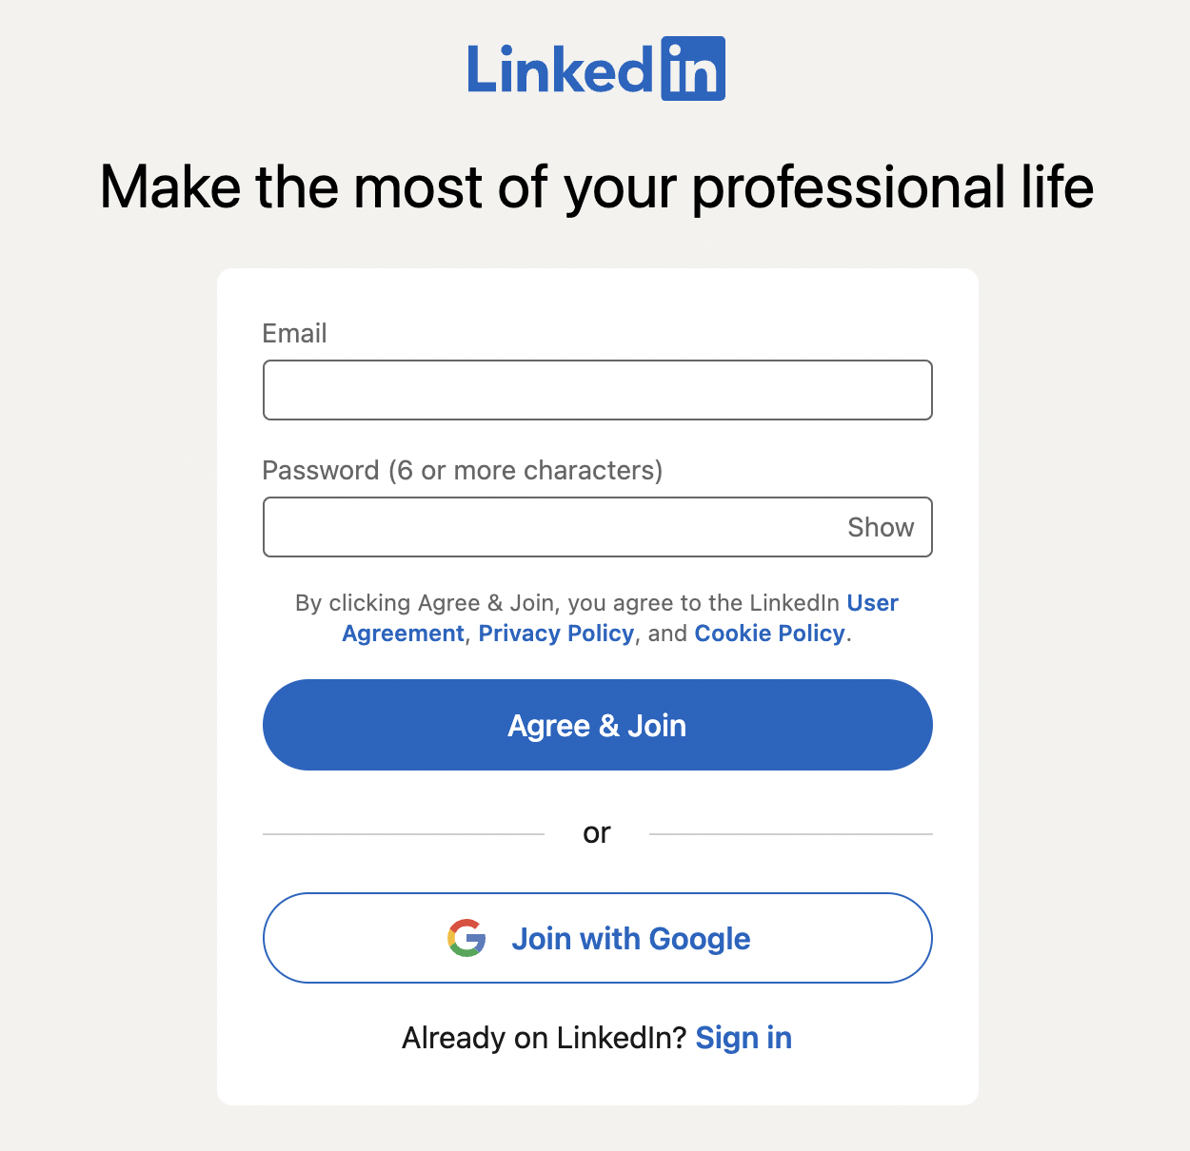
LinkedIn: Creating an Account
Go to linkedin.com.
Click the sign up button.
A Create your account pop up box will appear, and you’ll be guided through the sign up experience. You’ll be prompted to enter information such as your name and phone number or email address. You will be asked to verify these.
After entering your information, click Agree & Join.
Customize your account.
Notes:
Another tactic we’re employing to get exposure on national television and radio stations is the distribution of our national brand PSA which, as you can see, in one month was picked up by stations throughout the country and helped us reach nearly 12M people with media value of $330K –
All donated airtime in one month to build awareness of Easterseals – which will continue throughout the year..

Slide 17
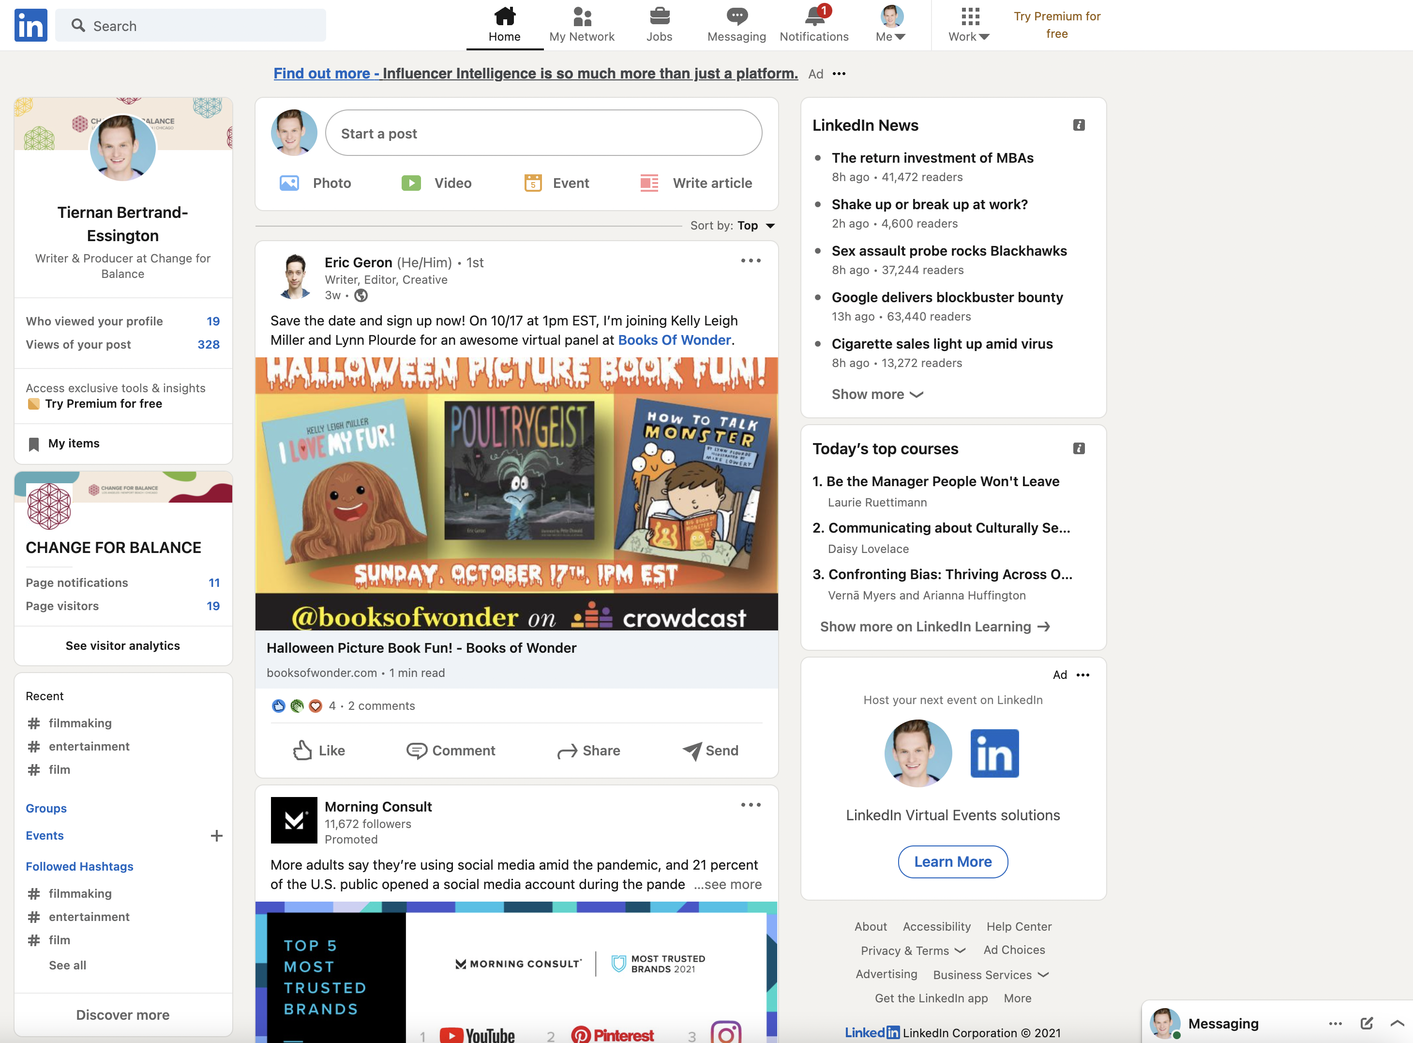
LinkedIn: Overview
Utility/Settings
Post Something
Trends
News Feed
Messages
Notes:
Another tactic we’re employing to get exposure on national television and radio stations is the distribution of our national brand PSA which, as you can see, in one month was picked up by stations throughout the country and helped us reach nearly 12M people with media value of $330K –
All donated airtime in one month to build awareness of Easterseals – which will continue throughout the year..

Slide 18
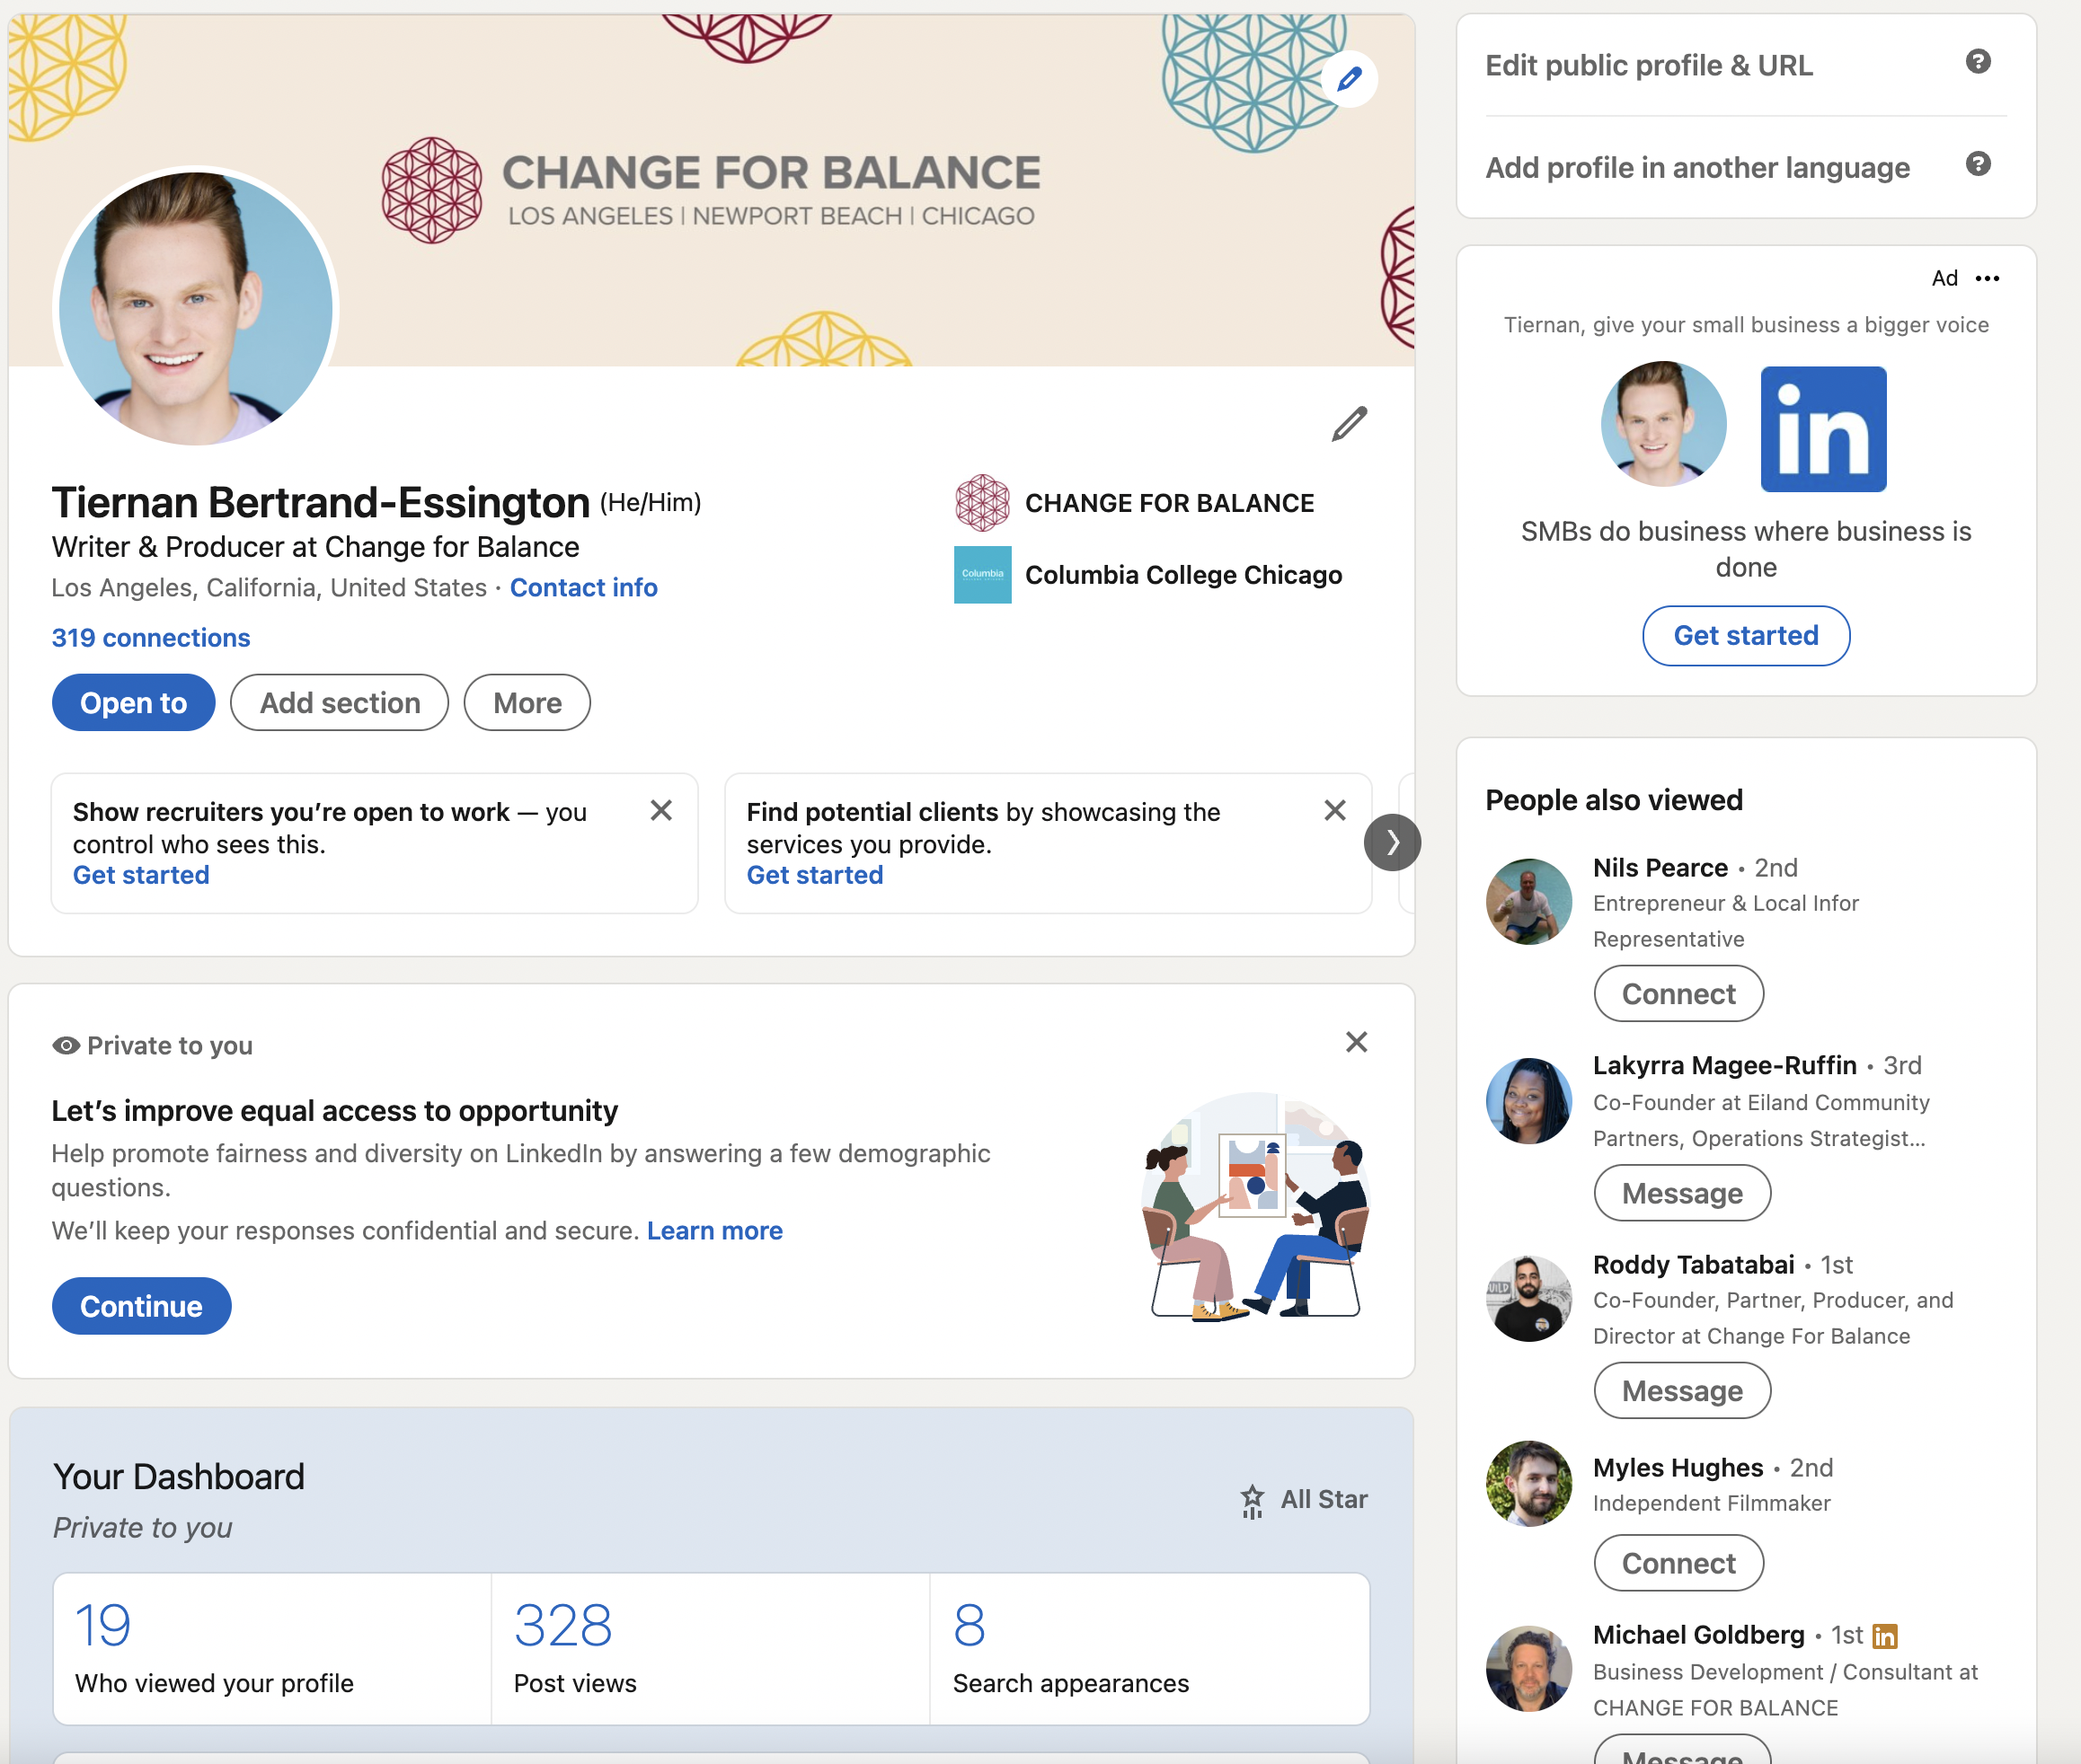
Profile Info
Suggestions
Dashboard
Notes:
Another tactic we’re employing to get exposure on national television and radio stations is the distribution of our national brand PSA which, as you can see, in one month was picked up by stations throughout the country and helped us reach nearly 12M people with media value of $330K –
All donated airtime in one month to build awareness of Easterseals – which will continue throughout the year..

Slide 19
LinkedIn: Posting and Content
Notes:
September 25, 2020 Symposium Goals & Participation
The Easterseals Network Public Policy Symposium goals:
Discuss, debate, and agree on top public policy priorities for the next Congress
Discuss, debate, and agree on a recommendation for the Easterseals’ official position on mandatory immunizations
Discuss, debate and agree on a recommendation for the Easterseals’ official position on 14[c]
What We Recommend – Mandatory Immunizations
Easterseals National supports a policy of mandatory, evidence-based immunizations with the affiliate network being given flexibility to establish their own position consistent with state laws.
What We Recommend – Subminimum Wage (14(c))
Easterseals National position should be:
(1) Easterseals National recognizes the contribution 14(c) made;
(2) Easterseals National supports transitioning away from subminimum wage programs with the right infrastructure supports needed to secure a success.

Slide 20
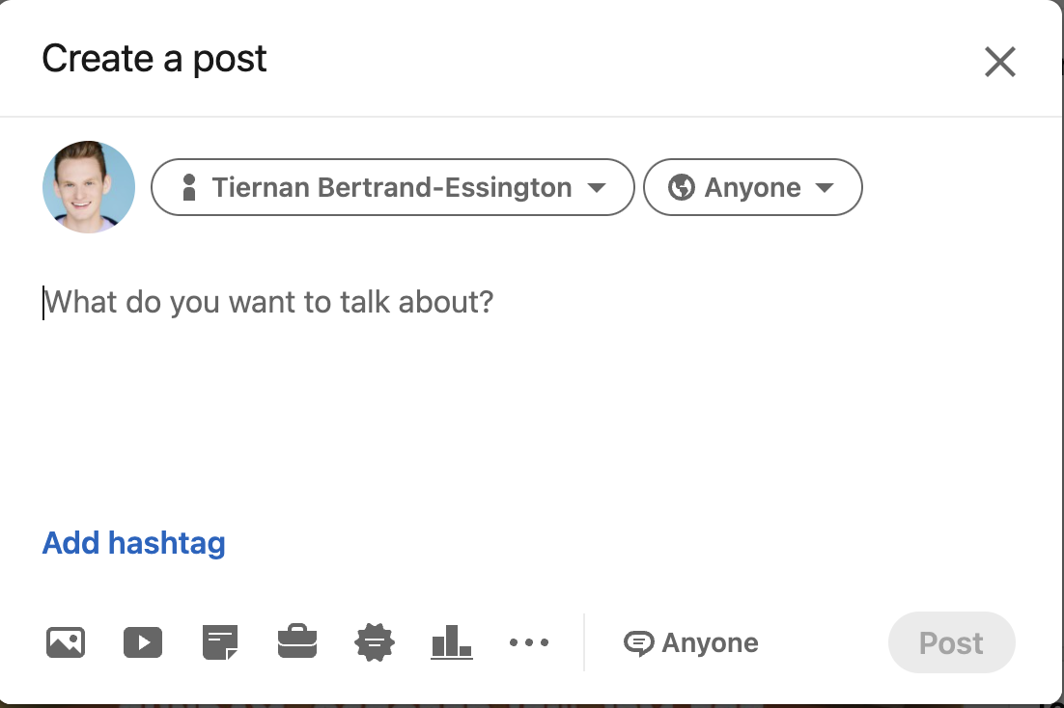
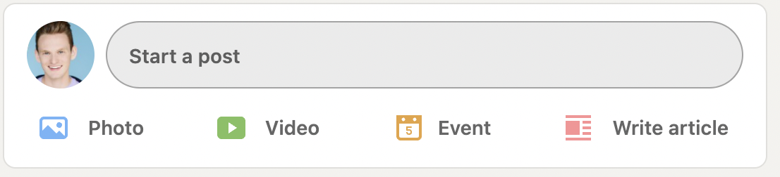
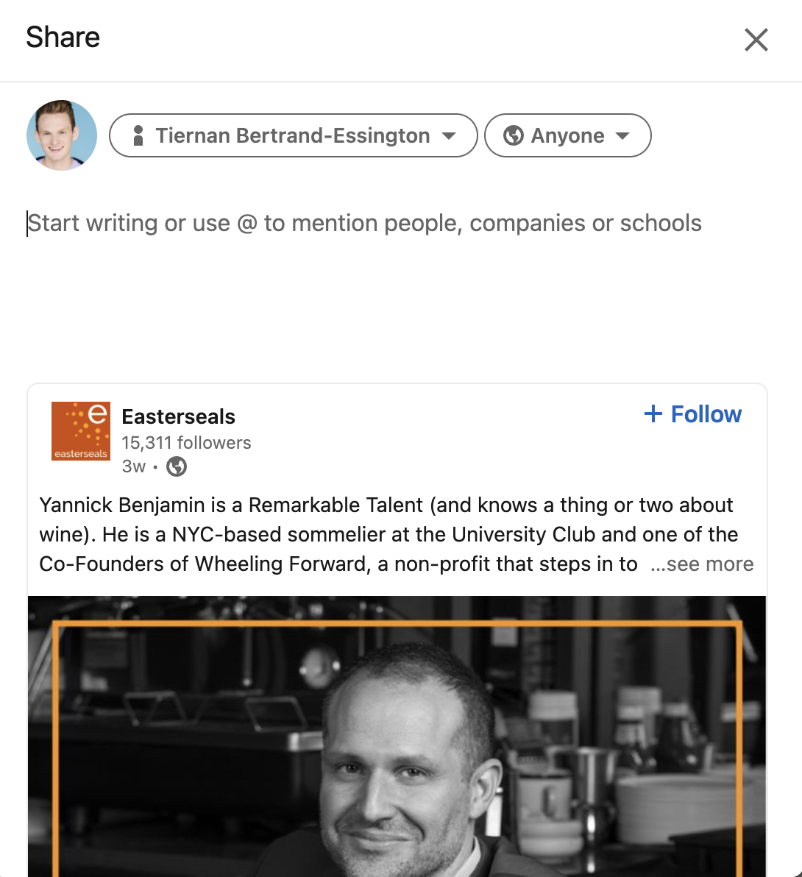
LinkedIn: How to Post
Options:
Text updates
Photo/Video (short)
Articles
Sharing from a business’ page
Notes:
Another tactic we’re employing to get exposure on national television and radio stations is the distribution of our national brand PSA which, as you can see, in one month was picked up by stations throughout the country and helped us reach nearly 12M people with media value of $330K –
All donated airtime in one month to build awareness of Easterseals – which will continue throughout the year..

Slide 21
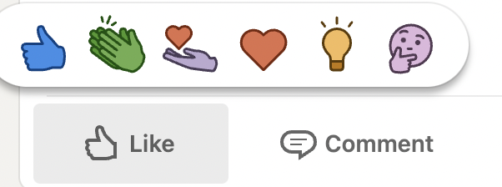
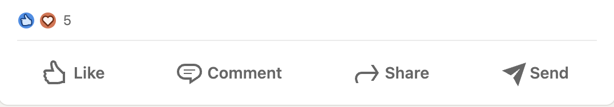
LinkedIn: Ways to Interact
Commenting
React (like, love, celebrate, etc.)
Share
Notes:
Another tactic we’re employing to get exposure on national television and radio stations is the distribution of our national brand PSA which, as you can see, in one month was picked up by stations throughout the country and helped us reach nearly 12M people with media value of $330K –
All donated airtime in one month to build awareness of Easterseals – which will continue throughout the year..

Slide 22
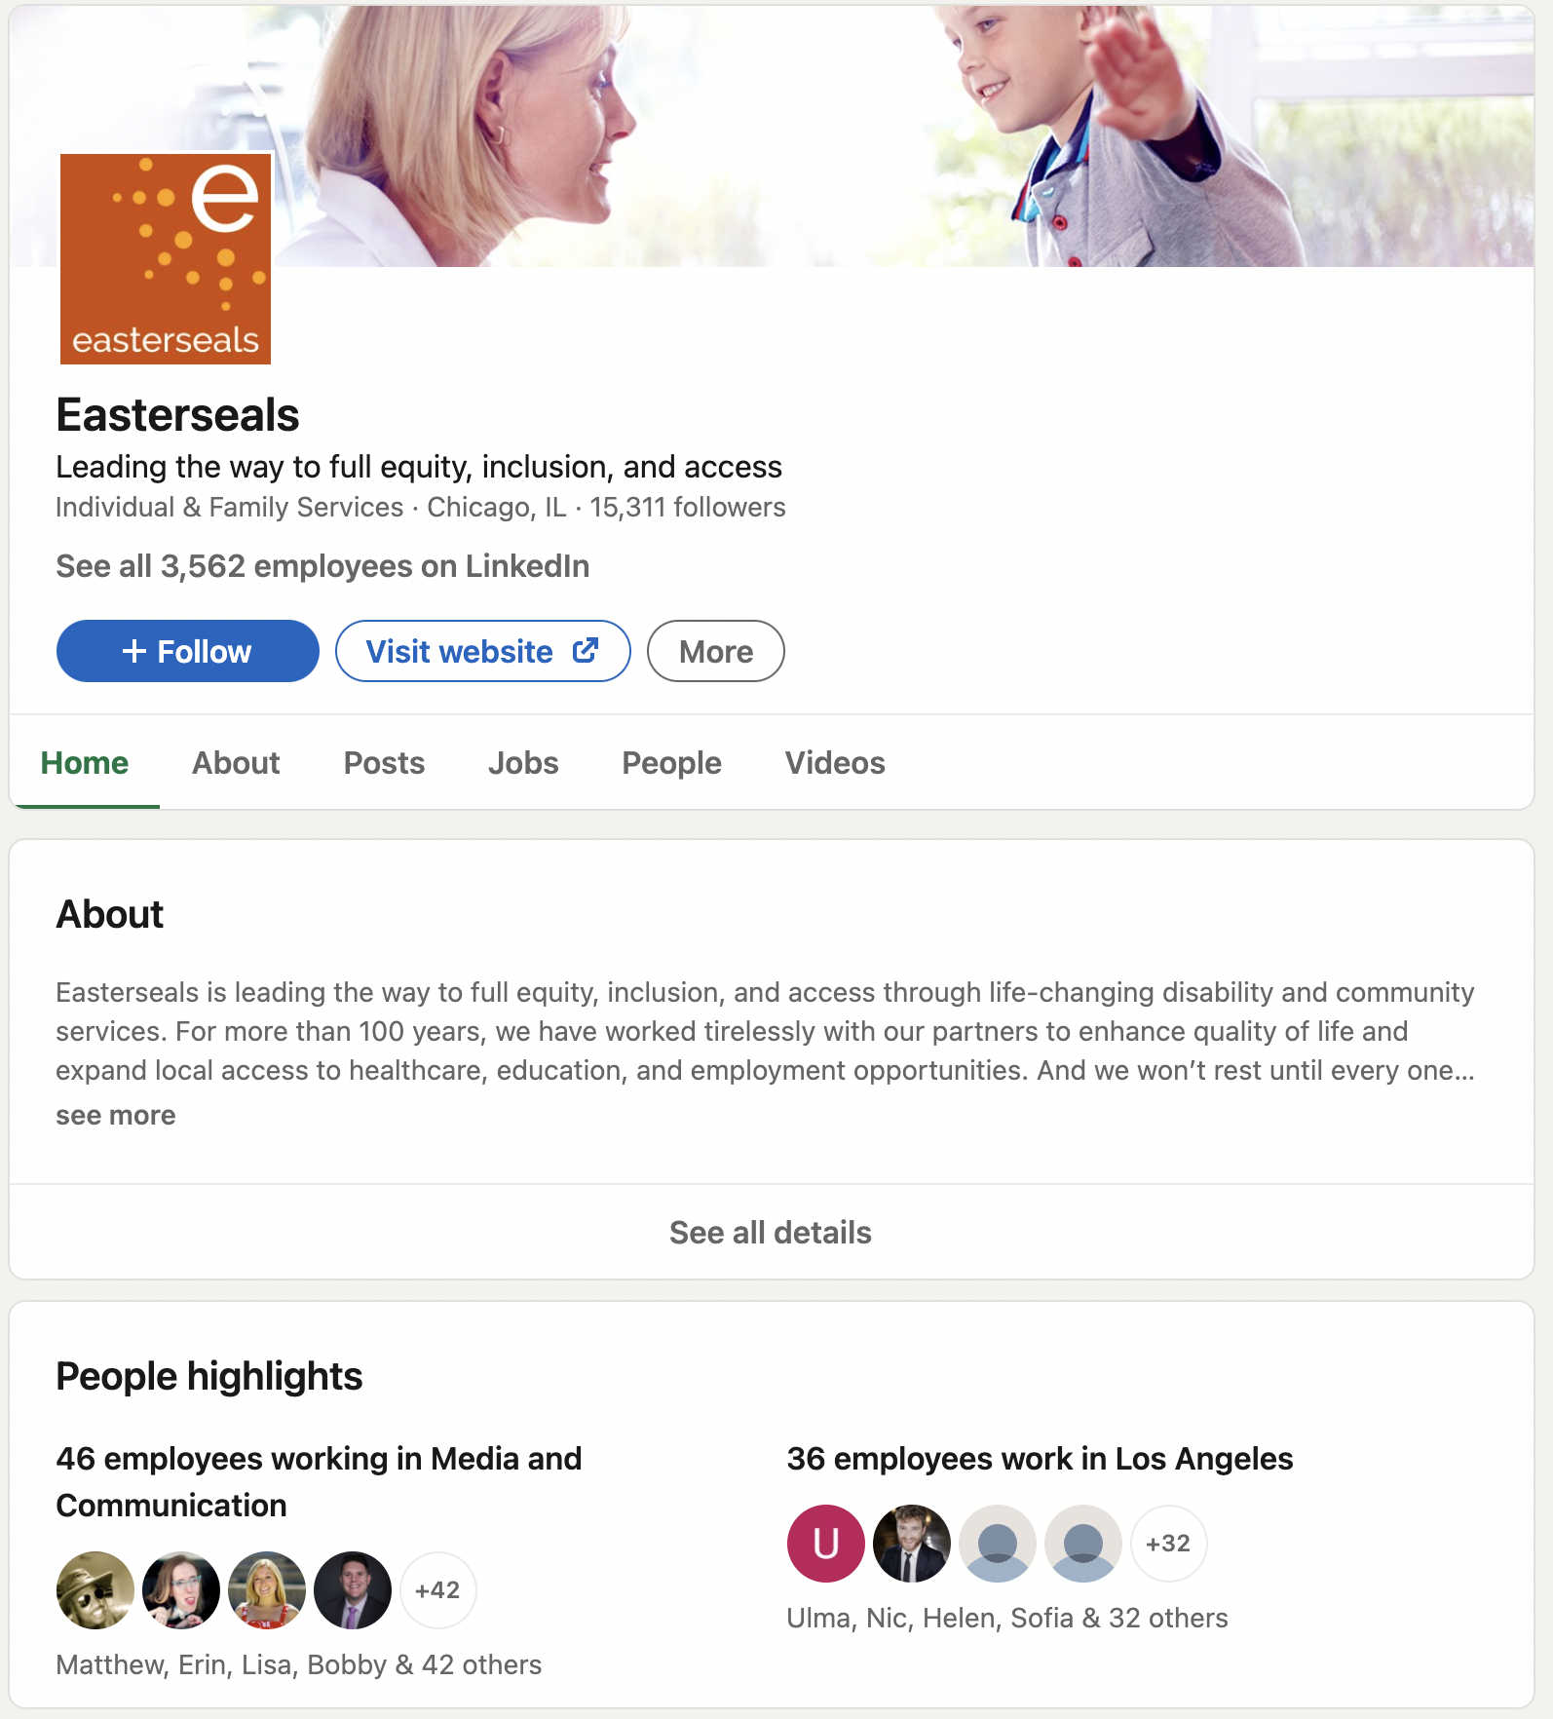
Easterseals on LinkedIn
Follow
  https://www.linkedin.com/company/easterseals/
  Look for your local affiliate page: https://www.easterseals.com/connect-locally/
Like and comment on posts
Share Easterseals’ posts with additional comments
Use #Easterseals
Mention Easterseals in conversations around education, health, and employment for people with disabilities, families and communities.
Notes:
Another tactic we’re employing to get exposure on national television and radio stations is the distribution of our national brand PSA which, as you can see, in one month was picked up by stations throughout the country and helped us reach nearly 12M people with media value of $330K –
All donated airtime in one month to build awareness of Easterseals – which will continue throughout the year..

Slide 23
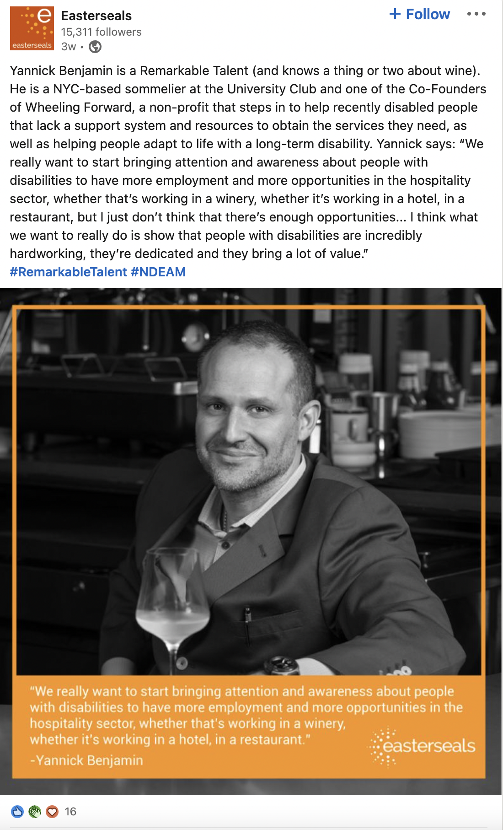
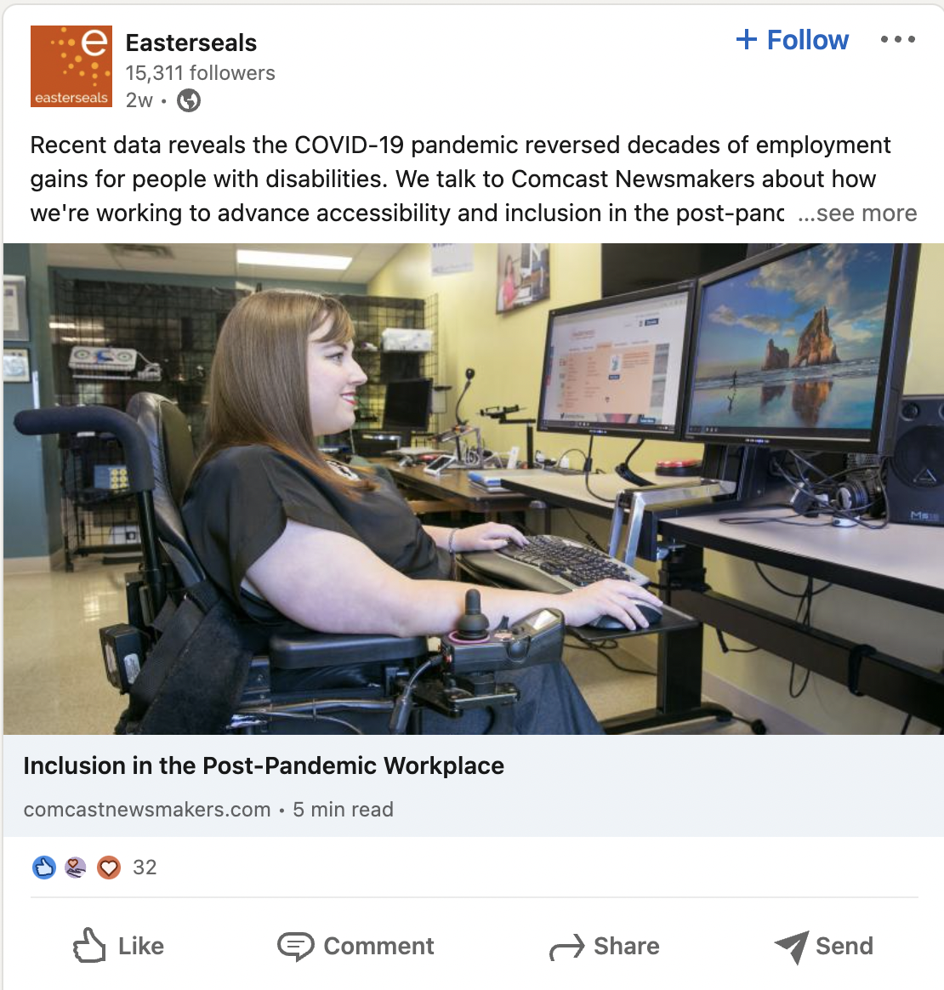
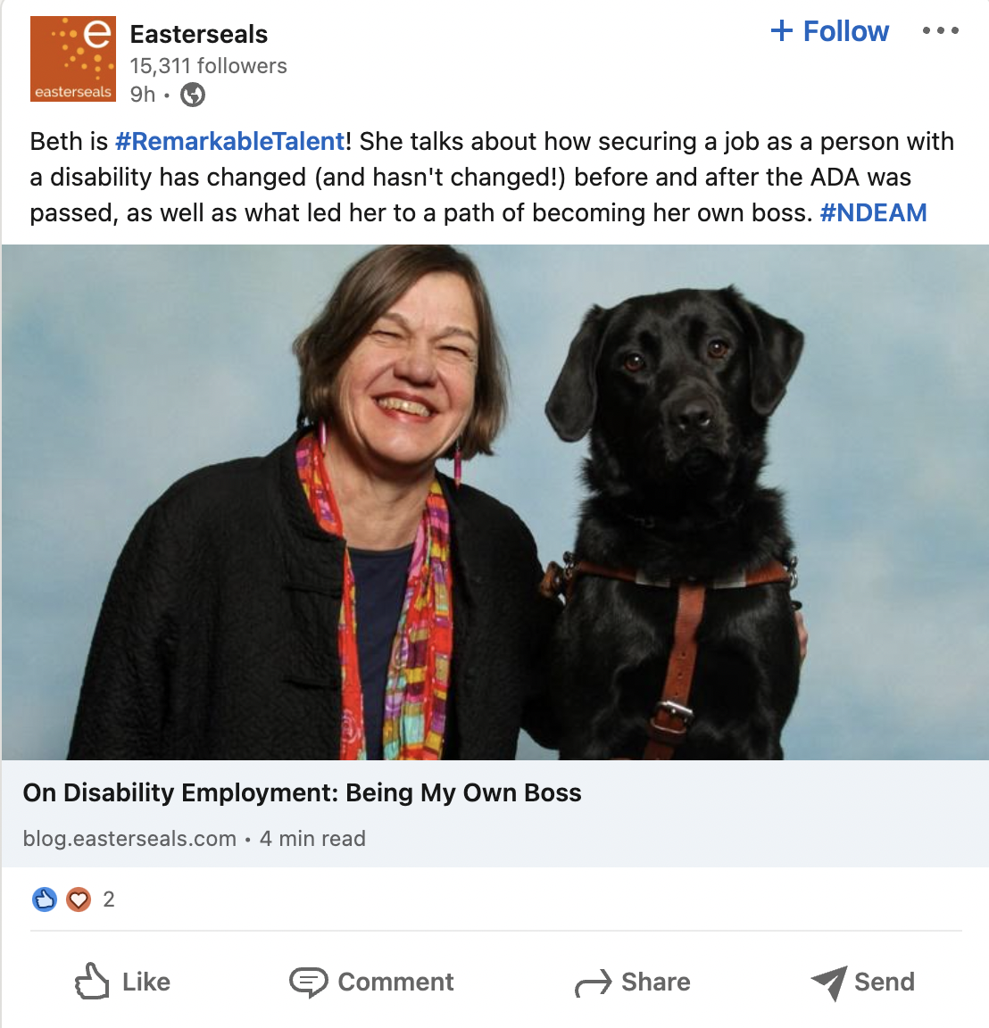
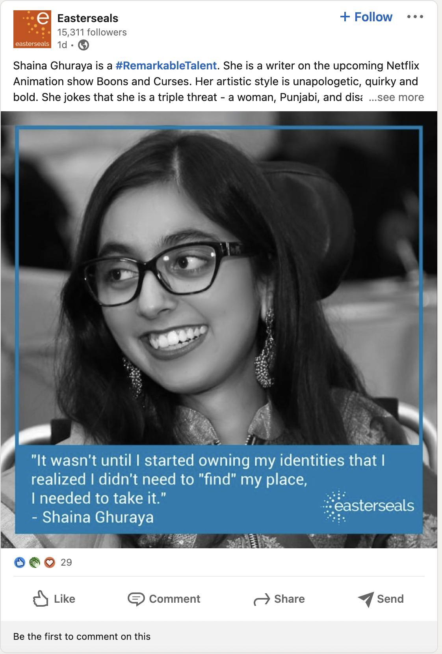
Easterseals on LinkedIn
Notes:
Another tactic we’re employing to get exposure on national television and radio stations is the distribution of our national brand PSA which, as you can see, in one month was picked up by stations throughout the country and helped us reach nearly 12M people with media value of $330K –
All donated airtime in one month to build awareness of Easterseals – which will continue throughout the year..

Slide 24
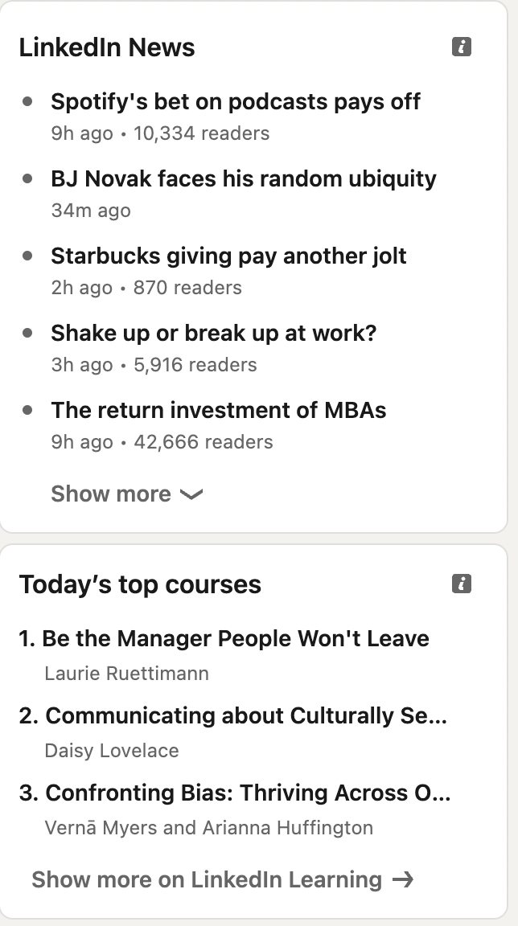
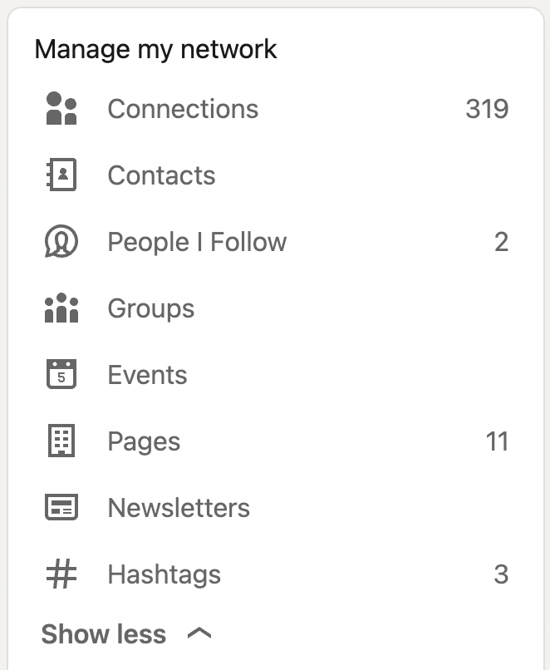
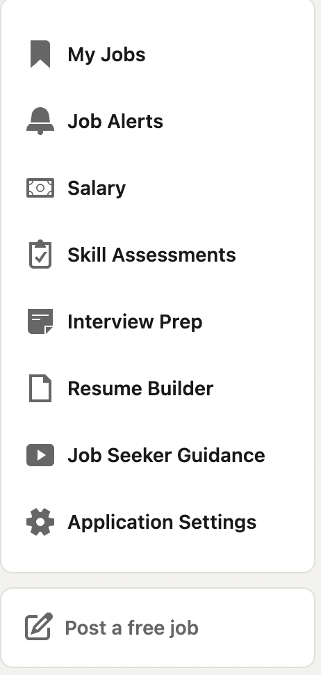
News and Resources
Network
Jobs

Slide 25
Thank You!

