Slide 1

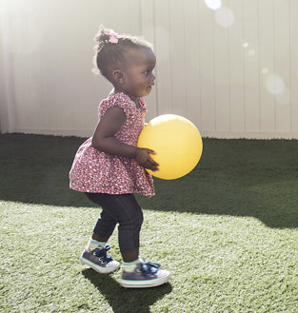
Easterseals Training Series:
Successful Social Media Campaigns
November 16, 2021

Slide 2
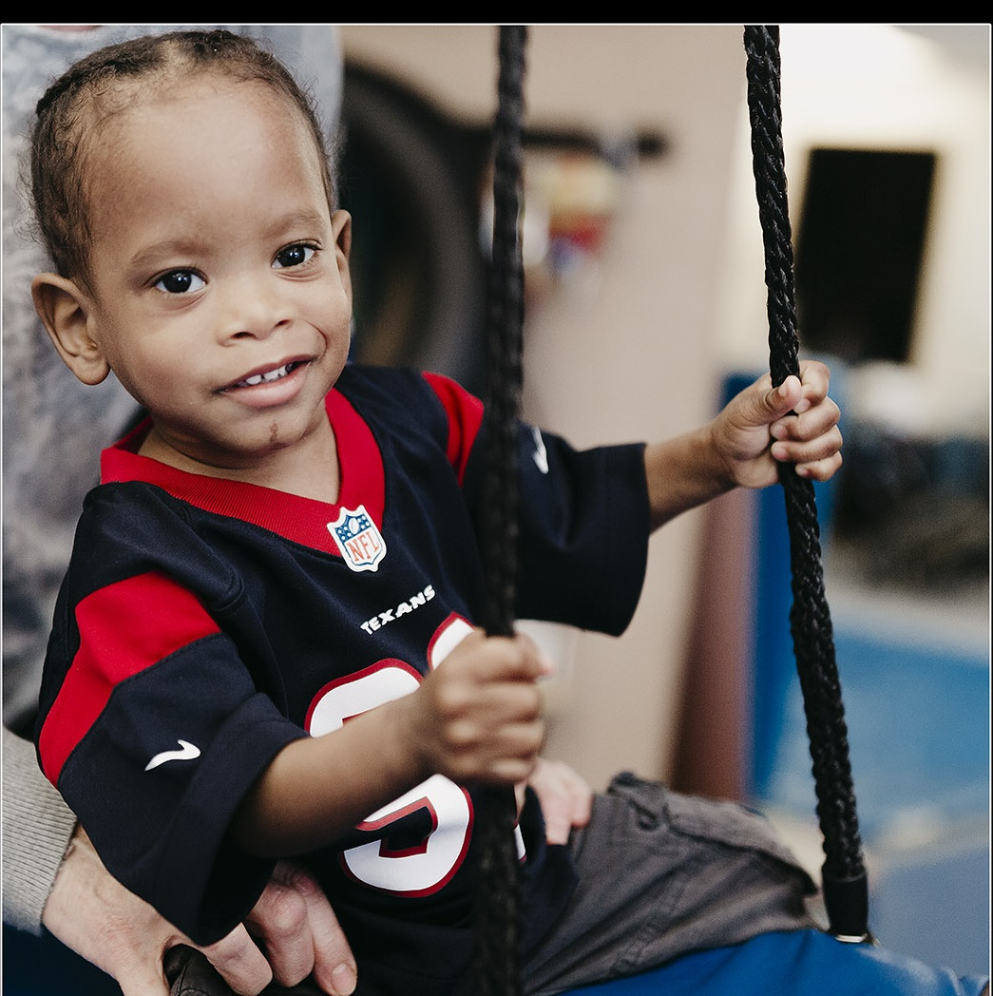
Easterseals DuPage & Fox Valley

Slide 3
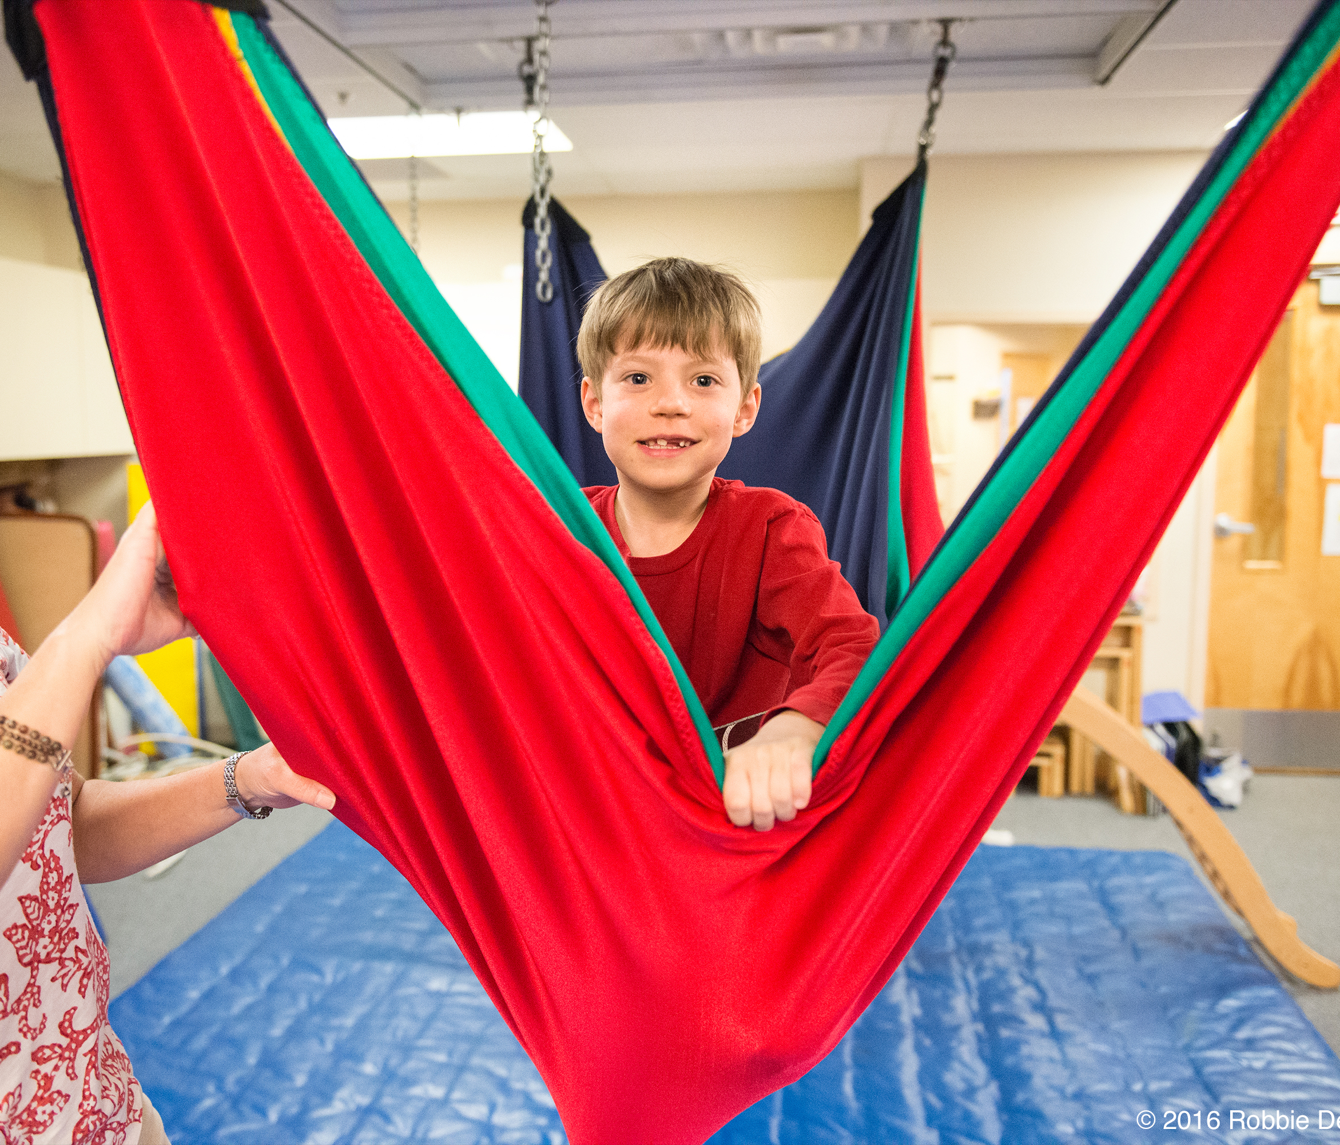
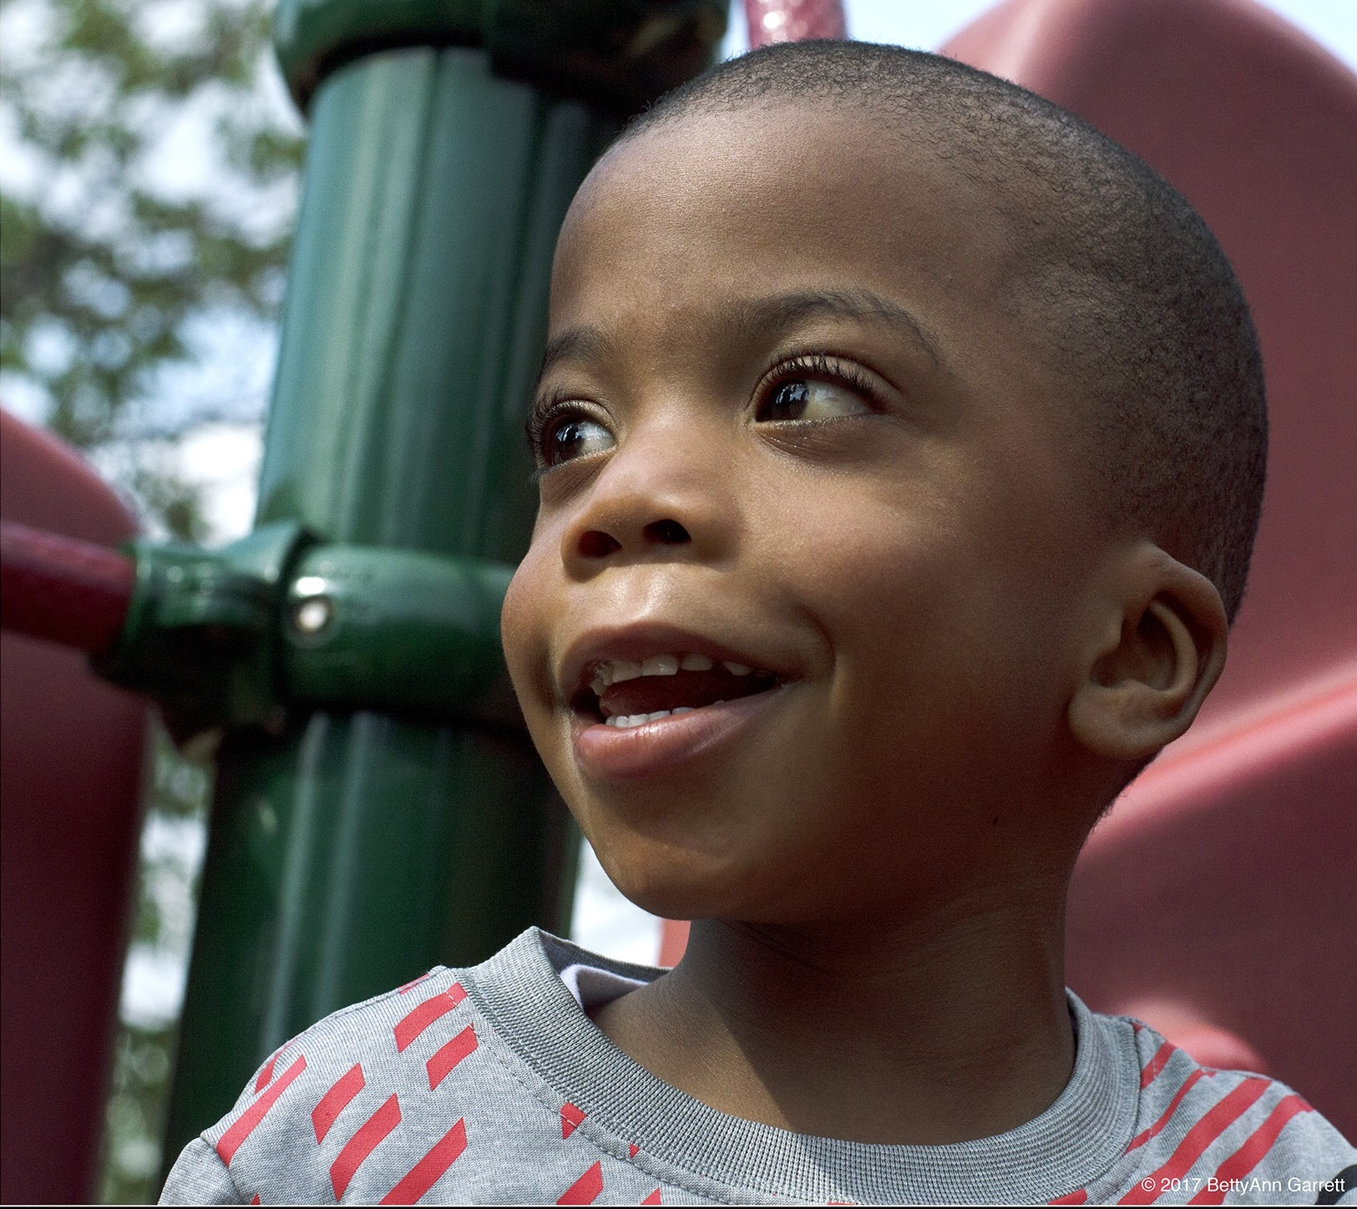
About Us
At Easterseals DuPage & Fox Valley, we believe every child deserves to thrive in an inclusive community.
Our mission is to ensure that children with disabilities and their families are empowered.
We offer pediatric therapy services throughout suburban Chicagoland from three rehabilitation centers
More than 1,000 infants, children and adults with developmental delays and disabilities are seen in-person or through tele-therapy each week

Slide 4
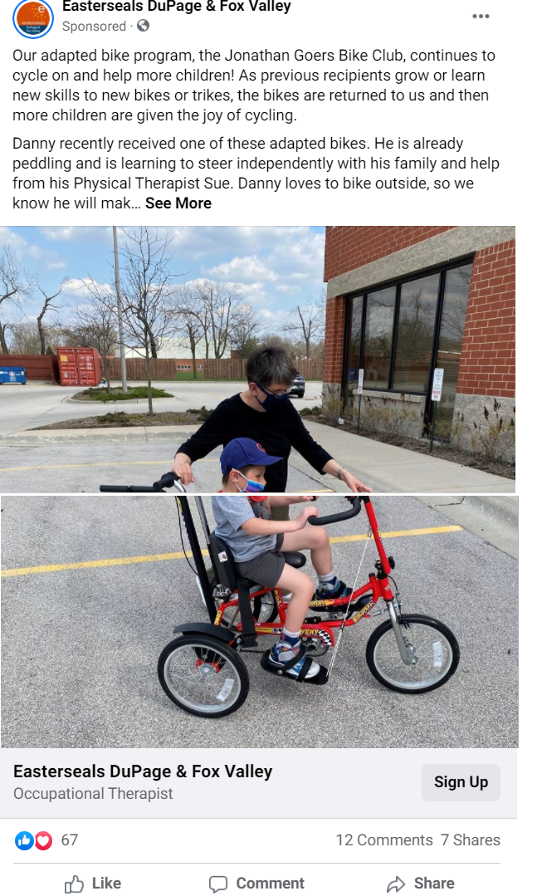
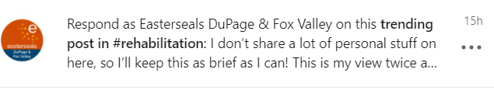
Event Campaigns
Facebook & Instagram:
Choose a client ambassador whose story will help the event come to life
Boost event posts, Even $15-20 makes a difference for your audience to see the content
Use advertising!
Share information & tag sponsors
  Include in sponsor benefits: 2 emails and 2 social posts
We do like all comments and respond frequently. Stay engaged!
LinkedIn:
Tag Sponsors
Give sponsors a toolkit to share and tag
Add hashtags to page as then you can comment on those

Slide 5
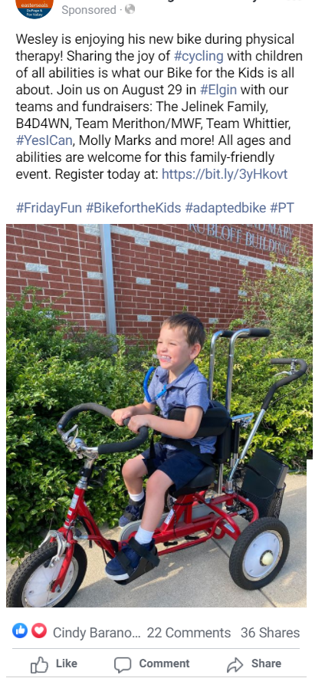
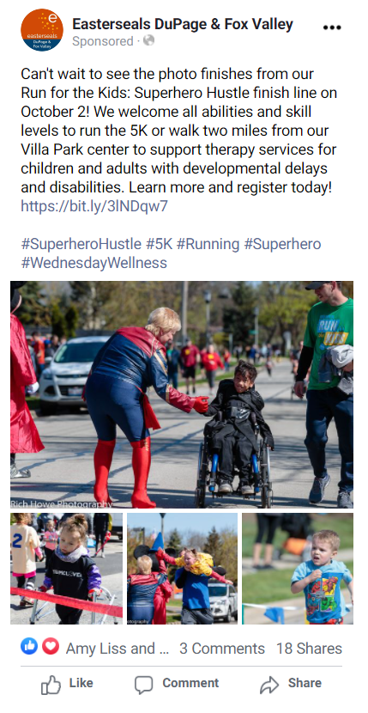
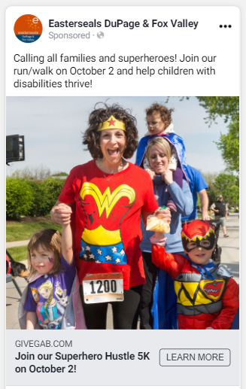
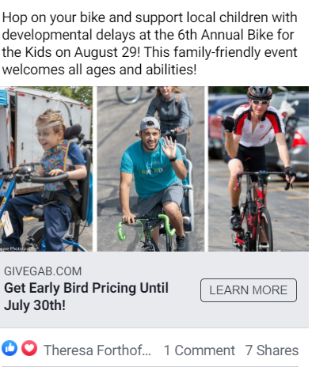
Run for the Kids: Superhero Hustle
Bike for the Kids
Promoted Posts
Outdoor events or virtual opportunities to share your org. information.
Work closely with our therapists to share stories of children reaching relevant milestones
RFTK: $400 Ad Budget: 14 Ads & Boosted Post
  Reach: 35,566
  Impressions: 47,305
  Unique Clicks: 510 (539 total)
Facebook/Instagram Ad: Running/Charity Audience
Facebook/Instagram Ad: Family Audience

Slide 6
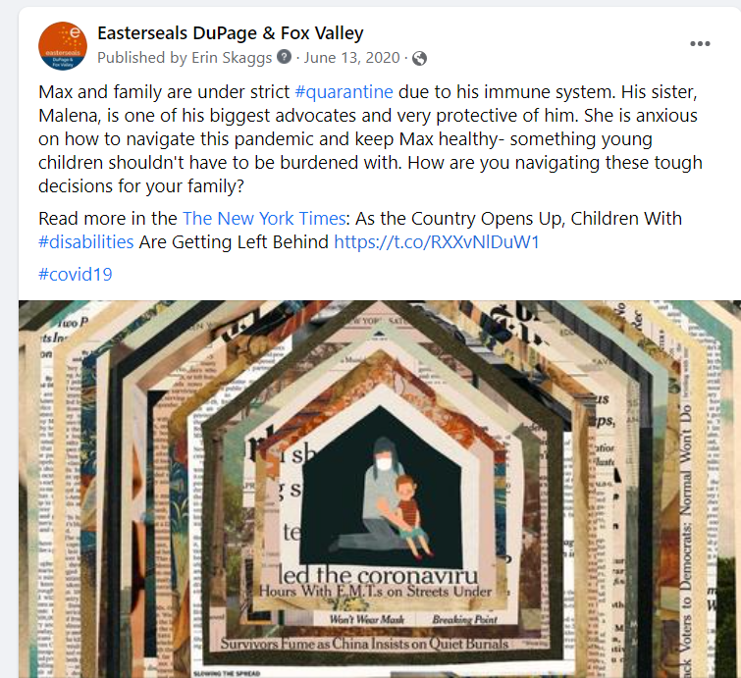
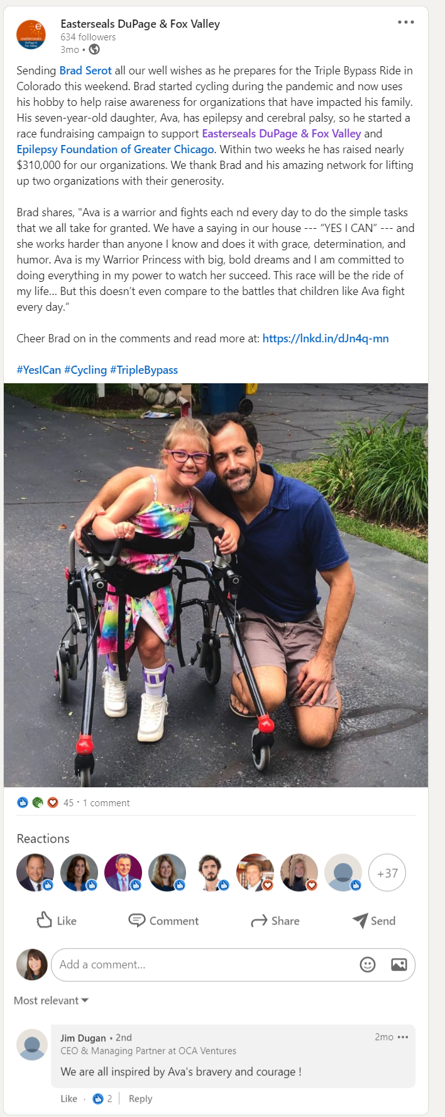
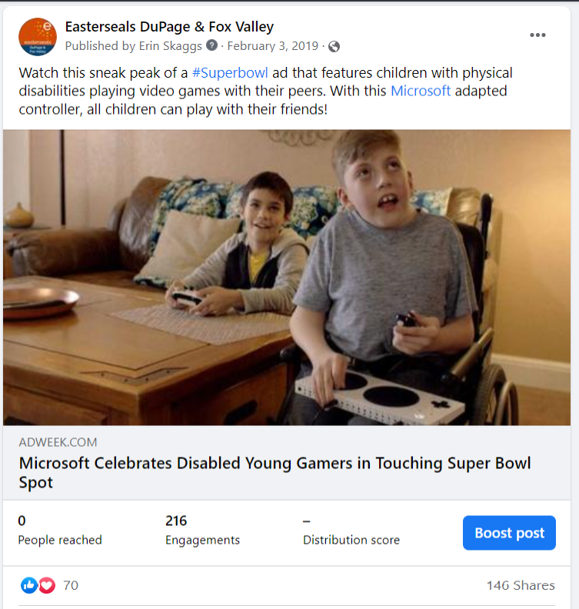
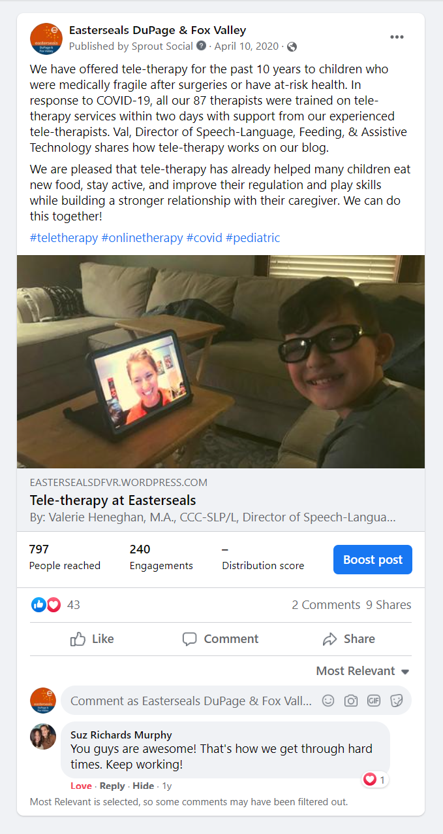
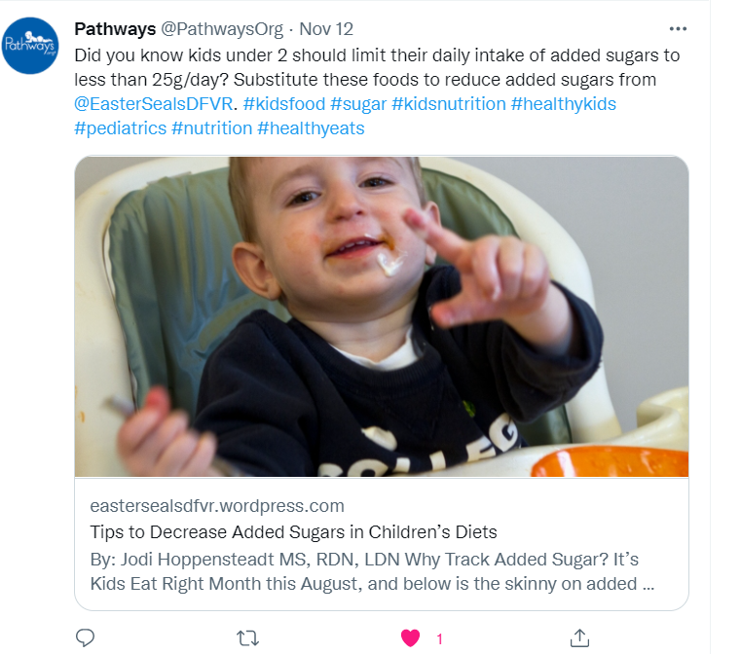
Timeliness
When you don’t have a large budget- be timely and make connections!

Slide 7
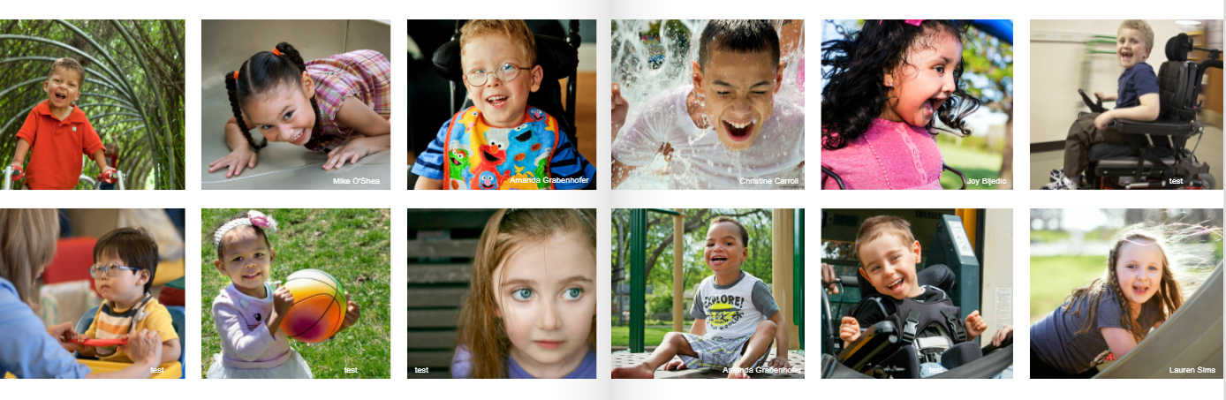
Photography Partnership
A 20+ year collaboration between a local community college photography department
Graduates make connections with the families and help with projects
Families share bios and their stories to create a library of content
Prints are the first thing you see in each center lobby and throughout the hallways

Slide 8
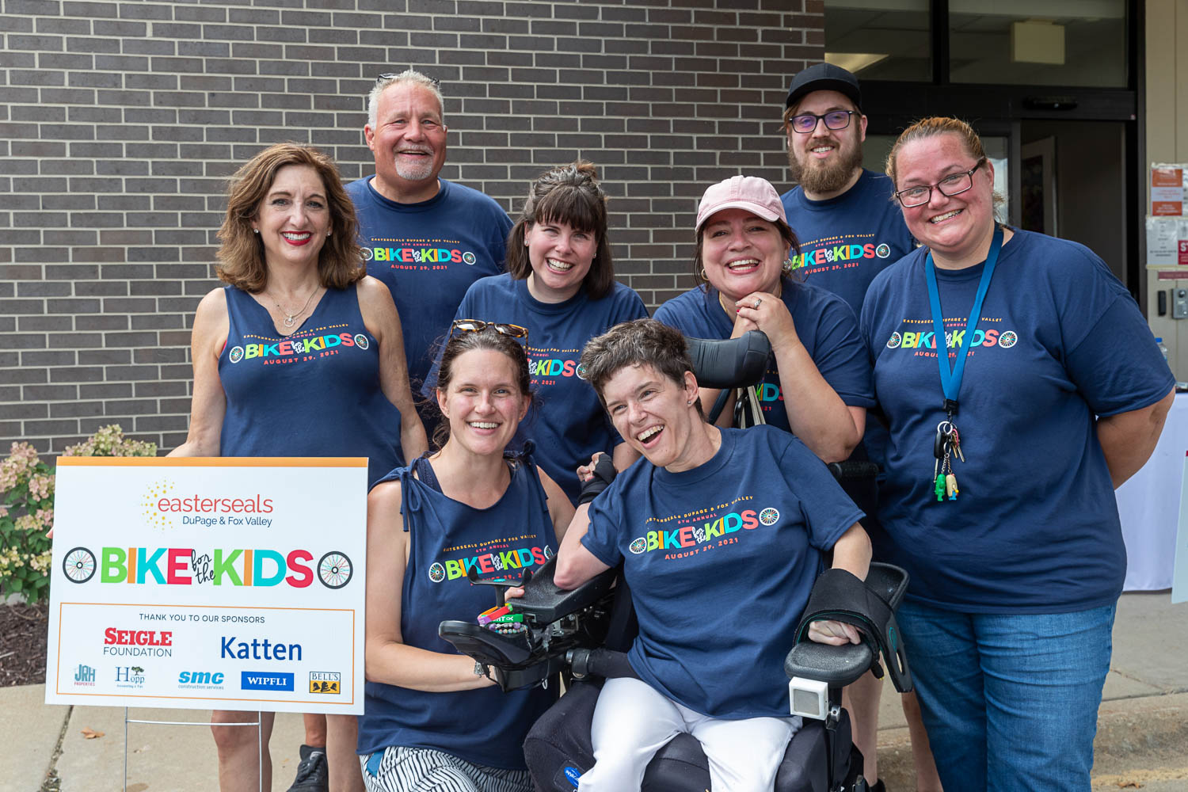
Questions or to Learn More
Erin Skaggs
Director of Marketing eskaggs@eastersealsdfvr.org

Slide 9


Slide 10


Slide 11
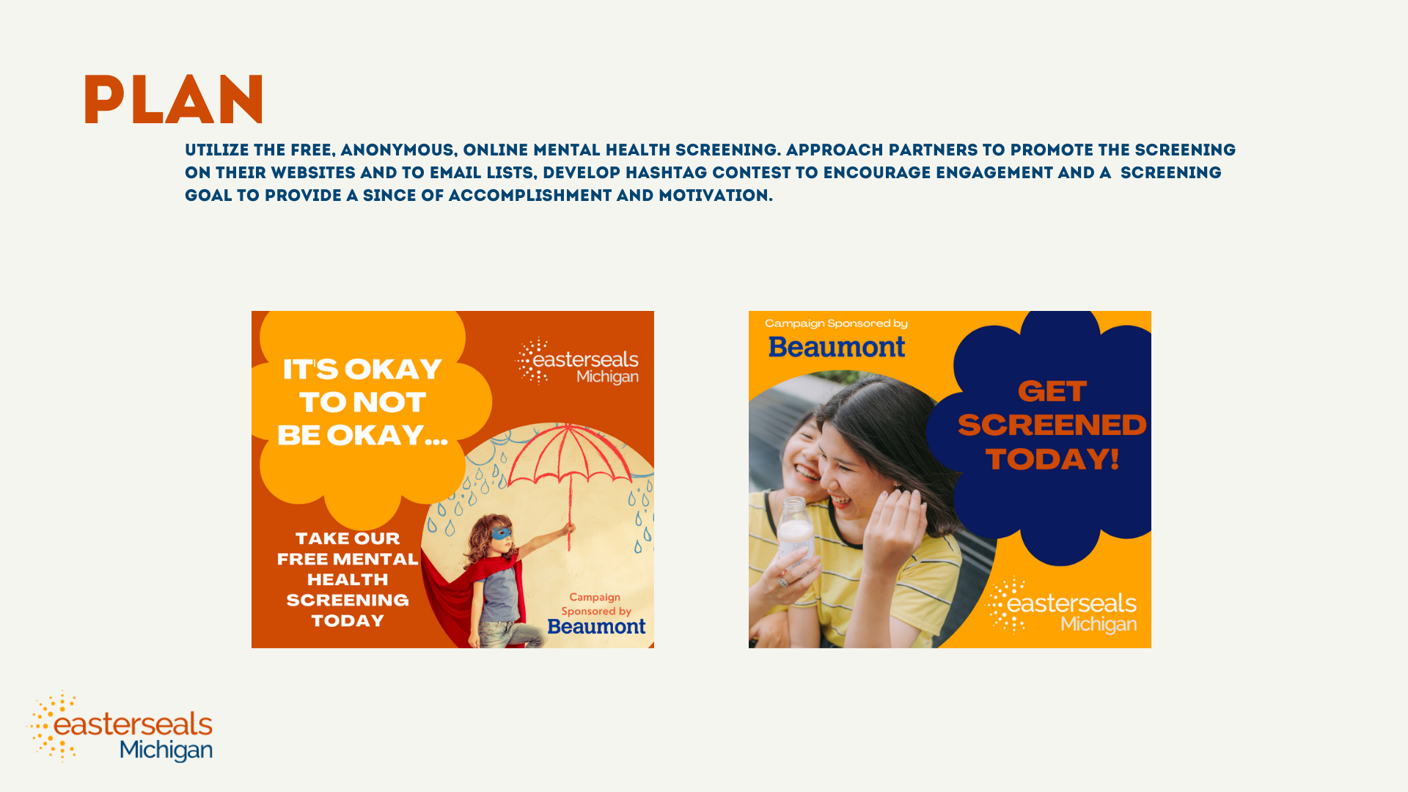

Slide 12
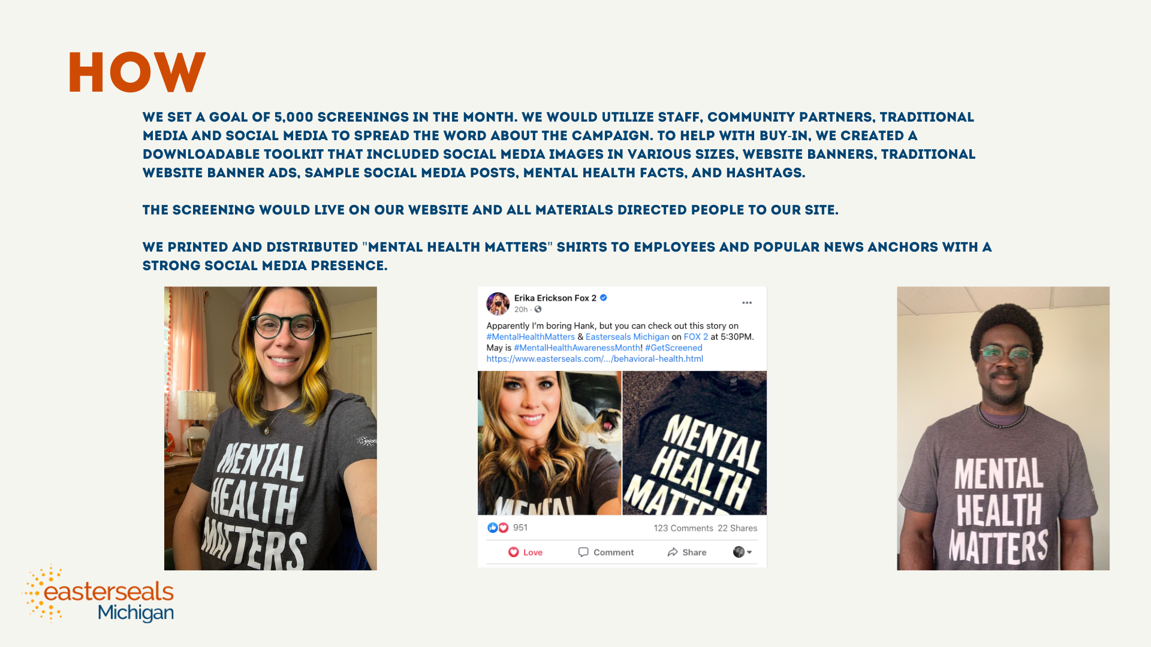

Slide 13
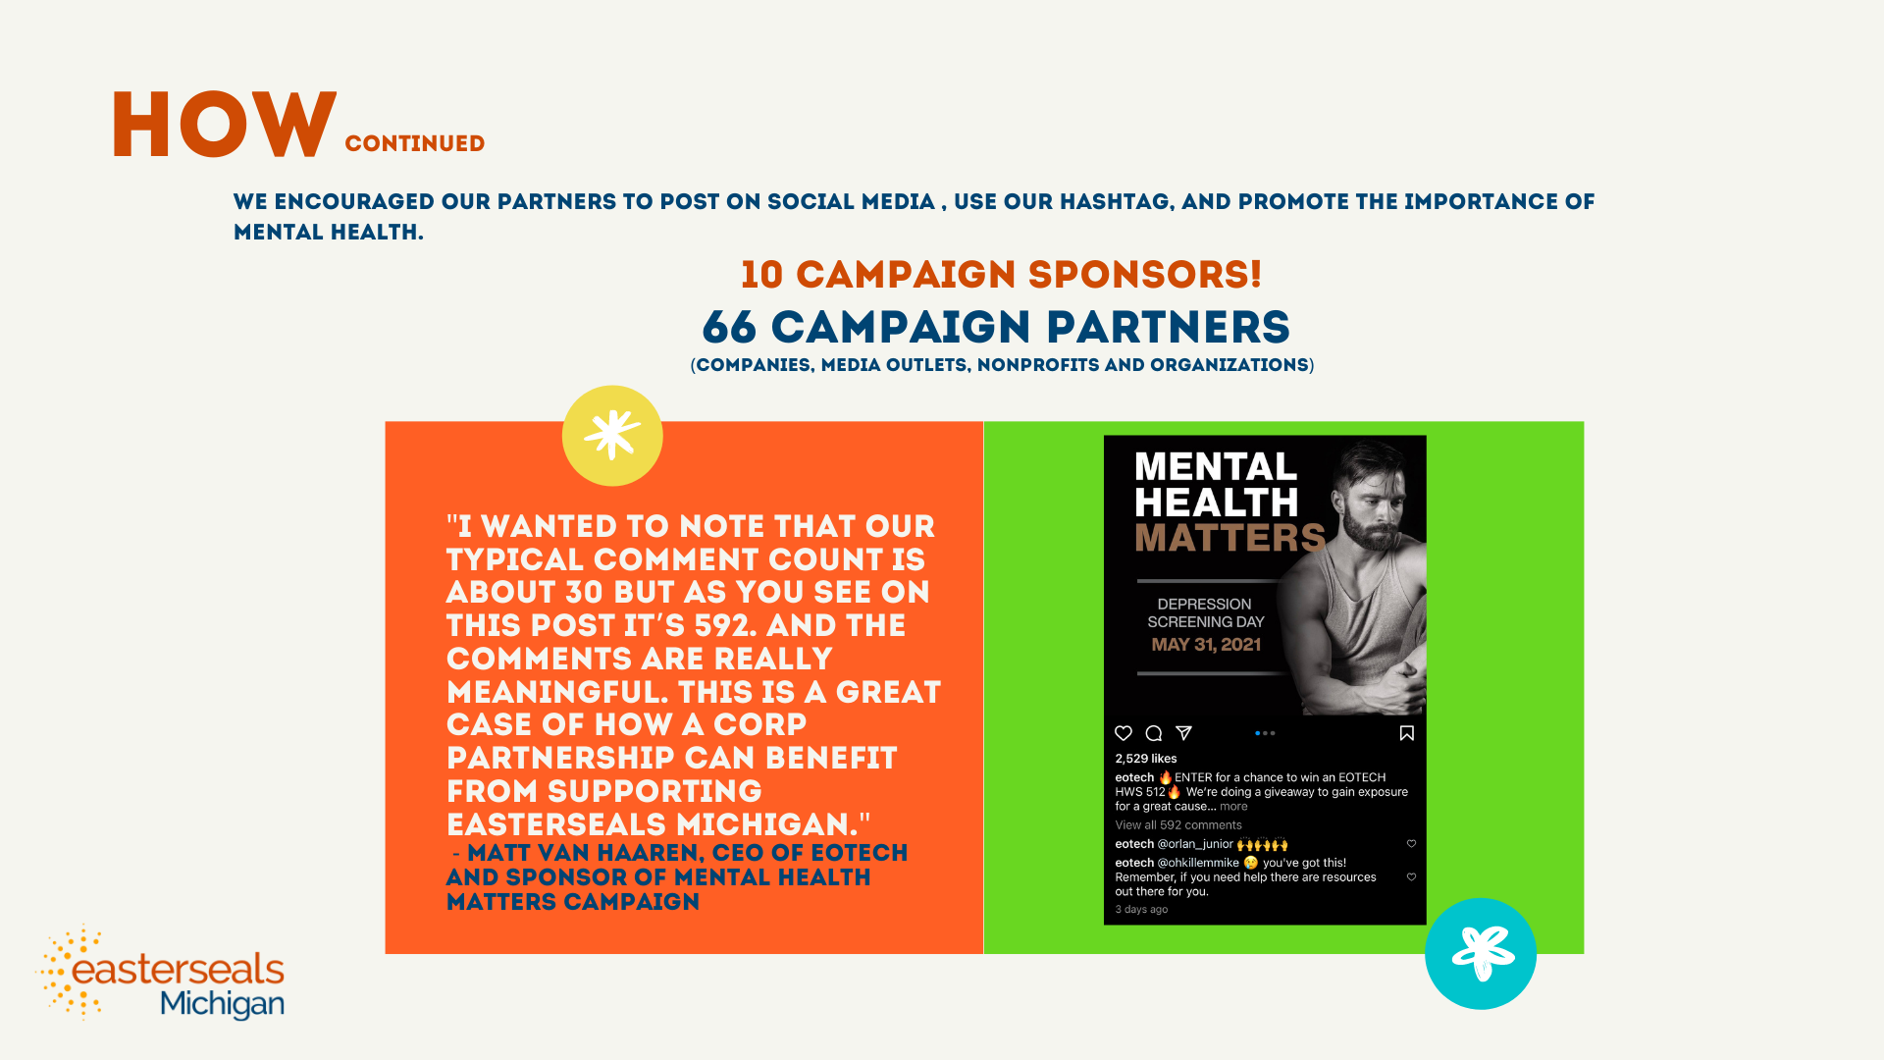

Slide 14
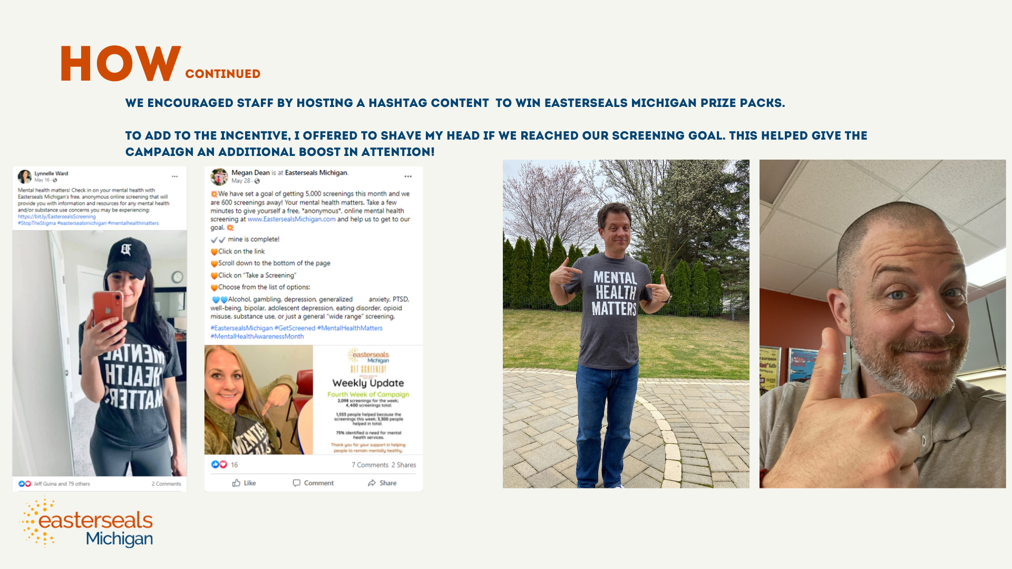

Slide 15
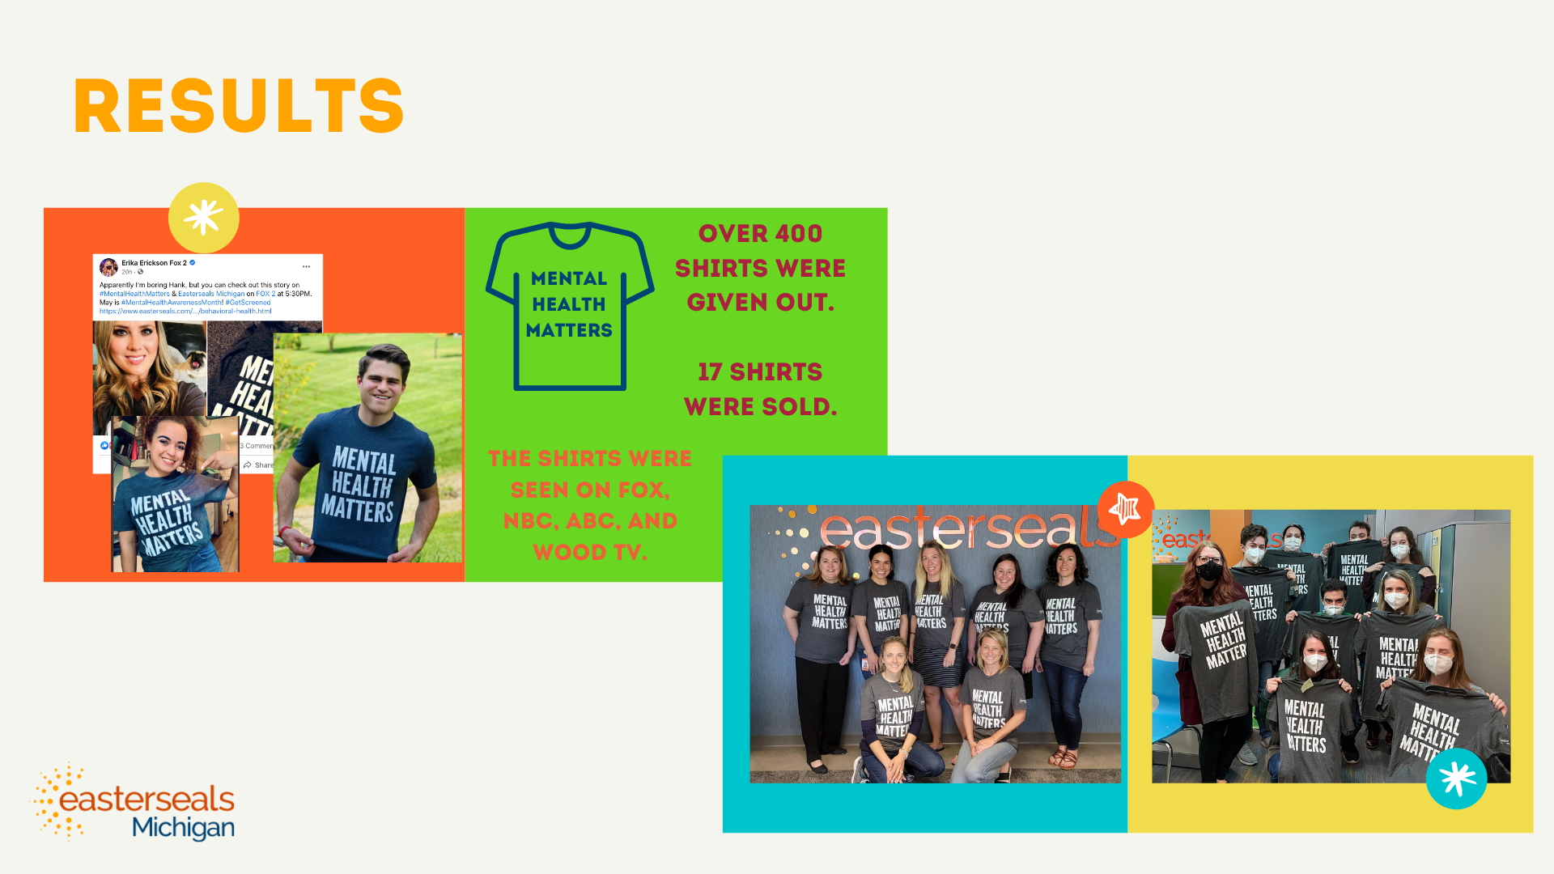

Slide 16
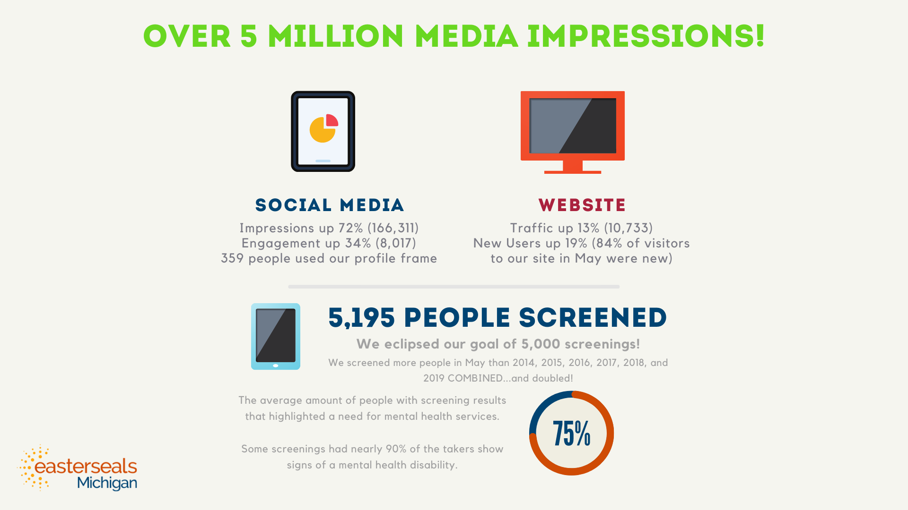

Slide 17

Successful Social Media Campaigns
Questions? khill@esng.org

Slide 18


Audit Yourself & Situation
You have to know where you are before you can see where you are going and the best route to get there.

Slide 19
What Are You Working With?
What platforms do we use and how are they doing?
Who is our current main audience?
What do our current analytics and growth rate look like?
What type of content & style of language are we using?
Does our content and page aesthetic match our branding?
What is the capacity of the team and what resources are there for support?

Slide 20

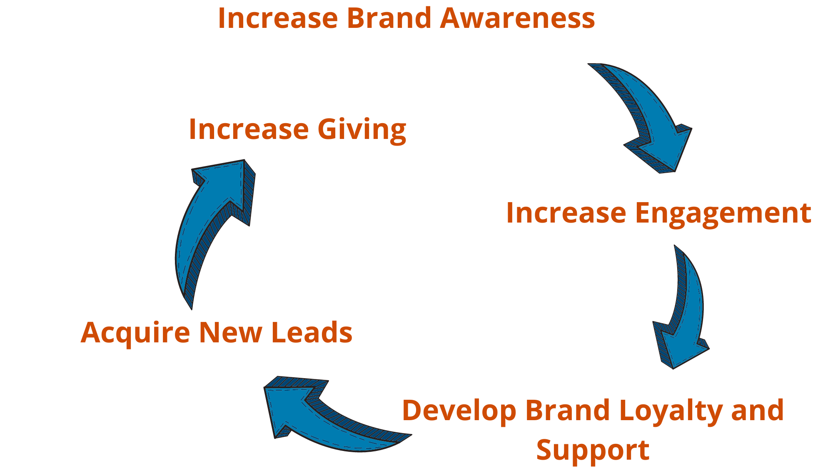
Figure Out Where You Want To Go…
#GOALS

Slide 21
And How To Get There
Low hanging fruit- Successful platforms to propel you forward
Tools- Streamlining your work
Language & Diversity- What are you saying and how?
Troubleshoot- Strategies evolve everyday
Slow build for supplemental resources- Where can you garner help?

Slide 22

Low Hanging Fruit
Use your most successful platform to help propel you forward while you grow your others.
If my audience is mostly on and engaging on Facebook and I am working on a year end giving campaign I focus my fundraising efforts (mainly) on Facebook while using my other platforms more to continue building awareness and loyalty.

Slide 23
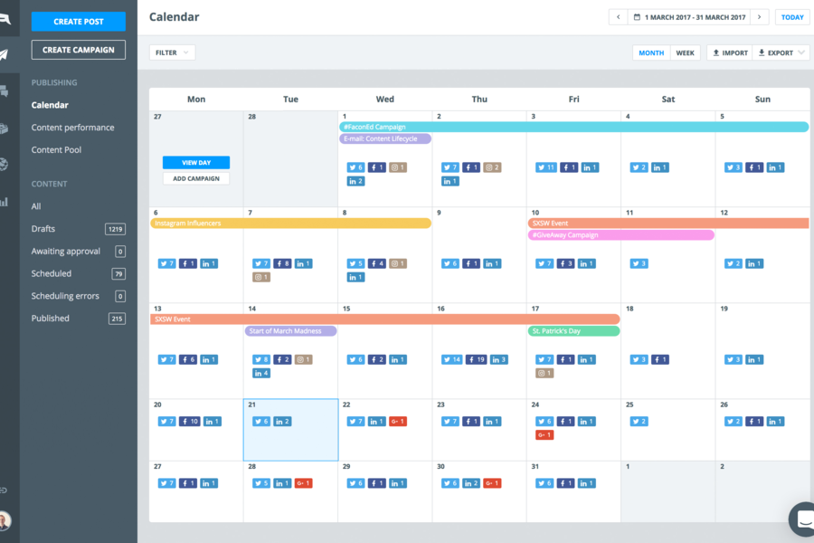


Tools
How can I streamline my work?
What tools will boost productivity?

Slide 24

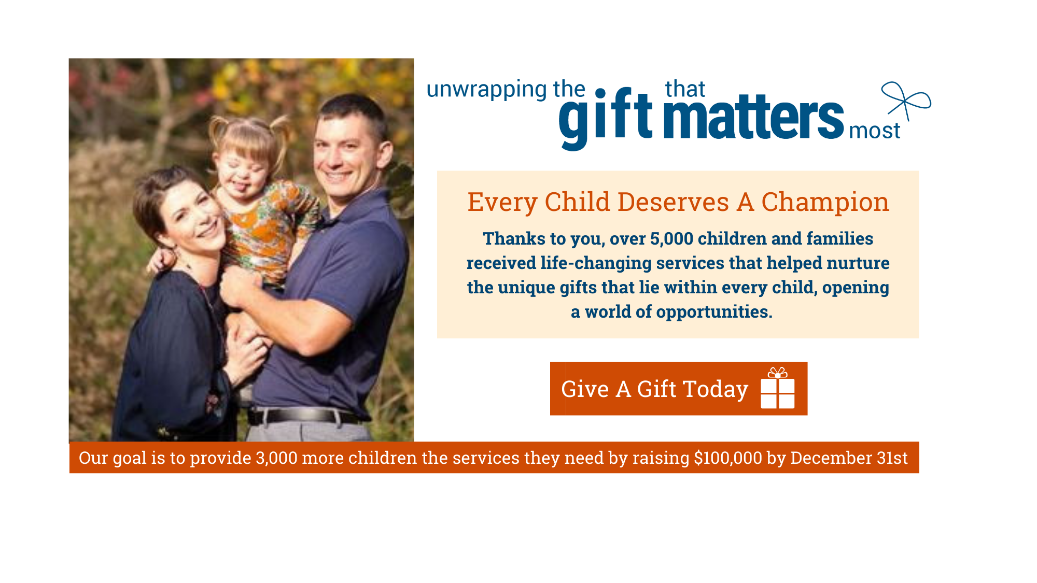
Language & Type of Content
Use a variety of content types
Mix polished branded content with informal and simple visuals/messaging
Tell the story of impact and need but lean more towards letting your clients tell their own story
Make it personal
Be transparent
Talk to them instead of at them
Let them know their role in the impact being made

Slide 25
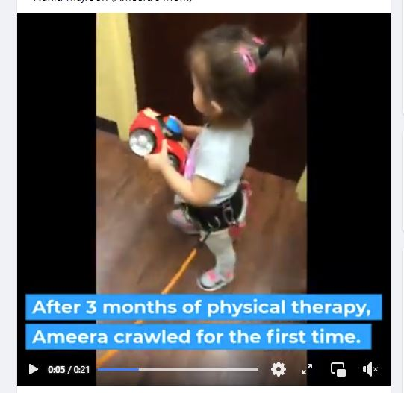
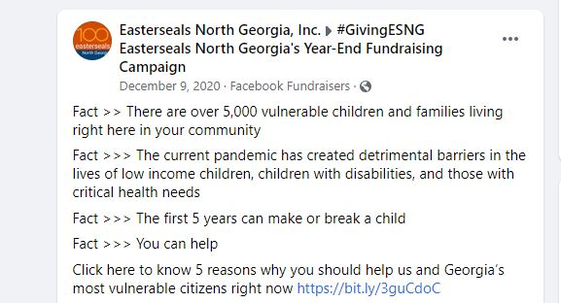
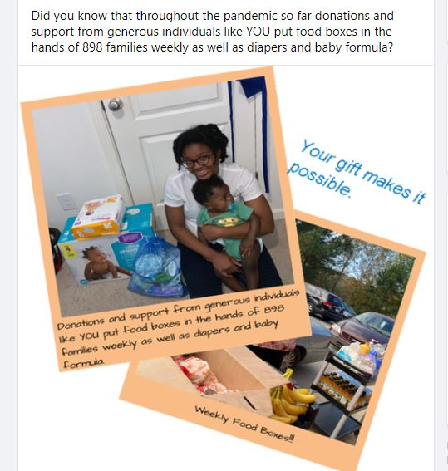
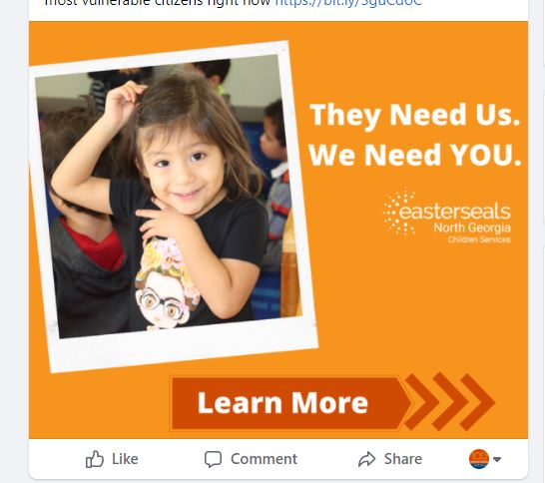
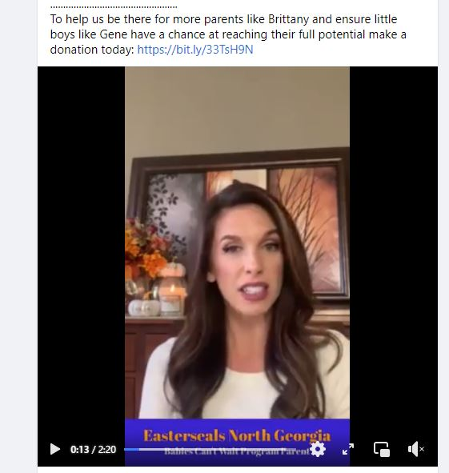
Language & Type of Content

Slide 26
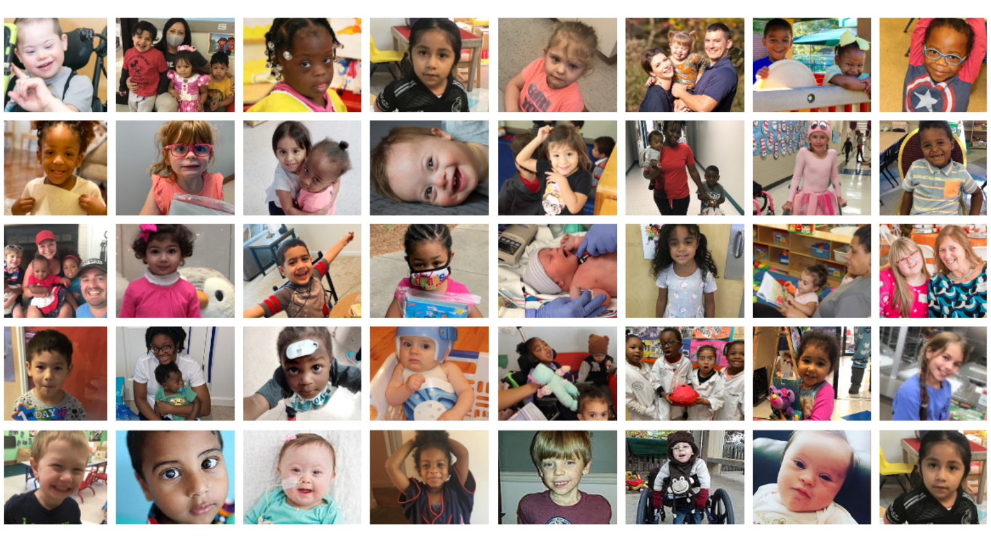
Diversity

Slide 27


Troubleshoot
Try, Try, and Try again until you find what works

Slide 28
Slow Build Supplemental Resources
Contract Help- Initial trial period with a digital advertising company running specific ongoing Facebook and IG ad campaigns. Then grew partnership to doing special event and annual giving campaigns.
Started boosting ads here and there then slowly began allocating more of the budget towards specialized campaigns and contract work.

Slide 29

What Happened?
Increase in growth rate by 30% over the last 2 years

Slide 30
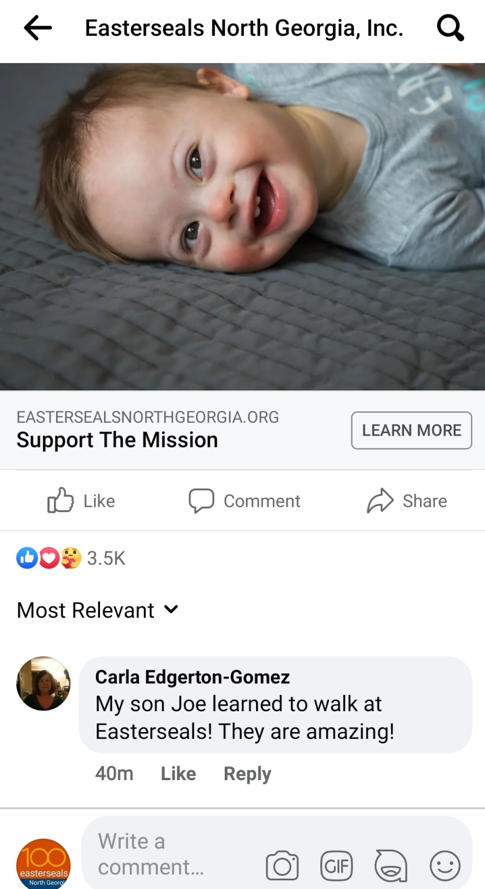





What Happened?
Jumps in impressions and engagement
Email subscribers
Volunteer sign ups
Enrollment inquiries
Long lost Easterseals stories
Fundraisers

Slide 31
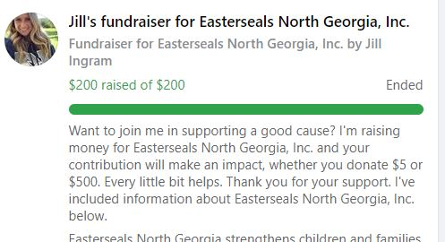
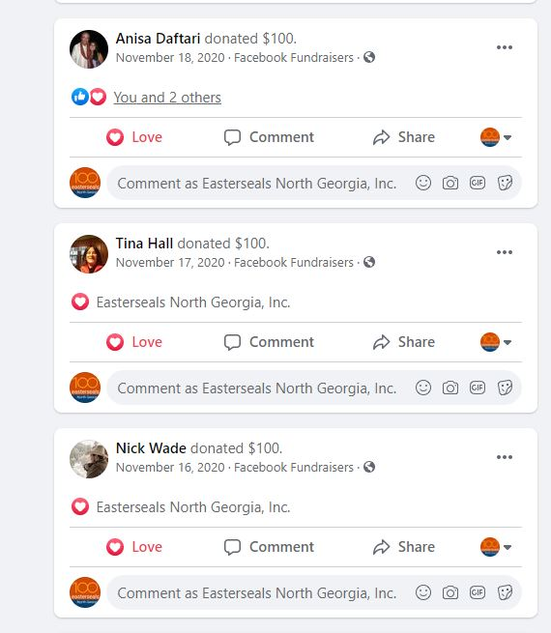
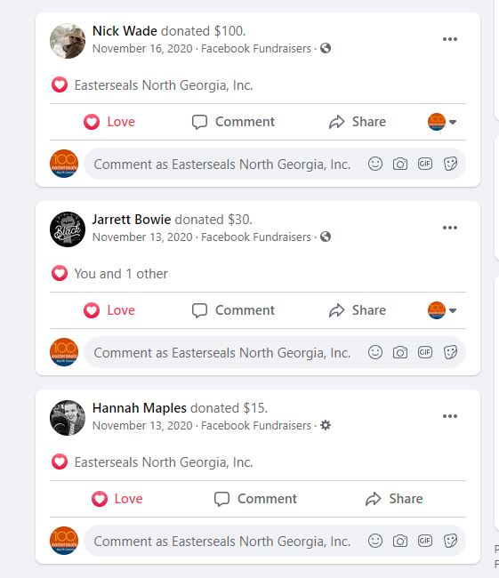
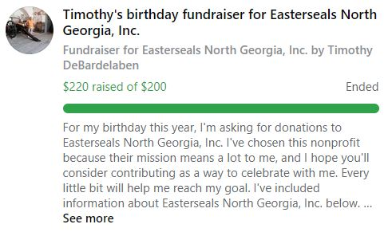
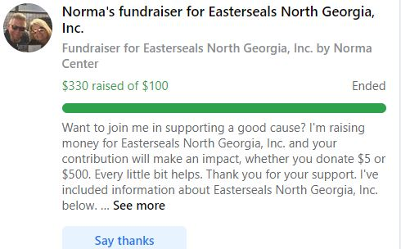
What Happened?

Slide 32
Thank You!

