Slide 1

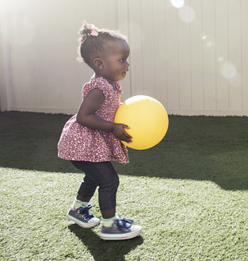
Easterseals Training Series:
Telling Our Story Through Media Placements
November 4, 2021
Notes:
For Discussion Today:
The Landscape of our Network
Highlights of what we’ve been up to lately (Corporate Partnerships, All In: The Plan for Disability Equity; Network Advancement; Thought Leadership; Advocacy)
Lessons from the Past & A Look Ahead (to the Strategic Plan)
PLEASE SIGN UP FOR OUR BI-WEEKLY NEWSLETTERS
Invite a volunteer to serve on our National Board Standing Committees

Slide 2
Increasing awareness of our brand,
our relevance, and our impact
through earned media placements
Notes:
September 25, 2020 Symposium Goals & Participation
The Easterseals Network Public Policy Symposium goals:
Discuss, debate, and agree on top public policy priorities for the next Congress
Discuss, debate, and agree on a recommendation for the Easterseals’ official position on mandatory immunizations
Discuss, debate and agree on a recommendation for the Easterseals’ official position on 14[c]
What We Recommend – Mandatory Immunizations
Easterseals National supports a policy of mandatory, evidence-based immunizations with the affiliate network being given flexibility to establish their own position consistent with state laws.
What We Recommend – Subminimum Wage (14(c))
Easterseals National position should be:
(1) Easterseals National recognizes the contribution 14(c) made;
(2) Easterseals National supports transitioning away from subminimum wage programs with the right infrastructure supports needed to secure a success.

Slide 3
Leveraging current events and issues to generate coverage around our advocacy, services, and impact
Equity, inclusion, and access for people with disabilities, families, and communities
Current issues and potential opportunities
  HCBS funding
    Story telling after bill passes; impact on people you serve
  Employment crisis
  Mental health needs
  Lack of affordable, quality childcare
  Healthcare
    Young children/free online screening tool
    Telehealth
    Social isolation solutions

Slide 4
Kristen Barnfield, Partner
Change For Balance
Easterseals National Public Relations Agency
Notes:
September 25, 2020 Symposium Goals & Participation
The Easterseals Network Public Policy Symposium goals:
Discuss, debate, and agree on top public policy priorities for the next Congress
Discuss, debate, and agree on a recommendation for the Easterseals’ official position on mandatory immunizations
Discuss, debate and agree on a recommendation for the Easterseals’ official position on 14[c]
What We Recommend – Mandatory Immunizations
Easterseals National supports a policy of mandatory, evidence-based immunizations with the affiliate network being given flexibility to establish their own position consistent with state laws.
What We Recommend – Subminimum Wage (14(c))
Easterseals National position should be:
(1) Easterseals National recognizes the contribution 14(c) made;
(2) Easterseals National supports transitioning away from subminimum wage programs with the right infrastructure supports needed to secure a success.

Slide 5

Building relationships with local media
Be a Consumer
Follow, Like, Share, Comment
Acknowledge & Appreciate
Establish & Show Expertise
Channel your Inner Reporter
Amp Up your Own Content
Need Help? Reach Out!
Notes:
Another tactic we’re employing to get exposure on national television and radio stations is the distribution of our national brand PSA which, as you can see, in one month was picked up by stations throughout the country and helped us reach nearly 12M people with media value of $330K –
All donated airtime in one month to build awareness of Easterseals – which will continue throughout the year..

Slide 6

Developing & Placing Local
Op-Eds & Letters to the Editor
Current Trends, Pop Culture, Issues-Based, Timely with unique POV
  DEI&A
  HCBS, Advocacy
  COVID’s impact
  Disabled Advocates, Clients/Families
  Co-Author
National creative, with a local twist
  How?
  Responsive?
An Example, Success story
Notes:
Another tactic we’re employing to get exposure on national television and radio stations is the distribution of our national brand PSA which, as you can see, in one month was picked up by stations throughout the country and helped us reach nearly 12M people with media value of $330K –
All donated airtime in one month to build awareness of Easterseals – which will continue throughout the year..

Slide 7
Placing PSAs Locally TV, Radio, Digital and Print
Make your pitch personal
  Introduce PSAs with a local touch, personalized letter from staff, client, CEOs about how your Easterseals benefits XX community
  Highlight key times of year relevant for airing (Autism Acceptance Month, ADA, NDEAM, Veterans Day, etc.)
Get to know the right contacts
  Broadcast TV/Radio – Public Affairs Director, Community Relations
  Print/Digital – typically through advertising/publishing, remnant space
Build your list … year-end is a great time to reach out and make an intro!
Consider non-traditional places for sharing…amplifying!
    Local influencers – celebrities, sports, pop culture
    Companies, corporate partners
    Board and board connections/network
    Clients & families
Notes:
Another tactic we’re employing to get exposure on national television and radio stations is the distribution of our national brand PSA which, as you can see, in one month was picked up by stations throughout the country and helped us reach nearly 12M people with media value of $330K –
All donated airtime in one month to build awareness of Easterseals – which will continue throughout the year..

Slide 8

Community Thought Leadership Moments
More virtual, hybrid opportunities than ever!
Seek out conversations to join, feature your SMEs or clients
Look to media outlets, organizations, corporations, professional groups, and more!
Build content & campaign around each, tout with your network, media, donors, Board, etc.
Notes:
Another tactic we’re employing to get exposure on national television and radio stations is the distribution of our national brand PSA which, as you can see, in one month was picked up by stations throughout the country and helped us reach nearly 12M people with media value of $330K –
All donated airtime in one month to build awareness of Easterseals – which will continue throughout the year..

Slide 9
Craig Sharum
Director of Marketing
Easterseals Michigan

Slide 10



Affiliate Information
We serve over 16,000 people at 10 locations and 2 baseball fields across the state.
550 employees
$41,000,000 annual revenue
Services include mental health care, autism, substance use disorders, veteran services, and more – for all ages.
Notes:
Another tactic we’re employing to get exposure on national television and radio stations is the distribution of our national brand PSA which, as you can see, in one month was picked up by stations throughout the country and helped us reach nearly 12M people with media value of $330K –
All donated airtime in one month to build awareness of Easterseals – which will continue throughout the year..

Slide 11
Pandemic!
Pitching Problems
Event Pitches
  Tough to get earned media
  Pushed to buy air-time
  If obtained, there was little to no engagement
Feel-Good Story Pitches
  Tough to get earned media
  If obtained, there was little to no engagement
Health Expert Pitches
  Positioned ourselves as subject experts first
  Massive coverage obtained
Notes:
Another tactic we’re employing to get exposure on national television and radio stations is the distribution of our national brand PSA which, as you can see, in one month was picked up by stations throughout the country and helped us reach nearly 12M people with media value of $330K –
All donated airtime in one month to build awareness of Easterseals – which will continue throughout the year..

Slide 12
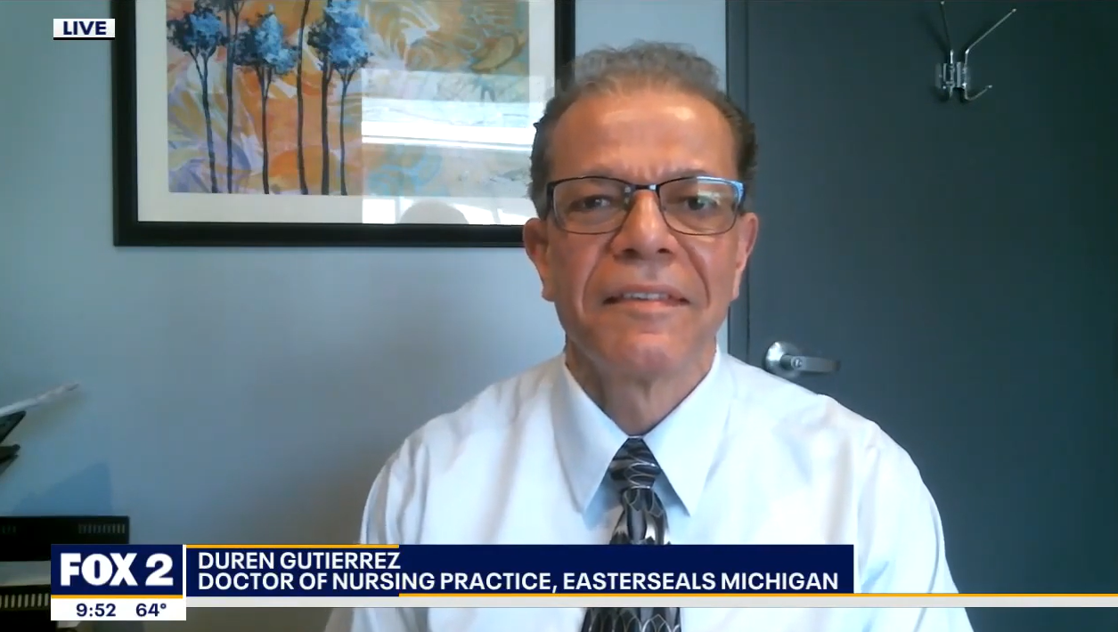
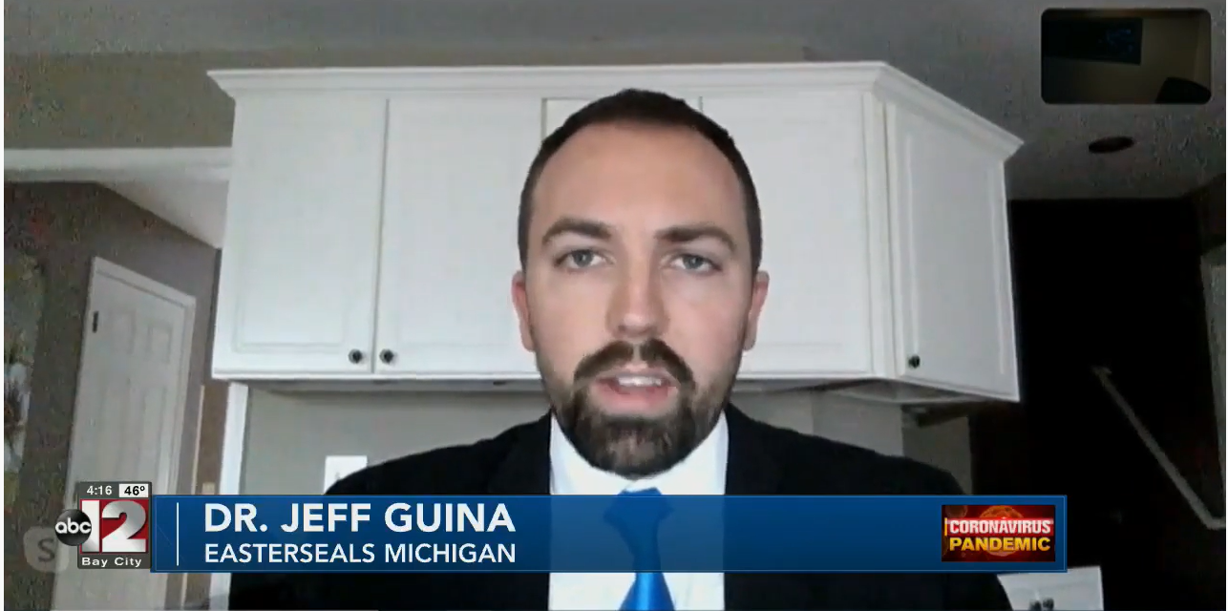
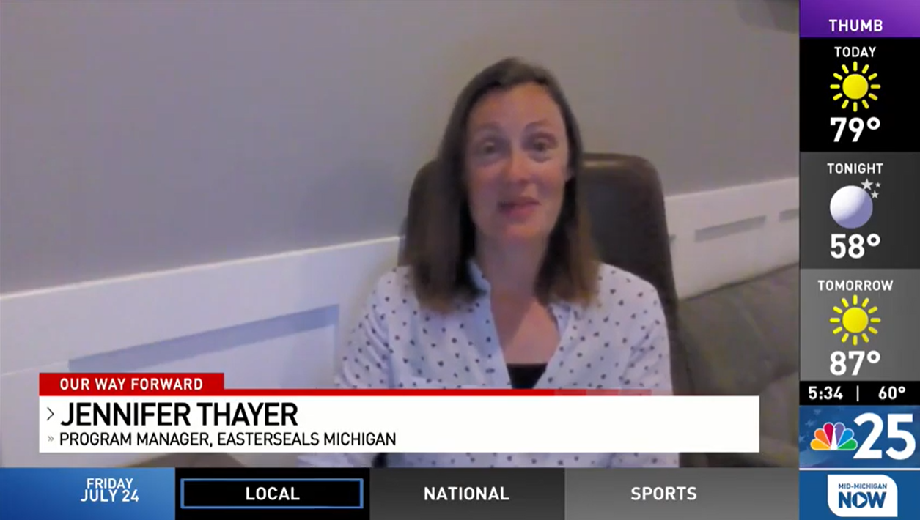
Leverage Strength
Pitching Strategy
Mental Health Crisis
  Utilize our expertise to discuss the mental health crisis resulting from the pandemic
  Identify and assemble a team of staff members to serve as media representatives
    The goal was to avoid using the same person too often
  Pitch the team as being able to provide insight on the crisis and offer free tips to help
  Place free downloadable resources and documents on the Easterseals Michigan website and drive traffic there
  Be ready to go at all times
  Don’t say no to any media, even if network isn’t near a location
Results
  We quickly became the “go-to” for mental health coverage
  Were asked to be an ongoing segment during the evening news
  Increased website traffic by 24% over the previous period with 83% of our visitors being new
  Despite cancelling in-person fundraising events, we exceed our fundraising goal for the year
  We obtained many new community partners, supporters, and donors
  earned over 500 million media
Notes:
Another tactic we’re employing to get exposure on national television and radio stations is the distribution of our national brand PSA which, as you can see, in one month was picked up by stations throughout the country and helped us reach nearly 12M people with media value of $330K –
All donated airtime in one month to build awareness of Easterseals – which will continue throughout the year..

Slide 13
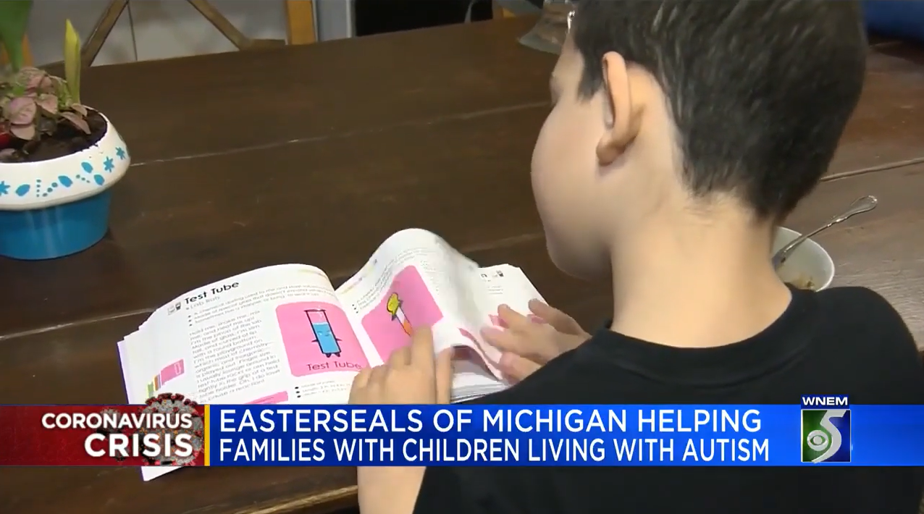
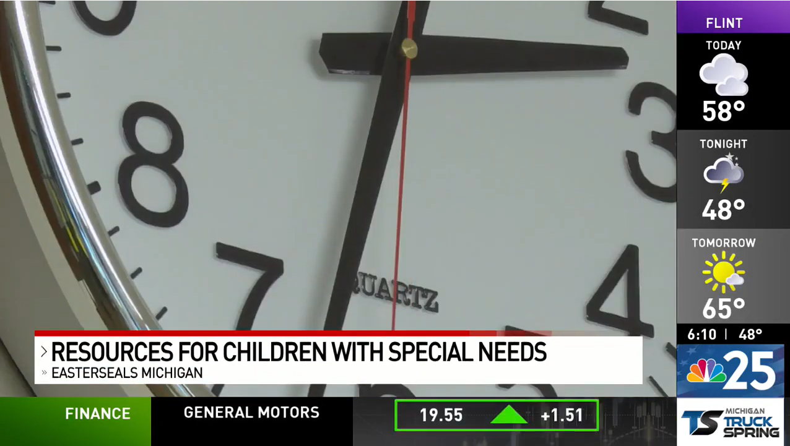
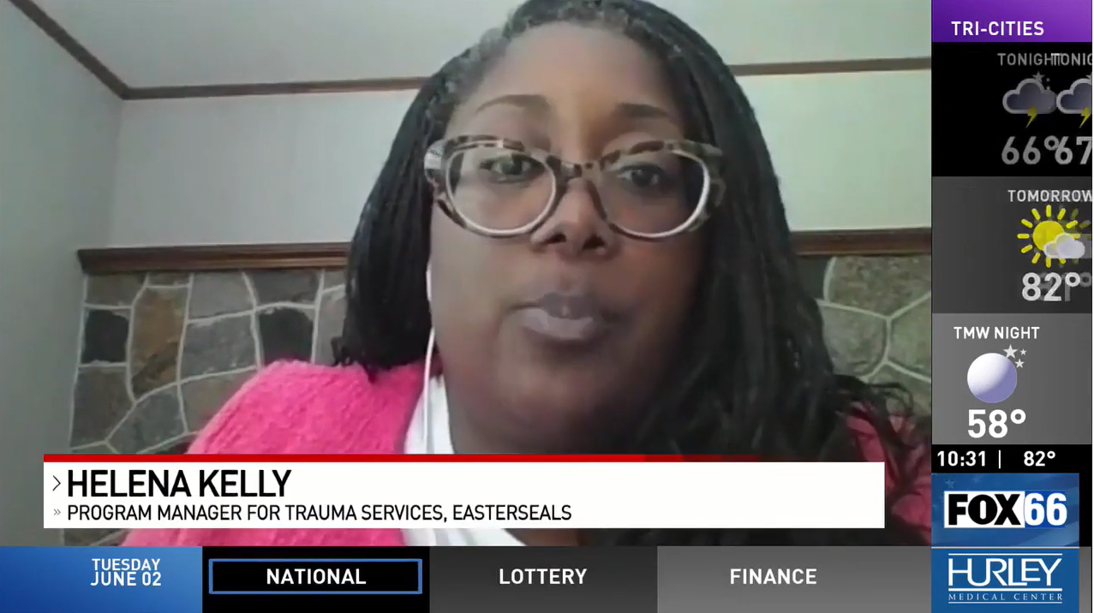
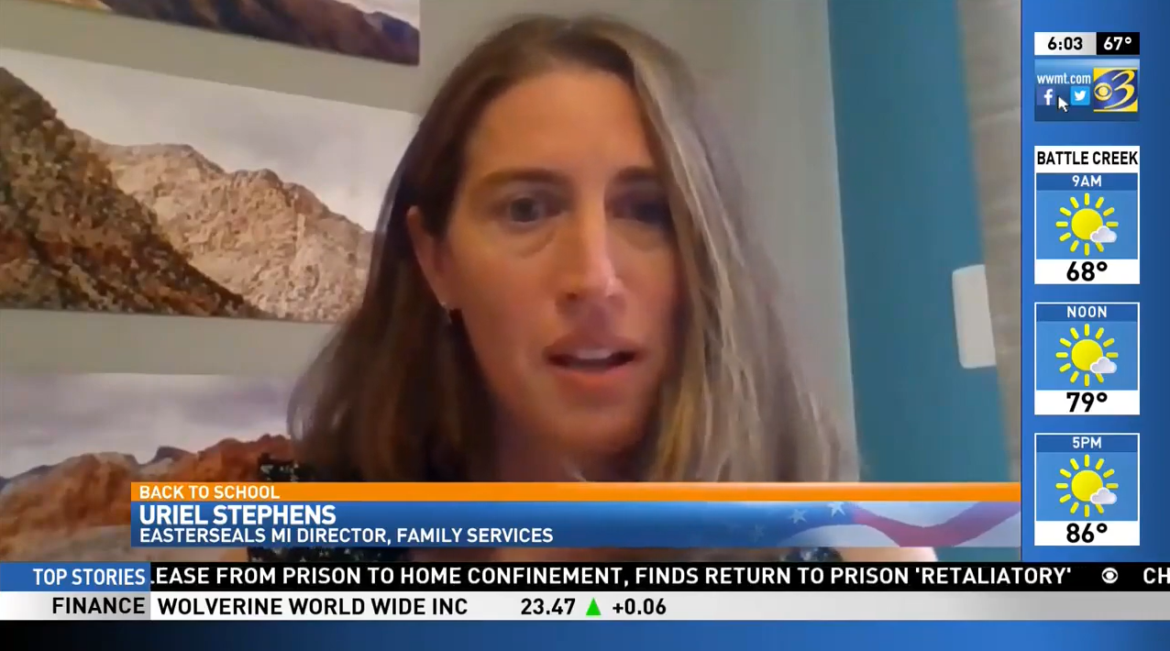
Draft Off Mental Health Coverage
Other Areas of Focus
We looked at other services we offered and pitched those to media as well
Autism
  Virtual potty training
  Free downloadable resources
  Earned media for virtual holiday party, back to school preparedness, Halloween
Childhood Trauma
  Going back to school after lock down
  Wearing a mask vs not wearing a mask
  Living in home dealing with opioid addiction (increased during pandemic)
  Earned media for all topics above
Notes:
Another tactic we’re employing to get exposure on national television and radio stations is the distribution of our national brand PSA which, as you can see, in one month was picked up by stations throughout the country and helped us reach nearly 12M people with media value of $330K –
All donated airtime in one month to build awareness of Easterseals – which will continue throughout the year..

Slide 14
Results since March 2020
Phone Calls/Intake
  Increased the number of people we served by 16%
  Had over 20,000 calls in 2020
    Top themes include: mental health, depression, anxiety, counseling, substance use, children mental health, and autism service
Media Coverage
  96 Unique Stories
  466 Total Stories (many stories aired multiple times)
  848,877,244 total media impressions
Fundraising
  We exceeded our fundraising goal despite having no in-person events
  Grew our donor database and brought in numerous new supporters/partners
Website/Social Media Impact
  Increased our social media followers by 16.7%
  84% of our visitors to the website were new
    Website traffic was up 16%
Notes:
Another tactic we’re employing to get exposure on national television and radio stations is the distribution of our national brand PSA which, as you can see, in one month was picked up by stations throughout the country and helped us reach nearly 12M people with media value of $330K –
All donated airtime in one month to build awareness of Easterseals – which will continue throughout the year..

Slide 15
Katie Harris
Director, Graphic Design and Communication
Easterseals Crossroads (Indianapolis)

Slide 16
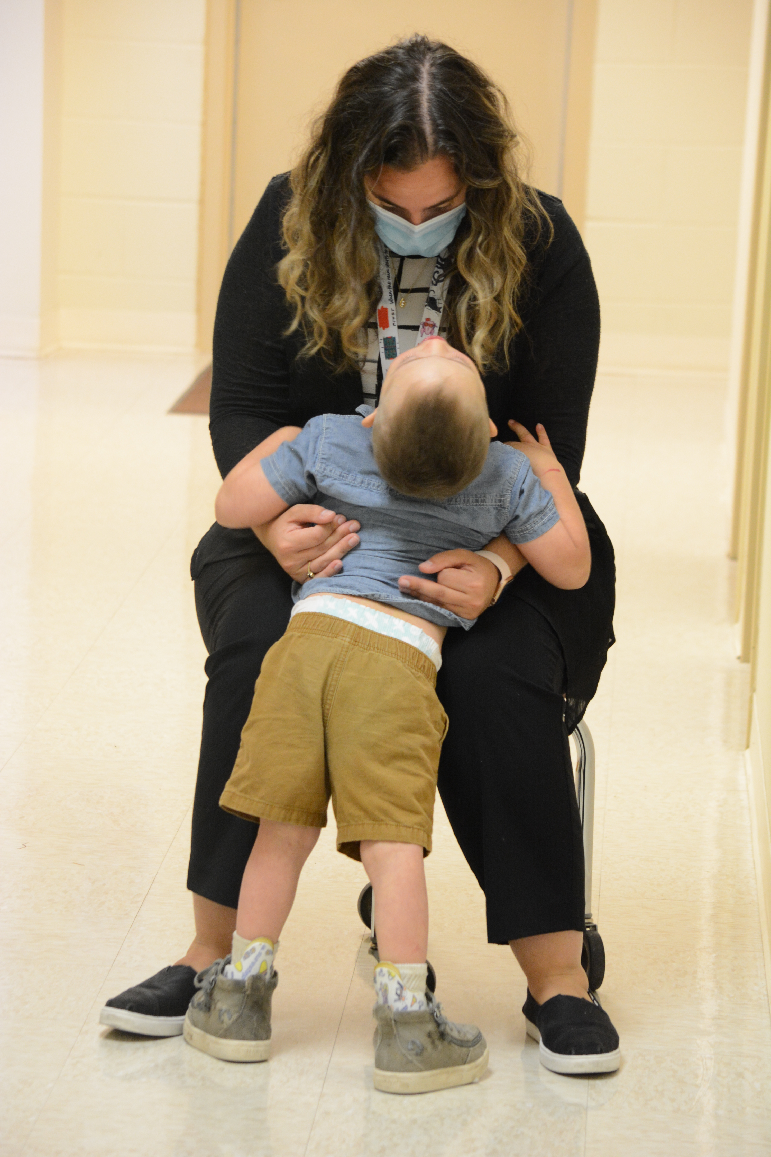
About Easterseals Crossroads
Located in Indianapolis, Indiana
Serving 5,438 individuals through direct service yearly;
250+ employees
Adults and Veterans
  Community Day Supports
  Employment and Transition
Children
  Autism and Behavior Services
  Children’s Outpatient Therapy
  Respite and Camp
Families
  Autism Family Resource Center
  Speech and Hearing Resource Center
  Home Modification Services
  Deaf Community Services
  Assistive Technology Services
Notes:
Another tactic we’re employing to get exposure on national television and radio stations is the distribution of our national brand PSA which, as you can see, in one month was picked up by stations throughout the country and helped us reach nearly 12M people with media value of $330K –
All donated airtime in one month to build awareness of Easterseals – which will continue throughout the year..

Slide 17
Easterseals is Amazing – Show it Off!
Create an outlet to identify potential stories from staff
Keep blogs, newsletters, social posts and updates current and relevant – stories may find you
Keep a library of photos and videos
Promote events and activities
Consider any “show and tell” stories
People want good stories; we have them!
Notes:
Another tactic we’re employing to get exposure on national television and radio stations is the distribution of our national brand PSA which, as you can see, in one month was picked up by stations throughout the country and helped us reach nearly 12M people with media value of $330K –
All donated airtime in one month to build awareness of Easterseals – which will continue throughout the year..

Slide 18
Be Prepared for a Story
Identify staff members in program areas for interviews
Identify program participants, board members, partners who may be able to share their experiences
Have photo releases in place; consider “ambient” photo releases
Identify a staff member who can coordinate, facilitate any media event
If you pass on a story, someone else won’t!
Notes:
Another tactic we’re employing to get exposure on national television and radio stations is the distribution of our national brand PSA which, as you can see, in one month was picked up by stations throughout the country and helped us reach nearly 12M people with media value of $330K –
All donated airtime in one month to build awareness of Easterseals – which will continue throughout the year..

Slide 19
You Got It; Now What?
Provide talking points for interviews
Provide agency info, photos, videos to reporters
Make it easy for the media
Keep media connection for future stories
Share the story after it takes place
Thank everyone
Have a Plan B ready to implement!
Notes:
Another tactic we’re employing to get exposure on national television and radio stations is the distribution of our national brand PSA which, as you can see, in one month was picked up by stations throughout the country and helped us reach nearly 12M people with media value of $330K –
All donated airtime in one month to build awareness of Easterseals – which will continue throughout the year..

Slide 20
Take into Consideration
Explore print editorials; blogs
Connect with local papers and weekly mailers
Participate in speaker series (when appropriate)
Media (TV) stories in 2021 include:
Assistive Technology
Summer Camp
Military and First Responders Day at the Indiana State Fair
Disability Employment Awareness Month
Notes:
Another tactic we’re employing to get exposure on national television and radio stations is the distribution of our national brand PSA which, as you can see, in one month was picked up by stations throughout the country and helped us reach nearly 12M people with media value of $330K –
All donated airtime in one month to build awareness of Easterseals – which will continue throughout the year..

Slide 21
Questions?
Thank You!

