Slide 1

AFFILIATE FUNDING WEBINAR:
University Partnerships
November 17, 2021
Erik Cooke, Senior Director of Grant Research & Development
Tina Nolan, Ed.D, Senior Director of Grant Research & Development
Stephanie Maras, Grants Manager

Slide 2
WHY PARTNER WITH UNIVERSITIES?
Enable focus
Expand Resource Access
Expand Revenue Sources
Reduce Costs
Foster Innovation
Access a market
Find a solution

Slide 3

Project-Based Partnership: Community Based Participatory Research
CBPR program has two aims:
To address the need for improved transdisciplinary and intervention research methods and approaches addressing urgent problems
To strengthen the science of community engagement by designing, conducting, and evaluating interventions with specific population groups
Notes:
SOURCE: http://www.researchandpractice.org

Slide 4
CBPR CHARACTERISTICS:
It’s participatory
It’ cooperative, engaging community members and researchers in a joint process in which BOTH contribute equally
It’s a co-learning process
It involves systems development and local community capacity building
It strikes a balance between research and action

Slide 5
TOOLS: Assessing Partnership Potential
 | Revenue and Profit Potential From Partner
HIGH | EARNING PARTNER | STRATEGIC PARTNER
 | LIMITED PARTNER | LEARNING PARTNER
LOW
 | LOW |  | HIGH
Partner’s Potential to Help You Develop Core Competencies
Notes:
Source: Kosnik & Montgomery (1994) “Managing Across Cultural Alliances: Can Trust Be Achieved in a Polygamous World?”

Slide 6
TOOLS: Assessing Partnership Value
HIGH
 | VALUE TO UNIVERSITY | OPPORTUNISTIC | STRATEGIC
 |  | MISFIT | ORPHAN
 |  | VALUE TO EASTERSEALS
LOW | LOW HIGH
Notes:
Source: Lynda Keele Smith, Stanford Center for Professional Development

Slide 7
Operational Model: Research Practice Partnership
Research-practice partnerships are long-term, mutually beneficial collaborations that promote the production and use of rigorous and relevant research evidence. (W.T. Grant Foundation, n.d.).

Slide 8
Operational Model: Research Practice Partnership
Persist beyond a single project
Foster institutional change
Build capacity
Notes:
Persist beyond a single project: RPP’s are sustained, collaborative relationships between a University and an educational, healthcare, or other public agency. A mutually beneficial arrangement, RPP’s connect researchers with on-the-ground practitioners. Researchers benefit from this arrangement in a variety of ways, not the least of which is continued research that both informs practice and uses it to spur research agenda from practitioner data. Non-profit organizations benefit from research outcomes which may inform practice and increase their ability to provide effective services aligned with the latest scientific evidence.
Pursue a joint research agenda: Easterseals and the IDHD will collaborate to define a research agenda where each partner role is clearly defined, the area(s) of research are identified, and the scope of research projects are mutually agreed upon.
Foster Institutional Change at the University
Benefits to the University partner can include:
Research infrastructure support changes
Sustained research funds for institutes or centers
Community-engaged research
Build skills to write policy-related briefs
Integration into University strategic plans
Teaching releases
Contributions to promotion and tenure for new faculty
Collaborations across University system campuses to expand institutional change
Positive public relations associated with partnering with a thought leader in nonprofit
Develop Research Capacity of Easterseals
Benefits to Easterseals include:
Build research skills
Sustained research funds for Easterseals
Research in real time
Integration into Easterseals strategic plan
Build skills to write policy-related briefs
Improved data collection
Research-informed decision making
Positive public relations associated with partnering with an academic institution known for research

Slide 9
Research Practice Partnership Types
Design Research
Networked Improvement Communities
Research Alliance
Hybrid
Notes:
Design Research Partnerships are collaborative efforts to design studies, often an iterative series, to investigate innovations in programs and/or services.
Networked Improvement Communities seek to establish collaborations among researchers, practitioners, and designers organized around a shared problem of practice (Bryk, Gomez, Grunow, & LeMahieu, 2015). The network commits to using shared tools and methods of improvement science to test new practices, gather data, and share what is learned across the network. The goal is to systematically investigate how promising practices are adapted to be effective in a variety of contexts.
Research Alliances typically have a focus on helping organizations to use data and research to improve outcomes for audiences served. For example, the Institute for Education Studies funded 10 regional educational laboratories across the country to work in partnership with educators and policymakers to conduct applied research and trainings with a mission of supporting a more evidence-based education system.
Hybrid approaches may combine these types of RPPs. As we gain more experience in developing and evaluating RPPs, we might expect an evolution in their approaches. For example, what starts out as a design research partnership may evolve into a networked improvement community.
Henrick, E., Muñoz, M. A., & Cobb, P. (2016). A better research-practice partnership. The Phi Delta Kappan, 98(3), 23–27. http://www.jstor.org/stable/24893574
Morris, Z. S., Bullock, A., & Atwell, C. (2013). Developing engagement, linkage and exchange between health services managers and researchers: Experience from the UK. Journal of Health Services Research & Policy, 18, 23–29. http://www.jstor.org/stable/26751397
Rogoff, B., Callanan, M., Gutiérrez, K. D., & Erickson, F. (2016). The Organization of Informal Learning. Review of Research in Education, 40, 356–401. http://www.jstor.org/stable/44668627
Thompson, K. D., Martinez, M. I., Clinton, C., & Díaz, G. (2017). Considering Interest and Action: Analyzing Types of Questions Explored by Researcher-Practitioner Partnerships. Educational Researcher, 46(8), 464–473. http://www.jstor.org/stable/44971879
William T. Grant Foundation. (n.d.). Research-Practice Partnerships. https://rpp.wtgrantfoundation.org/

Slide 10
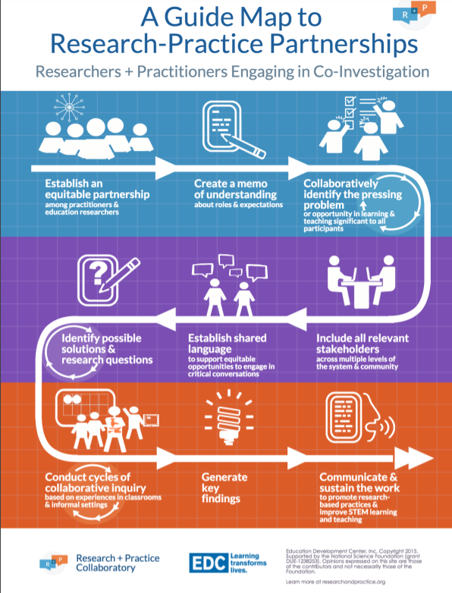
Notes:
http://researchandpractice.org/resource/guide-map-for-partnerships/

Slide 11
THANK YOU
Erik Cooke, ecooke@easterseals.com
Tina Nolan, tnolan@easterseals.com
Stephanie Maras, smaras@easterseals.com

