Slide 1

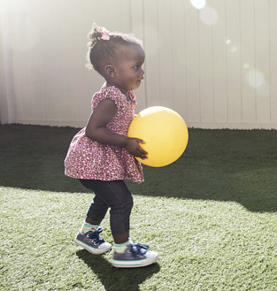
Easterseals Training Series:
Social Media Analytics
October 13, 2021
Questions? ygreen@easterseals.com
Notes:
For Discussion Today:
The Landscape of our Network
Highlights of what we’ve been up to lately (Corporate Partnerships, All In: The Plan for Disability Equity; Network Advancement; Thought Leadership; Advocacy)
Lessons from the Past & A Look Ahead (to the Strategic Plan)
PLEASE SIGN UP FOR OUR BI-WEEKLY NEWSLETTERS
Invite a volunteer to serve on our National Board Standing Committees

Slide 2
Overview of KPIs
Notes:
September 25, 2020 Symposium Goals & Participation
The Easterseals Network Public Policy Symposium goals:
Discuss, debate, and agree on top public policy priorities for the next Congress
Discuss, debate, and agree on a recommendation for the Easterseals’ official position on mandatory immunizations
Discuss, debate and agree on a recommendation for the Easterseals’ official position on 14[c]
What We Recommend – Mandatory Immunizations
Easterseals National supports a policy of mandatory, evidence-based immunizations with the affiliate network being given flexibility to establish their own position consistent with state laws.
What We Recommend – Subminimum Wage (14(c))
Easterseals National position should be:
(1) Easterseals National recognizes the contribution 14(c) made;
(2) Easterseals National supports transitioning away from subminimum wage programs with the right infrastructure supports needed to secure a success.

Slide 3

Engagement
The total number of actions users took on a page or post (likes, shares, comments).
Why is it important? It shows that people care about the content/brand/mission enough to react to it in some way.
Metrics:
Validation (likes, favorites)
Sharing (or retweeting/reposting)
Conversation (replies/@mentions)
Notes:
Another tactic we’re employing to get exposure on national television and radio stations is the distribution of our national brand PSA which, as you can see, in one month was picked up by stations throughout the country and helped us reach nearly 12M people with media value of $330K –
All donated airtime in one month to build awareness of Easterseals – which will continue throughout the year..

Slide 4

Reach
General:
The number of people that have seen your post/page.
Why is it important? This tells you how far your message is traveling.
Fan Reach:
The number of people ONLY within your follower/fan network that has seen your post.
Why is it important? You want to engage the people who made the choice to join your community as much as possible – they are your most valued audience and are the most likely to interact and share with your content. If your fan reach is low, your content isn’t getting to your core audience.
Notes:
Another tactic we’re employing to get exposure on national television and radio stations is the distribution of our national brand PSA which, as you can see, in one month was picked up by stations throughout the country and helped us reach nearly 12M people with media value of $330K –
All donated airtime in one month to build awareness of Easterseals – which will continue throughout the year..

Slide 5


Impressions
The number of times your post/page was displayed on someone’s feed.
Why is it important? The more impressions you have, the more your content is being seen.
Metrics:
Organic Reach/Impressions
Viral Reach/Impressions
Paid Reach/Impressions
Notes:
Another tactic we’re employing to get exposure on national television and radio stations is the distribution of our national brand PSA which, as you can see, in one month was picked up by stations throughout the country and helped us reach nearly 12M people with media value of $330K –
All donated airtime in one month to build awareness of Easterseals – which will continue throughout the year..

Slide 6
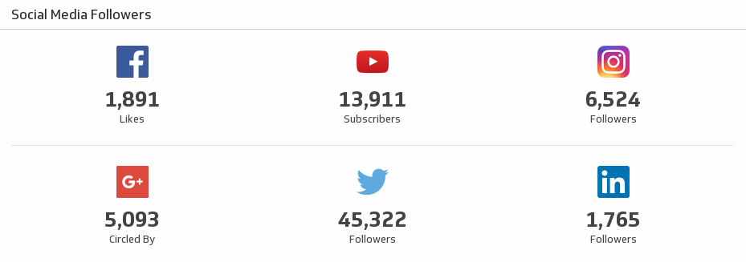
Fans/Follower Growth
The total amount of followers gained over a period of time.
Notes:
Another tactic we’re employing to get exposure on national television and radio stations is the distribution of our national brand PSA which, as you can see, in one month was picked up by stations throughout the country and helped us reach nearly 12M people with media value of $330K –
All donated airtime in one month to build awareness of Easterseals – which will continue throughout the year..

Slide 7
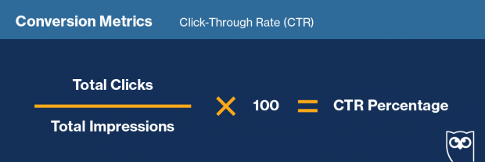
Click Throughs /
Page Traffic
The number of times users have visited your page.
Notes:
Another tactic we’re employing to get exposure on national television and radio stations is the distribution of our national brand PSA which, as you can see, in one month was picked up by stations throughout the country and helped us reach nearly 12M people with media value of $330K –
All donated airtime in one month to build awareness of Easterseals – which will continue throughout the year..

Slide 8

Ads
Impressions
Click Throughs
Engagement
Cost Per X (CPC/CPR/CPA): Showing you how much you are spending to land each result or conversion.
Return on Ad Spend: Measures the amount of revenue earned for every dollar spent on advertising.
Notes:
Another tactic we’re employing to get exposure on national television and radio stations is the distribution of our national brand PSA which, as you can see, in one month was picked up by stations throughout the country and helped us reach nearly 12M people with media value of $330K –
All donated airtime in one month to build awareness of Easterseals – which will continue throughout the year..

Slide 9
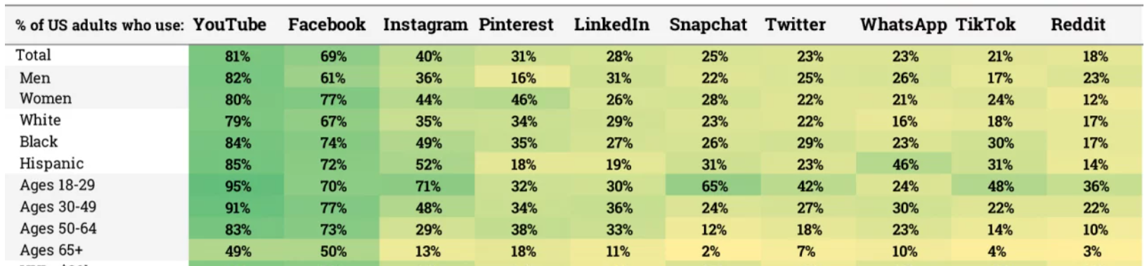
Other Metrics
Negative feedback
Best times to post
Demographics
Notes:
Another tactic we’re employing to get exposure on national television and radio stations is the distribution of our national brand PSA which, as you can see, in one month was picked up by stations throughout the country and helped us reach nearly 12M people with media value of $330K –
All donated airtime in one month to build awareness of Easterseals – which will continue throughout the year..

Slide 10
FAQs of Social Media Analytics
Notes:
September 25, 2020 Symposium Goals & Participation
The Easterseals Network Public Policy Symposium goals:
Discuss, debate, and agree on top public policy priorities for the next Congress
Discuss, debate, and agree on a recommendation for the Easterseals’ official position on mandatory immunizations
Discuss, debate and agree on a recommendation for the Easterseals’ official position on 14[c]
What We Recommend – Mandatory Immunizations
Easterseals National supports a policy of mandatory, evidence-based immunizations with the affiliate network being given flexibility to establish their own position consistent with state laws.
What We Recommend – Subminimum Wage (14(c))
Easterseals National position should be:
(1) Easterseals National recognizes the contribution 14(c) made;
(2) Easterseals National supports transitioning away from subminimum wage programs with the right infrastructure supports needed to secure a success.

Slide 11
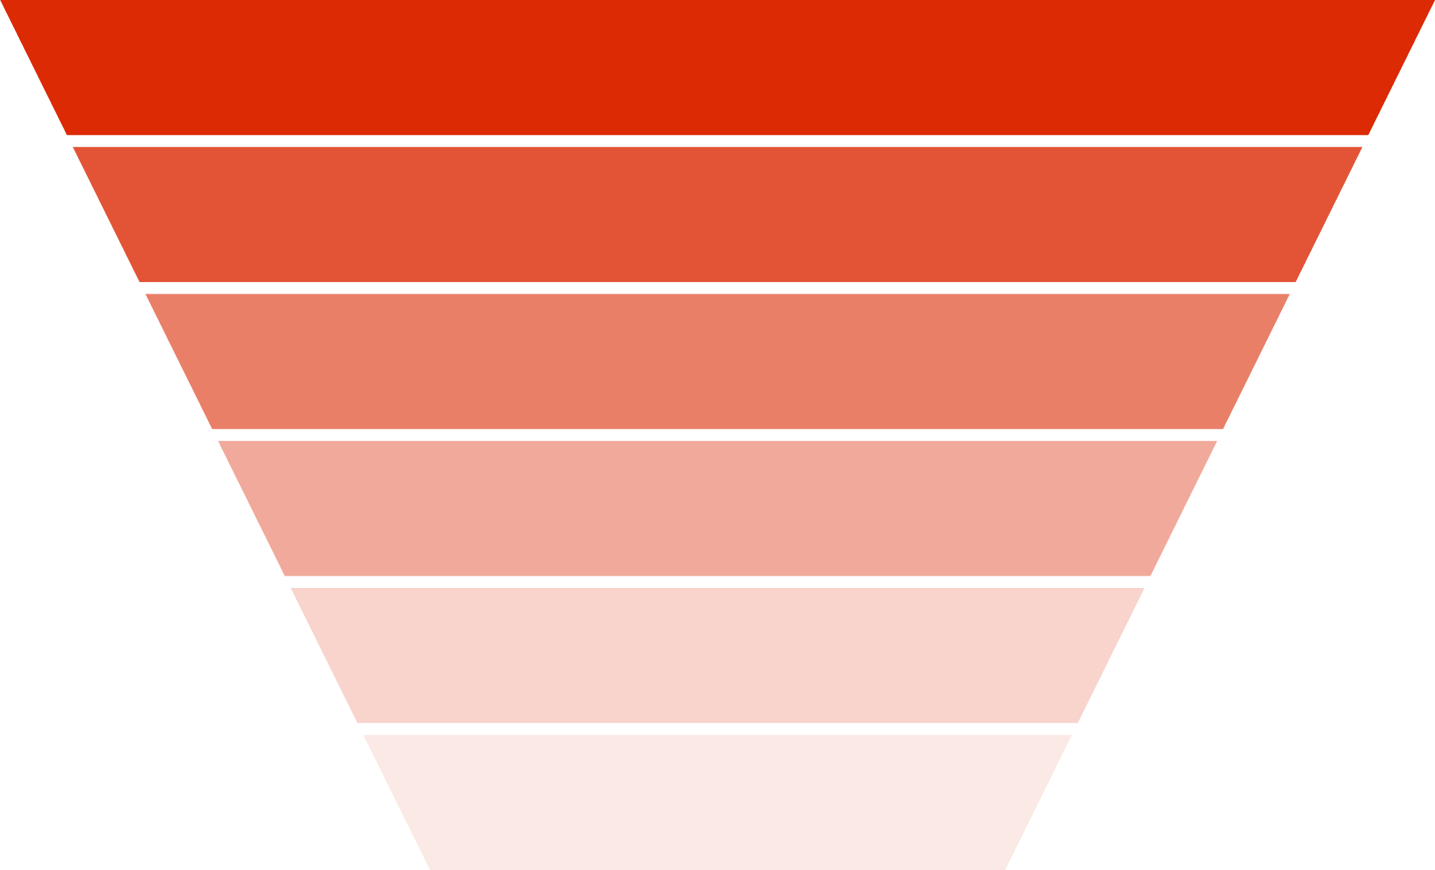
How do I determine which metrics to track?
Societal Context
Awareness
What are your organizational goals?
What does your marketing funnel look like?
What are your strong points/weak points?
Familiarity
Consideration
Choice
Loyalty
Recommendation
Notes:
Another tactic we’re employing to get exposure on national television and radio stations is the distribution of our national brand PSA which, as you can see, in one month was picked up by stations throughout the country and helped us reach nearly 12M people with media value of $330K –
All donated airtime in one month to build awareness of Easterseals – which will continue throughout the year..

Slide 12
How do I use data to optimize my content/posts?
Notice large swings/dips in data
1
Determine what content can be attributed to changes in that data
2
Analyze best performing and lowest performing posts
3
Test imagery and language
4
Notes:
Another tactic we’re employing to get exposure on national television and radio stations is the distribution of our national brand PSA which, as you can see, in one month was picked up by stations throughout the country and helped us reach nearly 12M people with media value of $330K –
All donated airtime in one month to build awareness of Easterseals – which will continue throughout the year..

Slide 13
How do I know if my content is doing well?
Benchmarking
Baseline patterns
Gradual improvement
Notes:
Another tactic we’re employing to get exposure on national television and radio stations is the distribution of our national brand PSA which, as you can see, in one month was picked up by stations throughout the country and helped us reach nearly 12M people with media value of $330K –
All donated airtime in one month to build awareness of Easterseals – which will continue throughout the year..

Slide 14
Were do I find metrics on my platforms?
Facebook: Click on “Insights” on the top bar navigation of the page that you manage
Instagram: “Insights” button on page profile
Twitter: https://analytics.twitter.com/
LinkedIn: The “Analytics” tab under admin view
Notes:
Another tactic we’re employing to get exposure on national television and radio stations is the distribution of our national brand PSA which, as you can see, in one month was picked up by stations throughout the country and helped us reach nearly 12M people with media value of $330K –
All donated airtime in one month to build awareness of Easterseals – which will continue throughout the year..

Slide 15
Resources / Learn More
Social Media Benchmarking:
https://www.rivaliq.com/blog/social-media-industry-benchmark-report/
https://www.socialstatus.io/insights/social-media-benchmarks/
How to Use Social Media Analytics to Reach Your Audience: https://www.falcon.io/insights-hub/how-to/elementary-guide/social-media-analytics/
Complete Guide to Social Media Analytics: https://www.meltwater.com/en/blog/social-media-analytics
Notes:
Another tactic we’re employing to get exposure on national television and radio stations is the distribution of our national brand PSA which, as you can see, in one month was picked up by stations throughout the country and helped us reach nearly 12M people with media value of $330K –
All donated airtime in one month to build awareness of Easterseals – which will continue throughout the year..

Slide 16
Thank You!

