Slide 1
MissionWired + Easterseals
Facebook Training

Slide 2
Overview
Acquisition Strategy Overview
Choose a platform
Draft and design creative
Define campaign goals
Choose audiences
Monitor and optimize results
Notes:
Hilary

Slide 3
Overview
Why Facebook?
For paid acquisition, Facebook is the most effective and efficient platform for digital growth
Facebook allows for precise targeting and engaging creative which can be optimized to maximize return on investment
Facebook is often the most cost-effective source for acquiring new names and drives immediate results
Notes:
Hilary

Slide 4
Overview
List Health and Growth
Investing in targeted acquisition is vital to the health and growth of a digital program
Growing the email list allows us to reach more people, which means more gifts to each email and more revenue
Notes:
Hilary

Slide 5
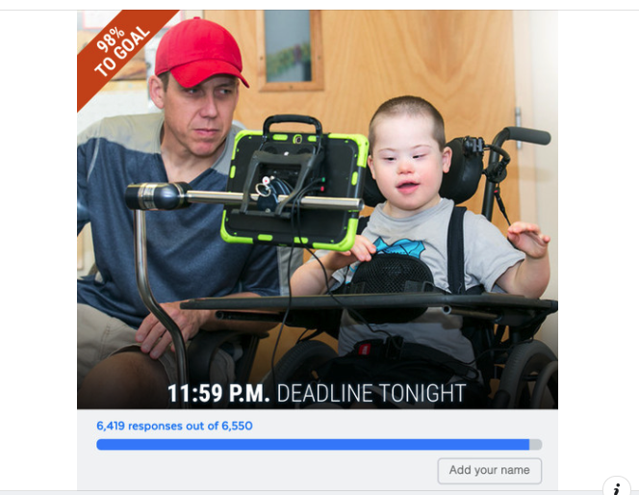
Overview
Acquisition Creative
Anatomy of Facebook Ads
Body Copy
Headlines
Link Description
Graphic
Goals of creative
Stop Scrolling
Succinct Copy
Establish Urgency
Clear CTA
BODY
GRAPHIC
HEADLINE
LINK DESCRIPTION
Notes:
Genevieve

Slide 6
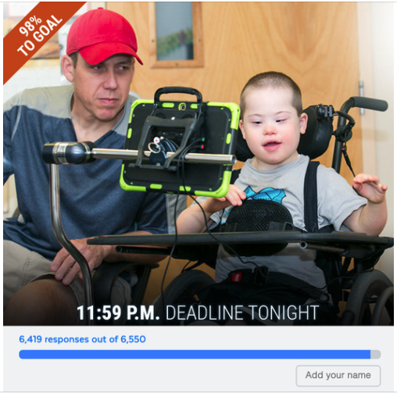
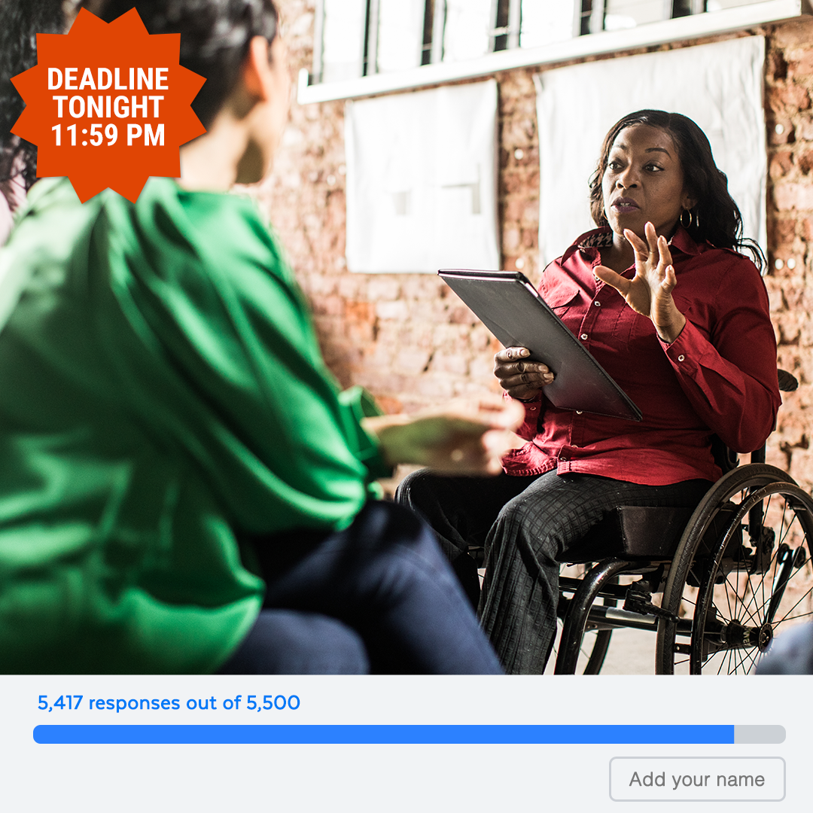
Overview
Graphic Examples
Notes:
Genevieve

Slide 7
Facebook Training
Campaign Goals
Notes:
Aaron

Slide 8
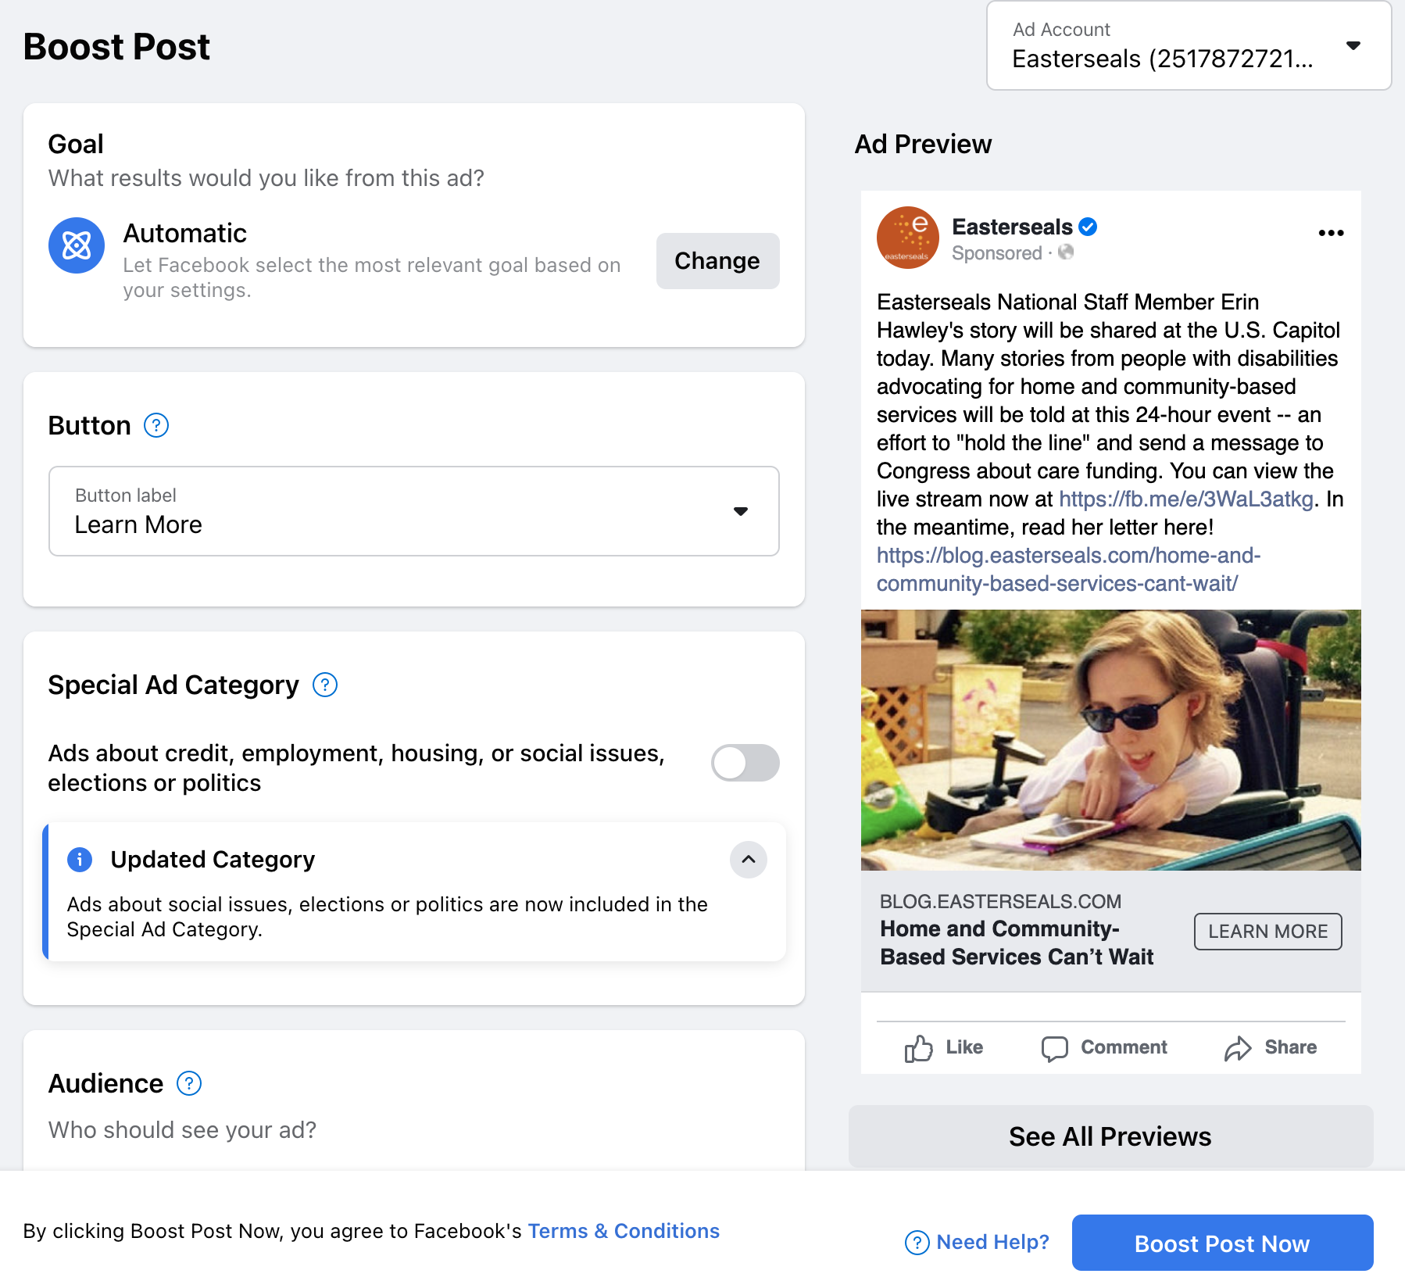
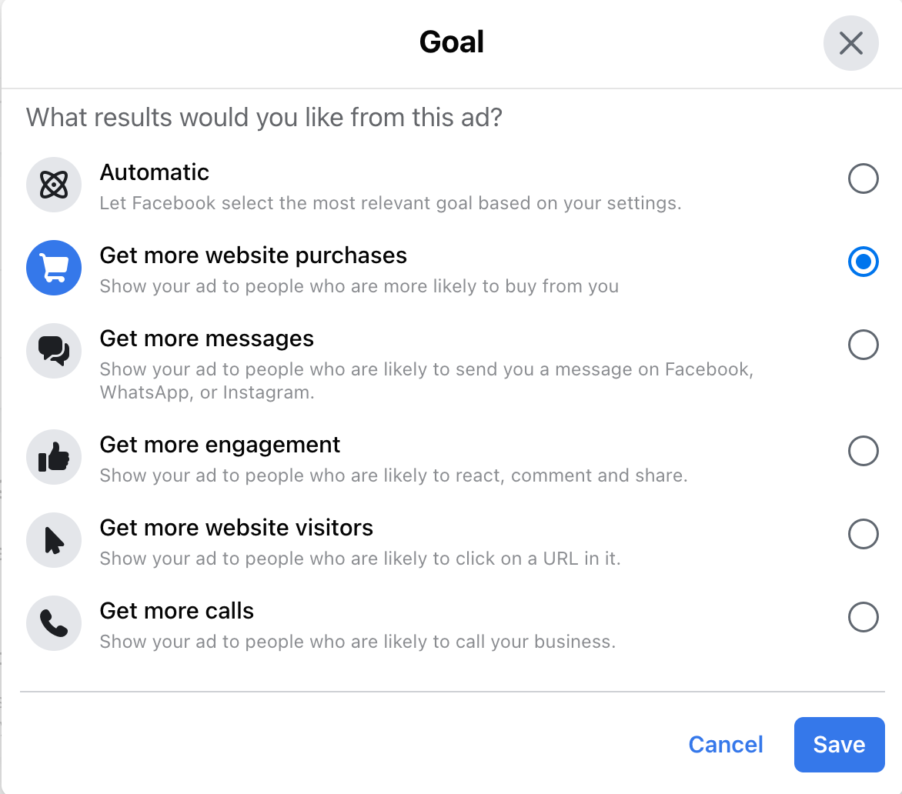
Campaign Goals
Boosted Posts
Notes:
Aaron

Slide 9
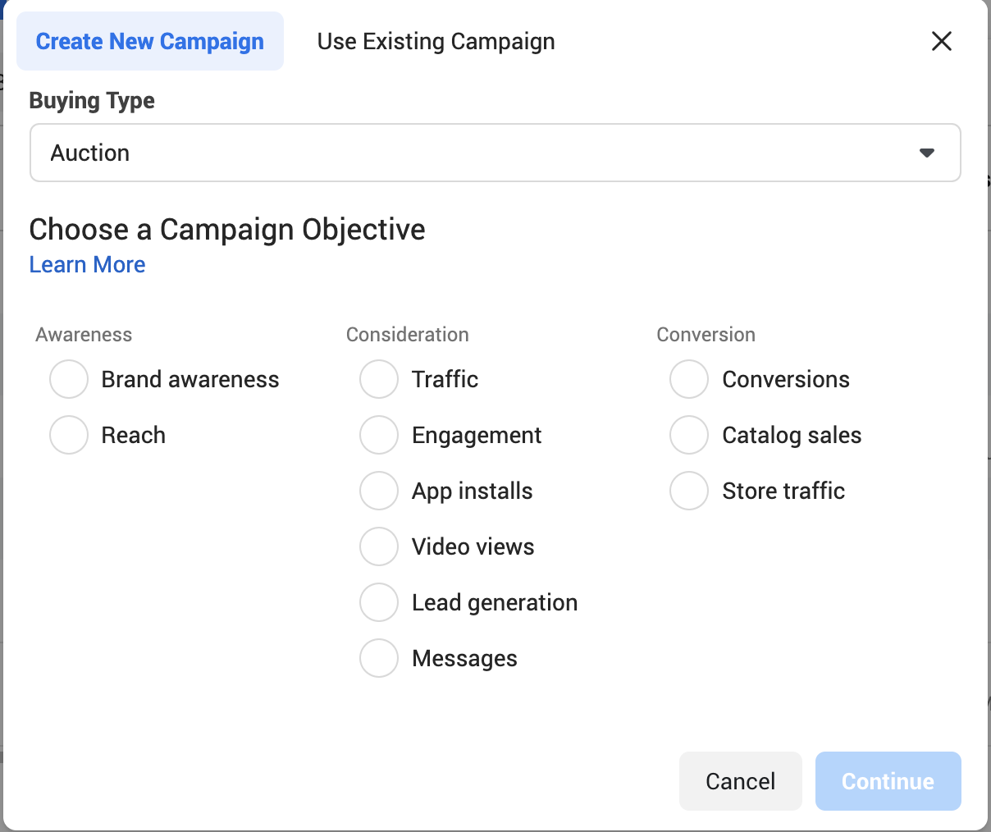
Campaign Goals
Ad Objectives on Facebook
Notes:
Aaron

Slide 10
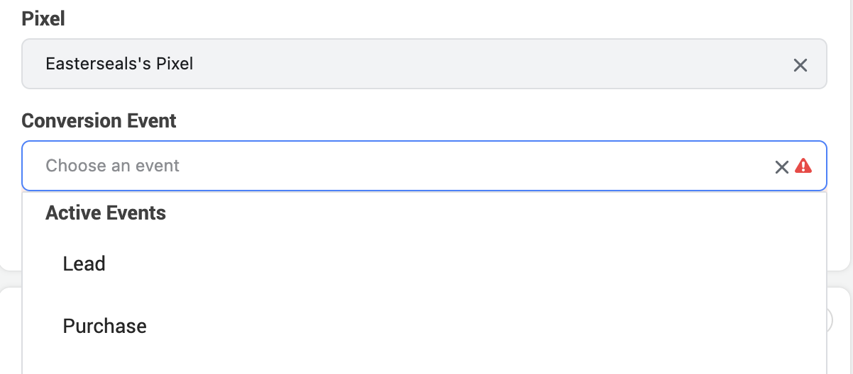
Campaign Goals
Lead vs. Purchase Optimization
When doing lead generation, optimizing for the Purchase event will have a higher CPA, but higher immediate and long-term ROAS.
Notes:
Aaron

Slide 11
Facebook Training
Basics
Notes:
Aaron

Slide 12
Facebook Basics
Pixels
Allows Facebook to optimize toward lower funnel goals (leads/donations)
Let’s you see results at a glance within Ads Manager*
*Apple now allows iOS users to opt out of tracking, which makes pixel tracking less reliable
Use CRM data to determine most accurate results
Submit a support ticket for help setting up a pixel
Notes:
Aaron

Slide 13
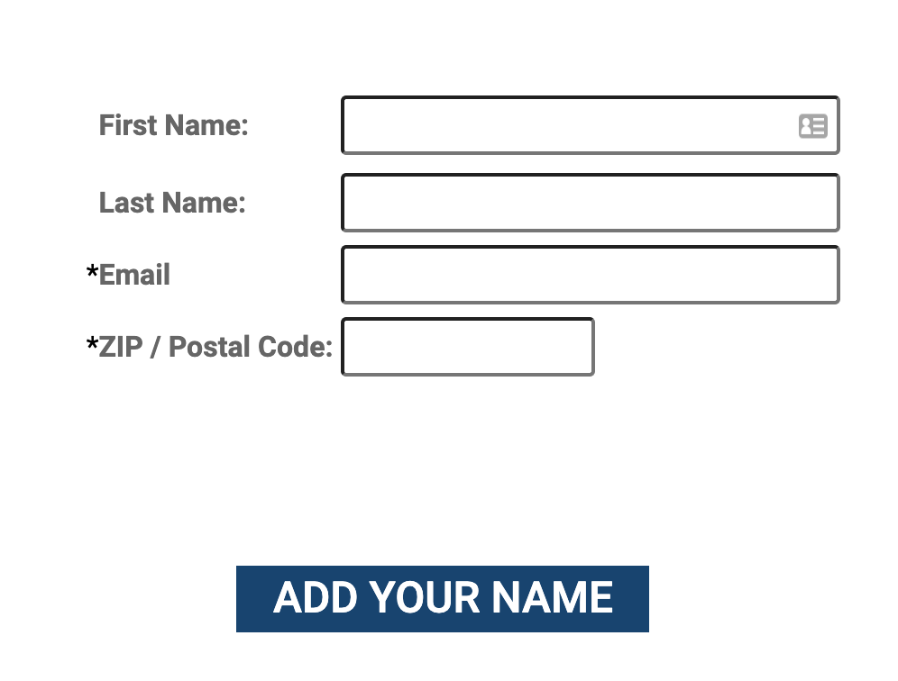
Facebook Basics
Landing Pages
Optimize for mobile
Minimize number of form fields
Notes:
Aaron

Slide 14
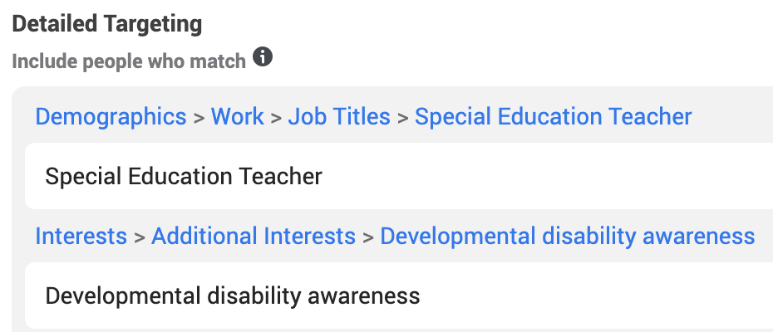
Facebook Basics
Audiences
Tie audiences to goals
Don’t microtarget
Most common audiences
Page engagers
Lookalike
Interest-based
Broad (age only)
Notes:
Aaron

Slide 15
Facebook Basics
KPIs + Benchmarks
Top KPIs
CPA - Cost Per Acquisition ($ Spent / # of Leads)
$5-8 with purchase optimization
$1.5-3 with lead optimization
Immediate ROAS - Immediate Return on Ad Spend ($ Raised / $ Spent)
10-20% with purchase optimization
0-5% with lead optimization
Other KPIs
Upsell Rate (# of Gifts/# of Leads)
4-6% with purchase optimization
0-1% with lead optimization
Conversion Rate (# Leads / Clicks)
30-50%
CTR - Click Through Rate (# Clicks/Impressions)
0.1-5%
CPC - Cost Per Click
$2-5

Slide 16
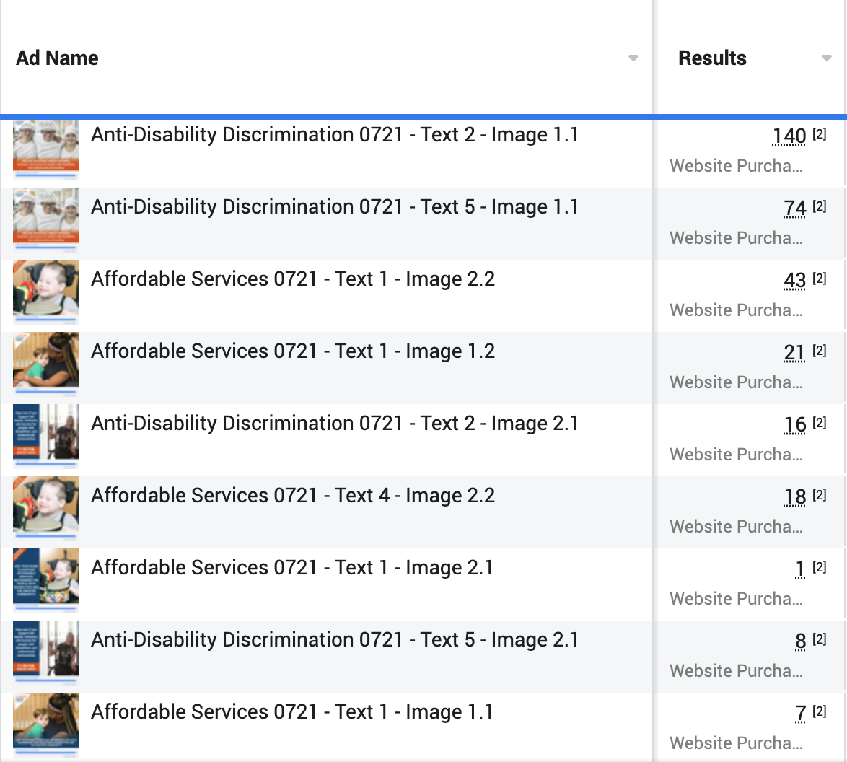
Facebook Basics
Monitoring & Optimizing Results
Launch ad versions strategically
Facebook Ads Manager & CRM
Amount spent/number of results usually correlates to performance
Watch for trends across weeks, not day-by-day results
Iterate on what’s working best
Notes:
Aaron

Slide 17
Thank You!
Questions?

