Slide 1

Easterseals National Impact Statements

Slide 2
Better Together Impact Measurement Framework – Draft in Progress
Notes:
-share who was on my committee

Slide 3
Why Measure Impact?
Impact statements demonstrate how our work makes a difference in the lives of people, communities, and the environment. Documenting the results of our efforts is increasingly expected by funders and stakeholders. Easterseals Affiliates agreed that aligning on impact is our anchor for change. Impact reporting is important because it:
Helps us reflect on and improve our work
Demonstrates the difference we make in people's lives, communities, and the environment
Improves visibility of programs (local, state, national)
Generates support
Helps us focus on issues, initiatives, and program themes
Builds a greater understanding of our programs by the public
Illustrates our accountability
Notes:
Donna – To give you some context, as part of our Network Better Together Strategic Plan imperatives it was decided that we need to demonstrate the impact of our work has on the lives of the people we serve and together, collect and report on those impacts. The goal was to start small. Affinity group members, program leaders and CEO’s worked on an impact measurement framework for three service lines; early childhood programs, workforce development programs and adult services

Slide 4

Impact Measurement Framework
We will measure impact together in the areas of Early Childhood Programs, Workforce Development Services and Adult Services.
The framework:
  Is inspired by our Mission
  Emphasizes our impact – WHY we do what we do
  Focuses on select nationally recognized data points in use at Easterseals
  Aligns with the Social Determinants of Health
Notes:
Donna – Although Easterseals Affiliates are known for meeting the program needs in their specific communities, we identified three areas that Easterseals is most known for.

Slide 5
Impact Statement Formula Step 1
Describe the issues or problems
A clear description of the issue or problem that you’re your organization would like to address.
Statistics related to the Issue
.
Notes:
Donna
(Donna, note that the Leadership Team had some good discussion about first bullet point under #3, looking for a bit more clarity on this Better Off statement in terms of the time frame, i.e. at the end of year 1 of what? 1 year of intervention services? Also the statement may be stronger if it includes the word “demonstrated”, i.e. Children who have demonstrated progress in achieving developmental milestones…”)

Slide 6
Impact Statement Formula Step 2
What does Easterseals do to address the issues or problems?
What Services do you provide?
  Screening?
  Evaluations?
  Treatment or intervention
  Training and Education
  Case management and coordination

Slide 7
Impact Statement Formula Step 3
Describe the Results Impact Statement –How are participants and their families better off?
  Impact Statement: Easterseals changed the ___________ path of XXX number of participants
  What happened to the audience as a result of the work described?
  What knowledge was gained?
  What skills were increased?
  What practices/behavior changed?
  How many people changed?
Notes:
Donna
(Donna, note that the Leadership Team had some good discussion about first bullet point under #3, looking for a bit more clarity on this Better Off statement in terms of the time frame, i.e. at the end of year 1 of what? 1 year of intervention services? Also the statement may be stronger if it includes the word “demonstrated”, i.e. Children who have demonstrated progress in achieving developmental milestones…”)

Slide 8
Impact Statement Formula - Step 4
Selecting Domains and Better Off Statements
Early Childhood Programs
Parents/Caregivers
Health and Nutrition
Intervention
Work Readiness
Competitive Employment
Quality of Life Advancement
Physical Health
Wellness (including caregivers)
Community engagement/integration
Workforce Development Services
Adult Services
Notes:
Marcy
Ad hoc work groups from the service lines developed domains as a starting point and then developed potential measures, recognizing that each Affiliate may use different tools, but could report the outcome.

Slide 9
Next Steps
We will review the three service lines:
  Early Childhood
  Workforce Development
  Adult Services
Polling - After each service line we will do a quick poll to see which measures under each domain have the most support
Wrap up – Our panel will take your questions.
Notes:
Marcy
Share names of Affiliate staff who are participating in the work groups

Slide 10
Easterseals National Impact Statements – Early Childhood Programs
Notes:
-share who was on my committee

Slide 11
Early Childhood
There is an urgent and substantial need to identify as early as possible children in need of services to ensure that intervention is provided when the developing brain is most capable of change.
High-quality early intervention programs for vulnerable children can reduce the incidence of future problems in their learning, behavior and health status.

Slide 12
Head Start and the expansion of state-funded programs since the 1990s have greatly increased access to preschool.
Many children, especially 3 year olds, continue to be left out, exacerbating socioeconomic differences in educational achievement.
High quality pre-Kindergarten programs for 3 – 4 year olds can improve school readiness with the greatest gains accruing to the highest-risk children.

Slide 13
Early Childhood Statistics
More children are in need of services than are currently being served.
  In 2009, Part C served almost 350,000 children nationally (2.7% of the general population of children birth – 3.
  Research indicates that as many as 13% of children birth – 3 have delays that would make them eligible according to criteria commonly used by the states.
There is a need to serve children earlier.
  Research has shown that at 9 months of age only 9% of children who have delays that would make them eligible for services actually receive services.
  At 24 months of age only 12% of children who would be eligible receive services.

Slide 14
Early Childhood Statistics Continued
Only 30% of children under the age of 6 received a standardized developmental screening.
Research suggests there are racial disparities in the receipt of EI services.
  Of children who would be eligible to receive services at 24 months of age, black children are up to 5 times less likely to receive services than white children.
52% of children ages 3 – 4 years old are not enrolled in school, including nursery school, preschool or kindergarten.
59% of children living below 200% of poverty are not in school.

Slide 15
Key Elements provided by Easterseals
Developmental Screenings
Physicals
Mental Health Screenings
High-quality Early Childhood Education (ECE) Programs
Early Intervention (EI) Services
Early Childhood Mental Health Services
Parent Training and Education
Case Management

Slide 16
Impact Statement
Easterseals changed the developmental path of _XXX_ number of children through early identification and treatment.

Slide 17
Better Off Statements
Number of families demonstrating increased knowledge of their child’s development
Number of participants who received needed resources or services (e.g. Healthcare needs, safe and stable housing)
Number of parents who reported improved relationships with their child
Parents/Families

Slide 18
Better Off Statements Continued
Number of children who receive intervention services after referral
Number of children transitioning into Kindergarten in a least restrictive environment or classroom
Number of children who achieve treatment/educational goals annually
Intervention

Slide 19
Better Off Statements Continued
Number of children receiving free and nutritious meals over the course of a year
Number of children current on physicals, screenings, and immunizations based on the EPSDT Periodicity schedule
Health and Nutrition

Slide 20
Examples of How an Affiliate Might Measure Whether or Not a Family is “Better Off”
Parents and Families
  Ex. 1 Number of families that have participated in parent training and/or advocacy training with our Behavioralist
  Ex. 2 Number of families/clients our Pediatric Navigator has successfully connected with an identified needed resource or service
  Ex. 3 Number or parents participating in PLAY Project who have reported positive relational changes after completing the program

Slide 21
Examples Continued
Intervention
  Ex. 1 Number of children in our Autism Diagnostic Center who have started center based therapy after diagnosis
  Ex. 2 Number of children graduating from our Charter Preschool entering Kindergarten
  Ex. 3 Number of children in our Early Steps/Early Intervention program who have achieved developmental goals while in the program

Slide 22
Examples Continued
Health and Nutrition
  Ex. 1 Number of children in our Early Childhood Education Centers who have received free and reduced meals during the past year
  Ex. 2 Number of children in our Early Childhood Education Centers who have completed the Ages and Stages Questionairre (ASQ)

Slide 23
Examples of different ways affiliates may define these metrics
Domains | Metric | Affiliate A | Affiliate B
Parents and Families | #/% of participants who received needed resources or services (e.g. Healthcare needs, safe and stable housing) | Number of families/clients our Pediatric Navigator successfully connected with an identified needed resource or service | Number of families that were referred in to our Affiliate from an outside entity for services needed
Intervention | #/% of participants who achieve treatment/educational goals annually | Number of children graduating from our Charter Preschool and entering Kindergarten in the least restrictive environment possible | Number of children in our Early Steps/Early Intervention program who have achieved their developmental goals while in the program
Health and Nutrition | #/% of participants receiving free and nutritious meals | Number of children in our Early Childhood Education Centers who have received free and reduced meals during the past year | Number of children in our Early Childhood Education Centers who have participated in the feeding program “Provision Packs” for evening and weekend meals

Slide 24
Early Childhood
Thank you for participating in the webinar and for your input in the survey.

Slide 25
Easterseals National Impact Statements – Adult Services
Notes:
-share who was on my committee

Slide 26
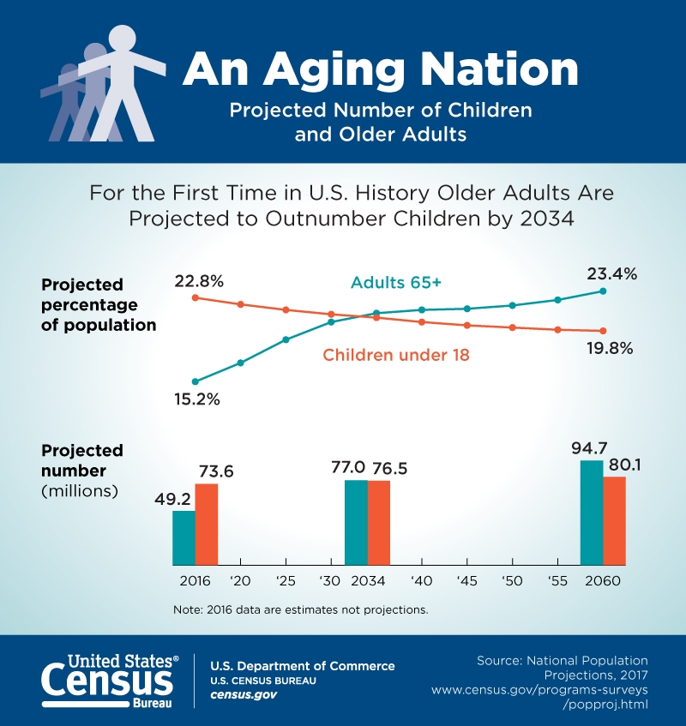
Describe the Need # 1 - Seniors comprise the nation’s fastest-growing population

Slide 27

Describe the Need #2 - High correlation between social isolation and health risks.
More than one-third of adults aged 45 and older feel lonely, and nearly one-fourth of adults aged 65 and older are considered to be socially isolated (NASEM)
Social isolation was associated with about a 50% increased risk of dementia and other
serious medical conditions.

Slide 28
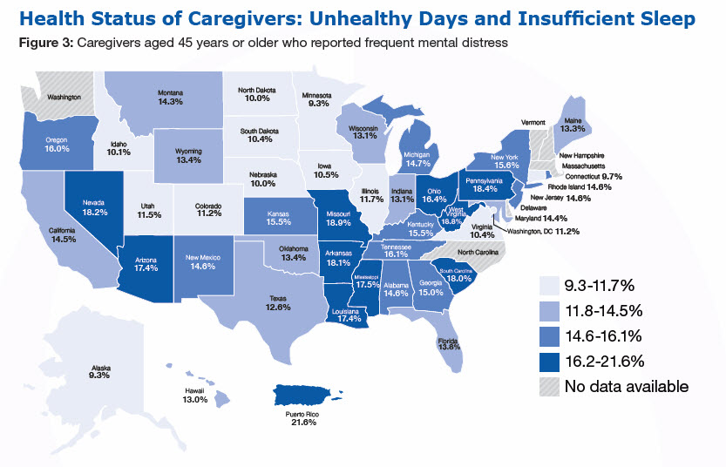
Describe the Need # 3- Caregiving and Impacts to Well-being
Notes:
#4 :Individuals with IDD are living longer, experiencing changes in their health status, receiving age-related diagnoses like dementia, and in need of a supportive environment as they age
#5: Need for a cost-effective solution to care for a greying population. According to Genworth Cost of Care Survey, ADS continues to be the most cost-effective option compared to other long-term care options - in-home care and nursing homes – across all states. (https://www.genworth.com/aging-and-you/finances/cost-of-care.html)

Slide 29
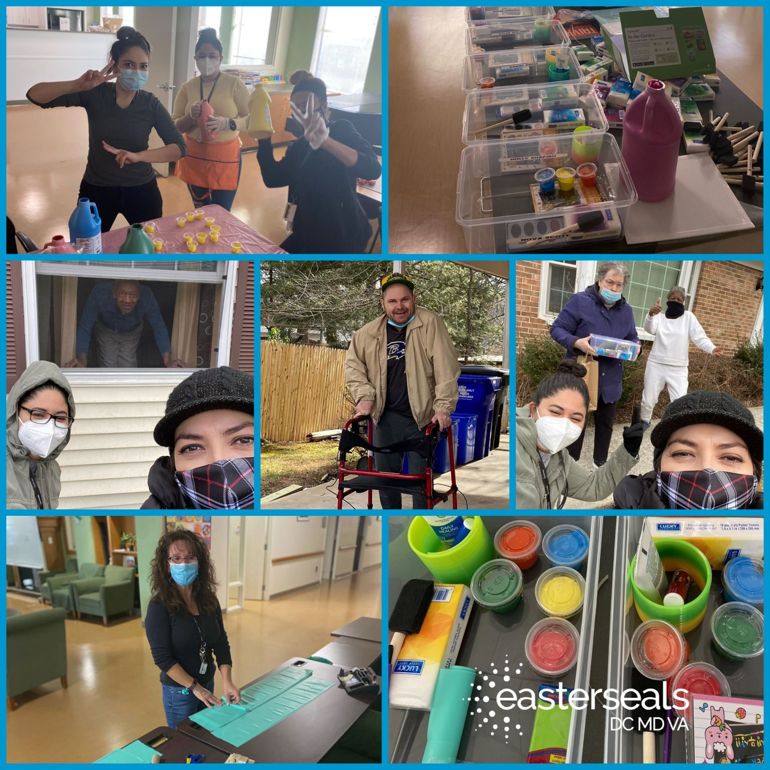
What do we do to address these needs?
  Health services
  Case management - including person-centered care plans
  Assist with mobility, personal care, eating, and ADL
  Provide rehabilitation therapy (PT, OT, Speech)
  Nutritious meals and snacks; special diets available
  Monthly activities with diversified programming
  Assistive technology, including remote services (daily phone calls, virtual activities)
  Community engagement and field trips every month (including food-shopping)
  Transportation
  Health education, information counseling, and caregiver support
  Staff training

Slide 30
Impact Statement – Adult Services
Impact statements demonstrate how our work makes a difference in the lives of people, communities, and the environment.
Easterseals has improved the health and well-being of XXX seniors and adults with disabilities/chronic illnesses who are living at home or in their communities.

Slide 31
Adult Services Impact Statement: 3 Primary Domains
Health and Well-being of Seniors and Adults with disabilities /chronic illnesses
Community Engagement/Integration
Physical Health
Wellness (including caregivers)

Slide 32
Adult Services Impact Statement – Metrics
*Definition of each metric and how you measure can be tailored to leverage existing program measures
*These will be ranked via the survey
Physical Health
1)#/% of Participants maintain wellness/delay rate of decline in physical functioning
2) #/% of Participants that access (medical/health/therapeutic) resources in their communities with the help of ADS services
Notes:
- Include different ways we define and measure

Slide 33
Adult Services Impact Statement – Metrics
*Definition of each metric and how you measure can be tailored to leverage existing program measures
* These will be ranked via the survey
2) #/% of Caregivers feel more in control of life and less stressed, and able to enjoy recreational, stress-relieving activities, and focus on oneself
1) #/% of Participants see an increase in social contact, social activities and a decrease in social isolation and feelings of depression and loneliness
Wellness
Notes:
- Include different ways we define and measure

Slide 34
Adult Services Impact Statement – Metrics
*Definition of each metric and how you measure can be tailored to leverage existing program measures
*These will be ranked via the survey
Community Engagement
1) #/% of Participants are integrated and socially connected into their communities
2) #/% of Participants engage in activities of their choice in their communities
3) #/% of Participants that access resources in their communities
Notes:
- Include different ways we define and measure

Slide 35
Examples of different ways affiliates may define these metrics
Domains | Metric | Affiliate A | Affiliate B
Physical Health | #/% of Participants maintain wellness/delay rate of decline in physical functioning | Annual Survey As a result of attending Easterseals ADS the participant has: …has visited the Emergency Room less than before. …been admitted to the hospital less than before. …fallen less than before. | Annual Survey As a result of attending Easterseals ADS the participant has: …experienced improved mental health (reduced confusion, agitation or hallucinations)
Wellness | #/% of Participants see an increase in social contact, social activities and a decrease in social isolation and feelings of depression and loneliness | Preplacement and annual survey: How often do you feel lonely? How often do you feel sad? | Annual Survey: There are multiple opportunities in a day to socialize with my peer group
Community Engagement/Integration | #/% of Participants are integrated and socially connected into their communities | Participants who participate in field trips and outings Participants who participate in virtual activities | Annual Survey: Various outings into the community are offered As a result of attending Easterseals ADS the participant has…felt more connected to their community.

Slide 36
EASTERSEALS NATIONAL IMPACT STATEMENTS: workforce development programs

Slide 37
Workforce Development Programs
1.Describe the issue or problem
It is urgent that individuals with disabilities and veterans receive support to successfully engage in meaningful employment.
There are many individuals who have significant barriers to employment. (alternative option)

Slide 38
Workforce Development Programs
only 29 % of adults with disabilities are gainfully employed, compared to 71% of able-bodied individuals
People with disabilities live in poverty (22.5%) at nearly three times the rate of people without disabilities (8.4%)
Underemployment affects more veteran job seekers than non-veteran job seekers. Nearly one-third of veteran job seekers are underemployed -- a rate 15.6% higher than non-veteran job seekers
Youth who do not complete high school are 3 times more at risk of living in poverty
It is urgent that individuals with disabilities and veterans receive support to successfully engage in meaningful employment.
2. STATISTICS RELATED TO THE ISSUE…………

Slide 39
Workforce Development Programs
3. What does Easterseals do to address that It is urgent that individuals with disabilities and veterans receive support to successfully engage in meaningful employment?

Slide 40
Workforce Development Programs
Individualized Job Development
Work Experience Programs
Job coaching
Case Management
Assessments
Peer Mentoring
Linkage to community resources/cross referrals
Supportive Services
Mental Health Screening and services
Job Placement
Certifications and Training (soft and hard skills)

Slide 41
Workforce Development Programs
IMPACT STATEMENT:
Easterseals has improved the quality of life of XXX individuals who have significant barriers to employment.

Slide 42
Workforce Development Programs
Workforce Development Programs improve the quality of life of individuals who have significant barriers to employment through…
Work Readiness
Competitive Employment
Quality of Life/advancement

Slide 43
WORKFORCE DEVELOPMENT PROGRAMS
# and % who successfully complete work preparation training
  Successfully complete
  Work preparation training
# and %who complete a skills assessment
  Complete
  Skills assessment
# and % who engage in work experience/transitional employment
  Engage
  Work experience
  Transitional employment
WORK READINESS
These will be ranked via the survey

Slide 44
WORKFORCE DEVELOPMENT PROGRAMS
# and % securing a job at minimum wage or above
  Securing a job
  Minimum wage
# and % obtain full time employment
  Full time employment
# and % of people who retain employment
  Retain employment
Competitive Employment
These will be ranked via the survey

Slide 45
WORKFORCE DEVELOPMENT PROGRAMS
# and % who reach financial self-sufficiency with living wage and health benefits
  Financial self-sufficiency
  Living wage
  Health benefits
# and % of participant who earn a credential of value
  Credential of value
# and % who receive promotions or increase wages
  Promotions
  Increase wages
Quality of Life/Advancement
These will be ranked via the survey

Slide 46
Examples of different ways affiliates may define these metrics
Domains | Metric | Veterans | Youth | Individuals w/disabilities
Work Readiness | # and % who successfully complete work preparation training Successfully complete Work preparation training | Veterans who finish assessment for work engagement | Youth who complete a summer work program | Individuals with disabilities enrolled in Pre-ETS
Competitive Employment | # and % obtain full time employment Full time employment | Veterans who obtain employment at 32+ hours per week | Youth who obtain employment at 32 hours per week | Individuals with disabilities who obtain employment at 32 hours per week.
Quality of Life/Advancement | # and % of participant who earn a credential of value Credential of value | Veterans who earn a credential in Peer Mentoring | Youth who complete the National Career Readiness Credential at a Bronze Level or above | Individuals with disabilities who obtain a ServSafe credential

