Slide 1

HVRP Funding
An overview of upcoming HVRP funding in 2021 for the Easterseals network.
Prepared by:
Erik Cooke, National Office
Grant Development and Research
February, 2021

Slide 2
Table of Contents
      This deck provides a general overview of the HVRP program to help Easterseals affiliates review, plan, and prepare winning proposals for success in securing HVRP grants.
page
page
page
page
page
3
8
13
25
29
HVRP Program Overview
Opportunity for Easterseals affiliates
RFP Run-through
Resources for Proposal Success
Easterseals’ HVRP Presences

Slide 3
HVRP
Program Overview
What is HVRP?
Comprehensive Services
Performance Standards and Inclusion
Service Models and Family Support
Selected Statistics for Program Year 2018

Slide 4
What is
HVRP?
      HVRP is the only federal program that focuses exclusively on the employment of veterans who are experiencing homelessness.
      Since 1987, HVRP has aimed to provide services to assist in reintegrating homeless veterans into meaningful employment within the labor force and to stimulate the development of effective service delivery systems that will address the complex problems facing homeless veterans.
      The program is administered by the U.S. Department of Labor Veterans’ Employment and Training Service (DOL-VETS).
      Grants are awarded by DOL to workforce investment boards, local public agencies, for-profit /commercial organizations, and non-profits.
      HVRP programs provide services that support veteran reintegration and employment opportunity:
      Outreach
      Assessment and Intake
      Job-Driven Training and Employment
      Follow-Up Services
    Learn more
    Office of HVRP: https://www.dol.gov/vets/programs/hvrp
    Statutory Authority - The 2001 Homeless Veterans Comprehensive Assistance Act: https://www.congress.gov/107/plaws/publ95/PLAW-107publ95.pdf
Since 1987, veterans and their families have received comprehensive services through the Department of Labor (DOL) to increase their employment opportunities..

Slide 5
Program
Specifics
      HVRP serves homeless veterans and their families. Depending on the type of HVRP program your affiliate may implement, the target beneficiary may be women with families and/or incarcerated veterans.
    HVRP qualifies an individual as homeless veteran if he/she meets one of the following definitions:
        A person who lacks a fixed, regular, and adequate nighttime residence
        A person living in a supervised public or privately operated
        Family engagement in transitions
        Family connections to peers and community, and
        Families as advocates and leaders.
Commonly referred to as HVRP, this funding opportunity from the DOL includes three distinct populations:
Homeless Veterans’ Reintegration Program (HVRP)
Incarcerated Veterans Transition Program (IVTP)
Homeless Female Veterans with Families Program (HFVVWF)
If your affiliate wishes to apply to any of the above programs, you will go through the HVRP RFP posted on grants.gov.

Slide 6
Comprehensive Services
    More than employment support
        Housing
        Career development
        Health services
        Transportation services
        Social services
        Connections and linkages to other providers and services
    Learn more
        HVRP Employment Assistance Guide for Service Providers: http://www.nchv.org/images/uploads/EAG_1-10.pdf
      HVRP programs take a case management approach to providing comprehensive “employment focused” services that directly assist homeless veterans as well as provide critical linkages for a variety of supportive services available in their local communities.
      These include job placement, training, development, career counseling and resume preparation.

Slide 7
Selected Statistics
(Program Year 2019)
    Grantees
        $48.1 million awarded to grantees
        149 grant recipients
        63.2% placement rate
        $15.18 average hourly wage
        Awards range from $100,000 - $500,000 in size
    Veterans and Families
        HVRP served about 18,000 veterans reintegrate into the workforce in 2019
        HVRP was available for veterans in 40 states across the U.S.

Slide 8
Affiliate Opportunity
Timing
Funding Opportunities
Strategy

Slide 9
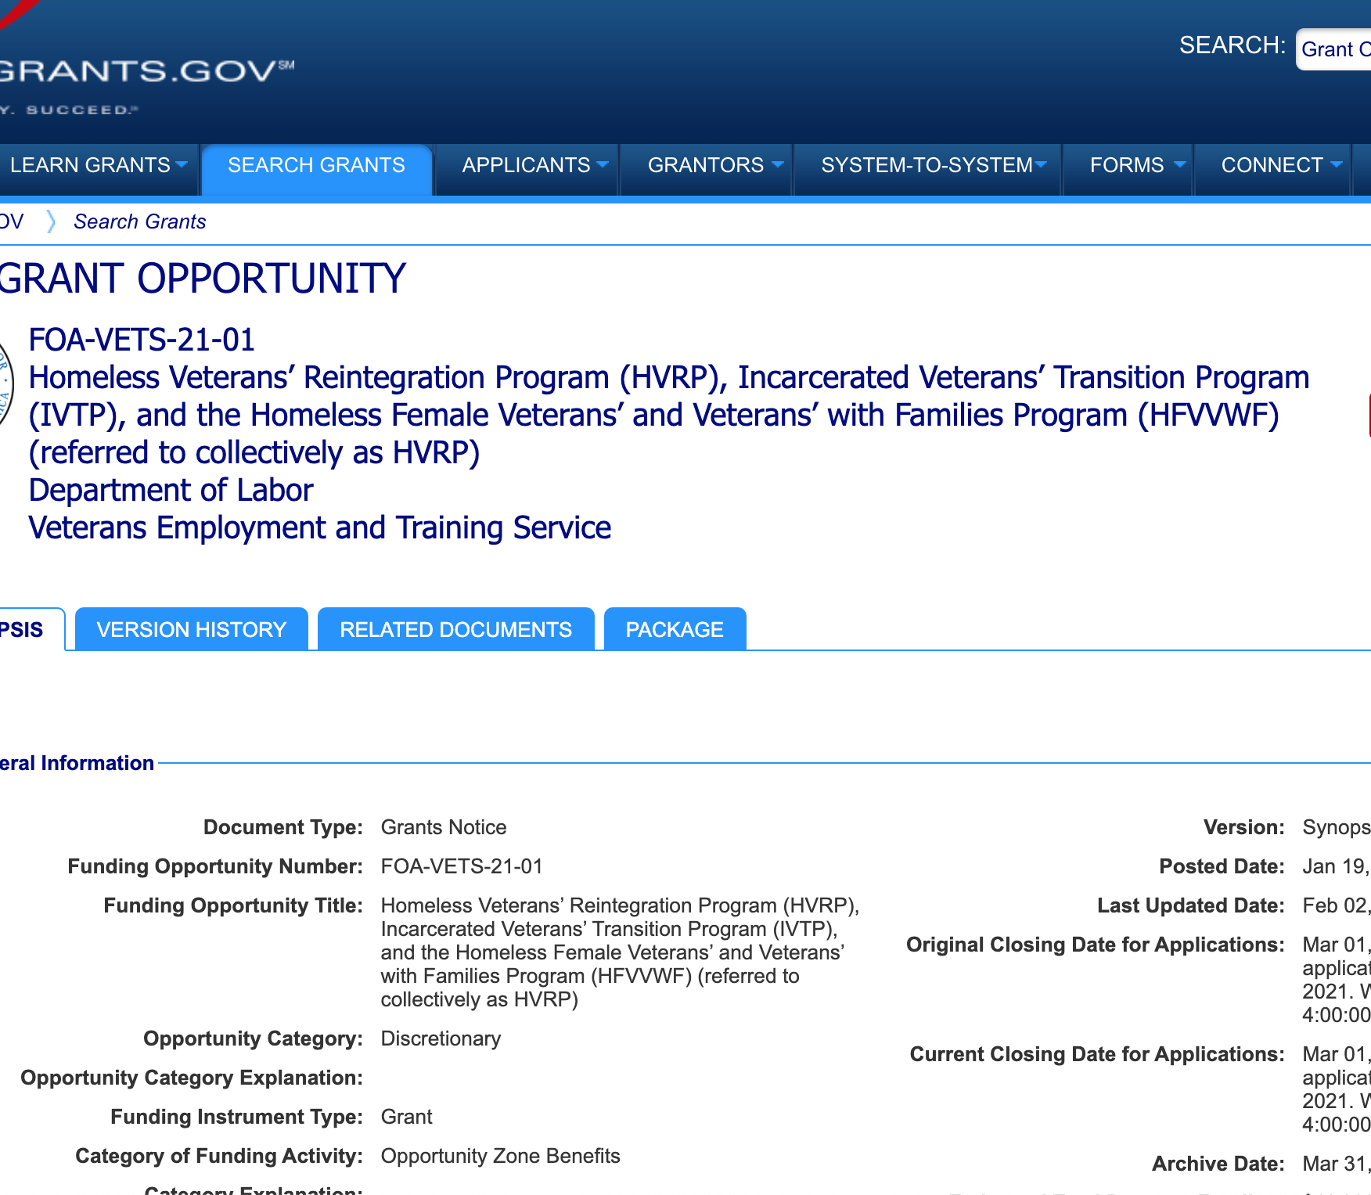
Timing & Funding Opportunities
      HVRP and included funding opportunities have a rhythm. Grants are funded for one year.
      Timeline
        January 19, 2021 - RFP released on http://www.grants.gov/
        March 01, 2021– Applications due via Grants.gov
        July 01, 2021 – Implementation start date
        Grant Period: three years, pending congressional funding approvals

Slide 10
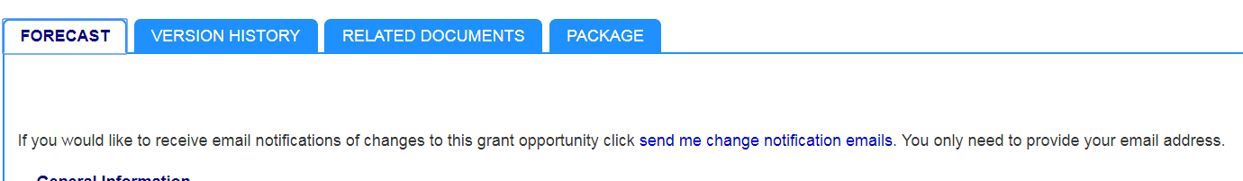
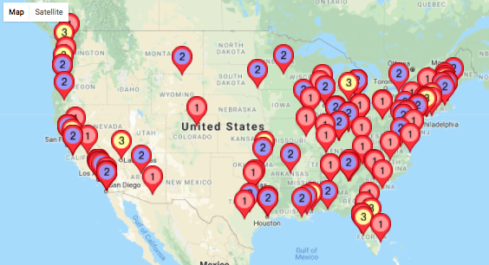
Strategy
      So, what can you do right now to get ready? Glad you asked. A useful feature of HVRP funding is its regularity and structure. You can (and, if interested, should) begin working on your grant development plan today.
      1) Track the RFP. Locate the RFP on Grants.gov (FOA-VETS-21-01) and click on “send me change notification emails” to receive any updates to the opportunity.
      2) Learn more about the current providers. Use the NVTAC Grantee Locator at https://www.nvtac.org/grants/, to find current grantees and to learn about their sites and to retrieve reports on their service profile and demographics.

Slide 11
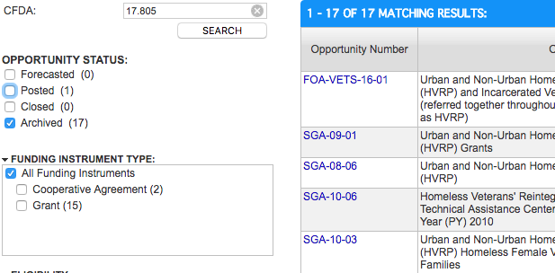
Strategy
      3) Review past RFPs and, if possible, sample proposals. HVRP requirements are highly standardized, and RFPs generally change only slightly from year to year, based mostly on the funding availability and service targets for particular geographies. You can find past RFPs on Grants.gov by searching for “closed” or “archived” opportunities using CFDA #17.805. The requirements and structure in these RFPs should give you a strong start to structure your proposal.
      4) Be on the look-out for partners. Not convinced that writing a proposal for a new HVRP grant is for you? Take a look at partner organizations and agencies that might be open to a partnership or a subcontract.

Slide 12
Strategy
      5) Get familiar with the National Veterans Technical Assistance Center (NVTAC). HVRP supports a main technical assistance center to support grantees in every aspect of service delivery, compliance, best practices, and more. NVTAC is an essential resource for building out winning proposals and implementing top notch programs.
      Learn More
      HVRP Technical Assistance Network (NVTAC): https://www.nvtac.org/
      NVTAC 30-day Checklist:
      https://www.nvtac.org/wp-content/uploads/2017/07/30-Day-HVRP-Checklist-V-2.pdf

Slide 13
RFP Run-through
Key Requirements
Proposal Components
Forms, Assurances, and Certifications
Budgeting
Review Criteria
Formatting Checklist
Automatic Disqualifications

Slide 14
Key
Requirements
    In order to meet the needs of those veterans experiencing homelessness, grant recipients are expected to provide an array of client-focused services utilizing a case management approach that directly assists homeless veterans as well as provide critical linkages for a variety of support services available in their local communities.
    Cost matching
      This program does not require cost matching or sharing. Applicants that include such funds in the application will not receive additional consideration during the review process.
      Identification of Program Population Categories
      Applicants must identify whether their program will prioritize HVRP, IVTP, or HFVVWF. If applicants fail to explicitly identify in the abstract that you intend for an application to be reviewed under the HFVVWF or the IVTP priorities, then the application will be reviewed under the HVRP priority.
Start your review of HVRP requirements now by studying previous RFPs or meeting with grantees..

Slide 15
Proposal Components
      There are four distinct parts to the application that must be included in response to the FOA:
    First File – SF-424 “Application for Federal Assistance”
    http://apply07.grants.gov/apply/forms/sample/SF424_2_1-V2.1.pdf.
    Second File – Project Budget
      This includes the SF-424A Budget Information Form as well as the Budget Narrative. This will include financial statements and audit reports.
    Third File – Project Narrative
      This must demonstrate your capability to implement the grant project in accordance with the provisions of the FOA.
      Fourth File – Attachments to the Project Narrative
Application Requirement | Instructions
The deadline submission met | Section IV.C
Eligibility | Section III.A
Components of the application are saved in any of the specified formats and are not corrupt. | Section IV.C.2
Does not exceed the one-year ceiling amount of $500,000 | Section II.A
SAM Registration | Section IV.B.1
SF-424, Application for Federal Assistance | Section IV.B.1
SF-424 includes a DUNS Number | Section IV.B.1
SF-424A, Budget Information Form | Section IV.B.2
Budget Narrative (one year) | Section IV.B.3
Project Narrative | Section IV.B.3
A letter of support from a State Workforce Agency or a local American Job Center | Section IV.B.4
Abstract (included as an attachment) | Section IV.B.4
Completed VETS-700 Summary of Proposed Goals | Section IV.B.4

Slide 16
Forms,
Assurances, and Certifications
SF-424 - Application for Federal Assistance
SF-424A – Budget Information
DUNS number and SAM.gov registration
SF-424 Key Contact Form
Project/Performance Site Locations
SF-LLL - Disclosure of Lobbying Activities
Certification Regarding Lobbying (Grants.gov Lobbying Form)
Assurance: Absence of Non-compete Agreement
Certificate of Good Standing
Proof of Policy Council Approval
SF forms are included in the Grants.gov application package
DUNS number and SAM.gov are separate registrations
RFPs usually contain templates for assurances

Slide 17
File 1:
SF-424
The SF-424 must clearly identify the applicant and must be signed by an individual with authority to enter into a grant agreement. Upon confirmation of an award, the individual signing the SF-424 on behalf of the applicant is considered the Authorized Representative of the applicant.
Requirement for DUNS Number
All applicants for federal grants must have a DUNS number and supply their number in the SF-424. Grant recipients authorized to make subawards must notify potential subawardees that no entity may receive a subaward from you unless the entity has provided its DUNS number
Requirement for Registration with SAM
Applicants must maintain an active SAM registration before applying for funding from HVRP.

Slide 18
File 2:
Project Budget
Project Budget: complete the SF-424 Budget Information Form, available at, http://apply07.grants.gov/apply/forms/sample/SF424A-V1.0.pdf
Budget Narrative:
The budget narrative must provide a description of costs associated with each line item on the SF-424A. It should also include a description of leveraged resources provided (as applicable) to support grant activities.
Budget calculations must include estimation methods, quantities, unit costs, and other similar quantitative detail sufficient for the calculation to be duplicated. Cost share/match sources must be identified on the SF-424 and SF-424A
    Supplies vs. Equipment
      Generally, ”equipment" means an article of nonexpendable, tangible property with a cost of at least $5,000. ”Supplies” refer to tangible property other than that included under Equipment, such as office and other supplies with a per-unit cost of less than $5,000.
    Budget Categories
      Personnel
      Fringe Benefits
      Travel
      Equipment
      Supplies
      Contractual
      Construction
      Other Costs
      Indirect Costs

Slide 19
File 3:
Project Narrative
This section provides a comprehensive framework and description of all aspects of the proposed project. It must be succinct, self-explanatory, and well organized so that reviewers can understand the proposed project.
Project Narrative Sections:
Statement of Need
Expected Outcomes and Outputs
Project Design
Organizational, Administrative, and Fiscal Capacity
Past Performance – Programmatic Capability
Budget and Budget Narrative
The suggested page limit for these combined documents is 15 double-spaced, single-sided pages.
The font must be Times New Roman 12 point and 1 in margins. The Narrative must start with page number 1.

Slide 20
File 4:
Attachments to the Project Narrative
In addition to the Project Narrative, you must submit attachments. All attachments must be clearly labeled as Attachments.
Required Attachments:
Abstract – up to two pages summarizing the proposed project.
Intent to Work Collaboratively Statement – a statement that confirms your intent to work collaboratively with the DOL and its contractor(s) on potential evaluation efforts related to veterans.
Competitive Grants Planned Goals Chart – chart included in FOA.
Requested Attachments:
Indirect Cost Rate Agreement
Project/Performance Site Location(s) Form
Organizational Chart and Qualifications
There is no page limit on these appendices
These files will be submitted in the Third File.

Slide 21
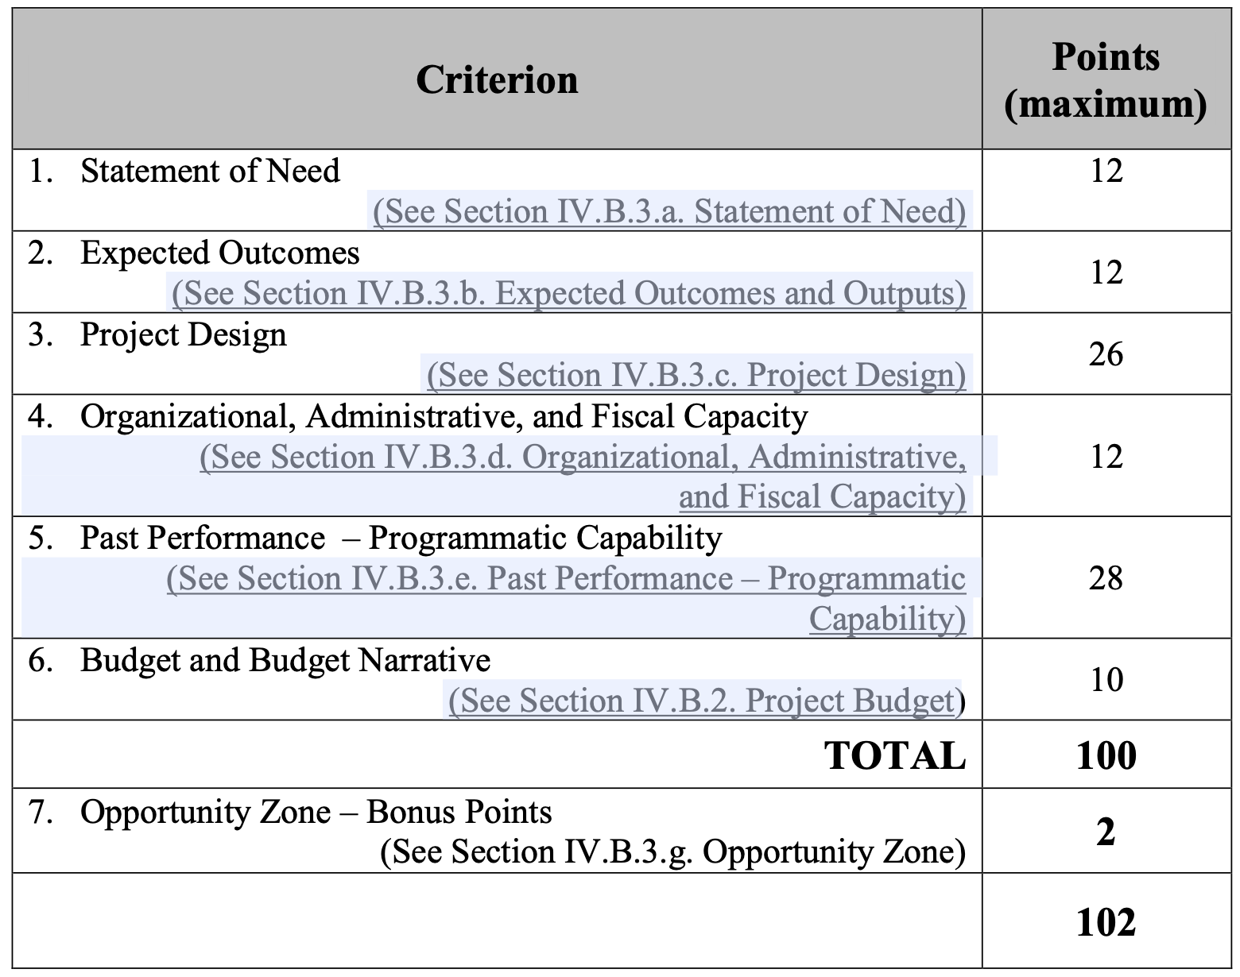
Review Process
Criteria
    Review Process
      The review Criteria is designed to objectively select qualified applicants based on technical merit.
      These criteria are based on the policy goals, priorities, and emphases set forth in the FOA.

Slide 22
Review Process
Review & Selection
    Section 1: Merit Review and Selection Process
      The final calculated scores of each application will serve as the primary basis for selection applications for funding. The panel results are advisory and are not binding on the Grant Officer. The Grant Officer reserves the right to make selections based solely on the final scores or to take into consideration other relevant factors.
      Section 2: Risk Review Process
      Prior to making an award, ETA will review information available though any OMB-designated repository of government-wide eligibility qualification or financial integrity information. The risk evaluation may incorporate results of the evaluation of the applicant’s eligibility (application screening) or the quality of its application (merit review).
    Review & Selection
      The review process includes a technical merit review panel that evaluates applications against the selection criteria.

Slide 23
Formatting
Checklist
      1) Clear language, acronyms identified
      2) Font and Spacing: All narrative documents must be in Times New Roman, 12-point font. Footnotes may be 10-point. Narrative documents must be double-spaced, with the exception of the Project Summary/Abstract, Table of Contents, and Budget and Budget Justification may be single-spaced. Numerical budget tables included in the narrative may be single-spaced.
      3) Appendices: Documents submitted in the Appendices must be readable. If the font size is not readable, all unreadable pages will be removed from the application and will not be reviewed.
      4) Page Limits: 15 pages total for most of the narrative documents. Some additional attachments (financials and audit reports) are not subject to the 15-page limit.
There are usually extensive file formatting requirements in HVRP FOA, including file names. Please refer to the actual RFP for the most current guidance.

Slide 24
Automatic Disqualifications
      If your application hits any of these thresholds, it will assuredly be disqualified.
      1) Ineligible entities: Applications from individuals and foreign entities
      2) Budgets exceeding award ceiling: Applications that request an award amount exceeding the Award Ceiling per budget or project period will be disqualified from competitive review. Inclusion of start-up/pre-award costs in the application is not subject to this criterion.
      3) Applications not submitted on time through Grants.gov. Please ensure that you are registered on Grants.gov well in advance of the deadline and plan to submit your application at least 3 days before the deadline.
      4) Non-responsiveness: If your application does not properly or adequately respond to the requirements in the RFP, it will be disqualified.

Slide 25
Resources for Proposal Success

Slide 26
HVRP
History and Policy
  The Office of HVRP – https://www.dol.gov/vets/programs/hvrp/
  The HVRP in Congress – https://www.congress.gov/congressional-report/114th-congress/senate-report/395/1
  National Veterans Technical Assistance Center – https://nvtac.org/
    A wealth of information
      HVRP has served veterans across the country for 30 years. There is a wealth of resources and research for organizations to build programs that meet the needs of the veterans and their families in their communities and take advantage of the strengths of the organization and its partners.

Slide 27
HVRP Resources
Designing Programs and Services
  The National Veterans Technical Assistance Center (NVTAC) provides free training and technical assistance to HVRP grantees. It has two primary objectives:
  provide comprehensive, informed services to nonprofits, employers, Veterans Service Organizations, and federal, state, and local government agency partners that cooperate to meet the goals of HVRP
  serve as a critical liaison between DOL-VETS program leadership and grantees to ensure timely and thorough communication of information.
Direct, Intensive TA
Web-based Training
Products and Resources
Best Practices and Research
Community of Practice
NVTAC.org

Slide 28
Funding
Information
  Grants.gov – https://www.grants.gov/
  Search Grants.gov under Funding Number FOA-VETS-18-01 to find current, forecasted, and closed funding opportunities. Researching past funding is a useful tool to review RFPs and application packages.
  USASpending.gov – https://www.usaspending.gov/
  This site is a database of competitive federal funding, and can be used to find current grantees and awards. This information can be very useful in competitive analysis.
  Department of HVRP Funding Opportunities - https://www.dol.gov/vets/programs/hvrp/

Slide 29
Easterseals’ HVRP Presence

Slide 30
Easterseals and HVRP
Affiliates currently in the HVRP network include:
  Easterseals Serving DC/MD/VA
  Easterseals New York
  Easterseals Maine
  Easterseals New Hampshire
  Easterseals Tristate
  Easterseals Oregon
  Easterseals Massachusetts
  Easterseals Capital Region & Eastern Connecticut

Slide 31

Affiliate
HVRP
Materials
    Easterseals Oregon
      This colorful newsletter shares program highlights and helpful tips for veterans and their families enrolled in HVRP.

Slide 32

Affiliate
HVRP
Materials
    Easterseals Maine
      This top-level web page shares helps connect families directly to services.

Slide 33
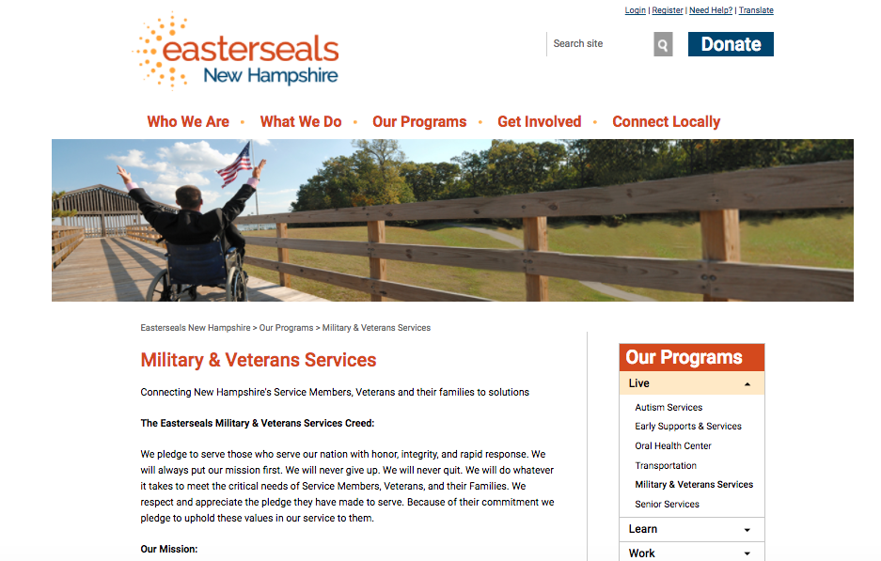
Affiliate
HVRP
Materials
    Easterseals New Hampshire
      This top-level web page markets HVRP’s programs, as well as connects families to services and resources across the state.

