Slide 1


Affiliate Funding Corner: SAM.gov & Grants.gov
November 10, 2020

Slide 2



What are SAM.gov & Grants.gov?
SAM.gov is the Federal government’s business
registration hub
Grants.gov is Federal government’s grant opportunity
hub and the primary system for submitting Federal grant
applications

Slide 3
Why do I need SAM.gov & Grants.gov?
•To do business with the Federal government (grants or contracts), your organization must be registered in SAM.gov.
•To apply for most Federal grant opportunities, your organization and key personnel must be registered in Grants.gov.
•In order to use Grants.gov to apply for a grant opportunity, your organization must first be registered in SAM.gov

Slide 4
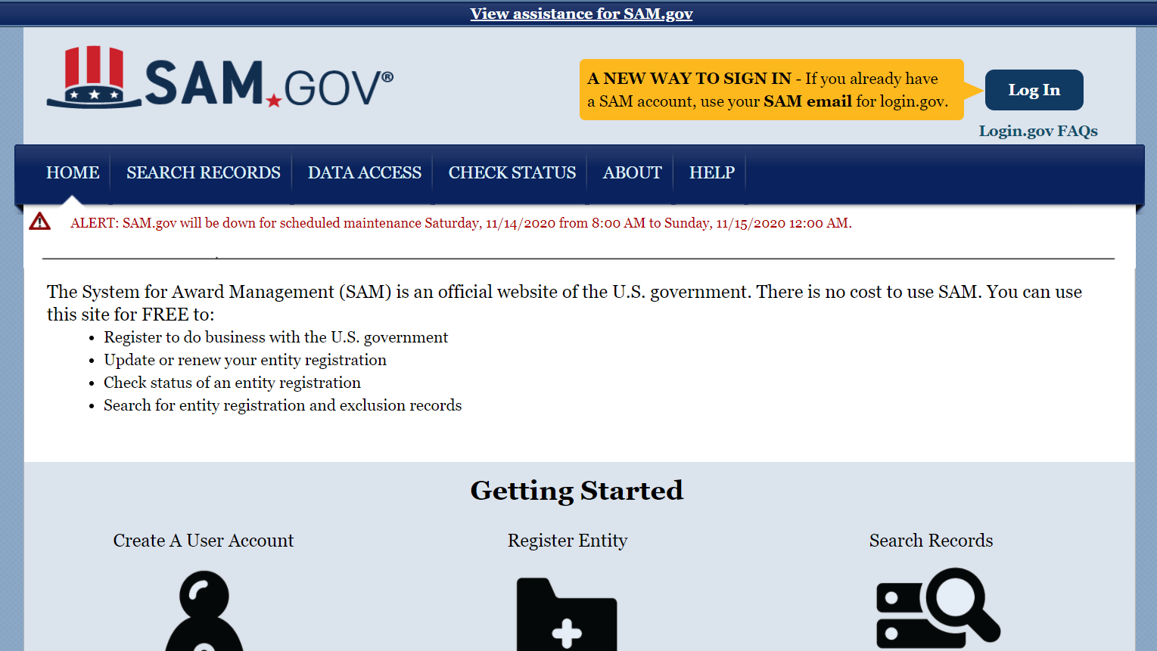
SAM.gov
Create/update an individual user account
Register your entity (organization)

Slide 5
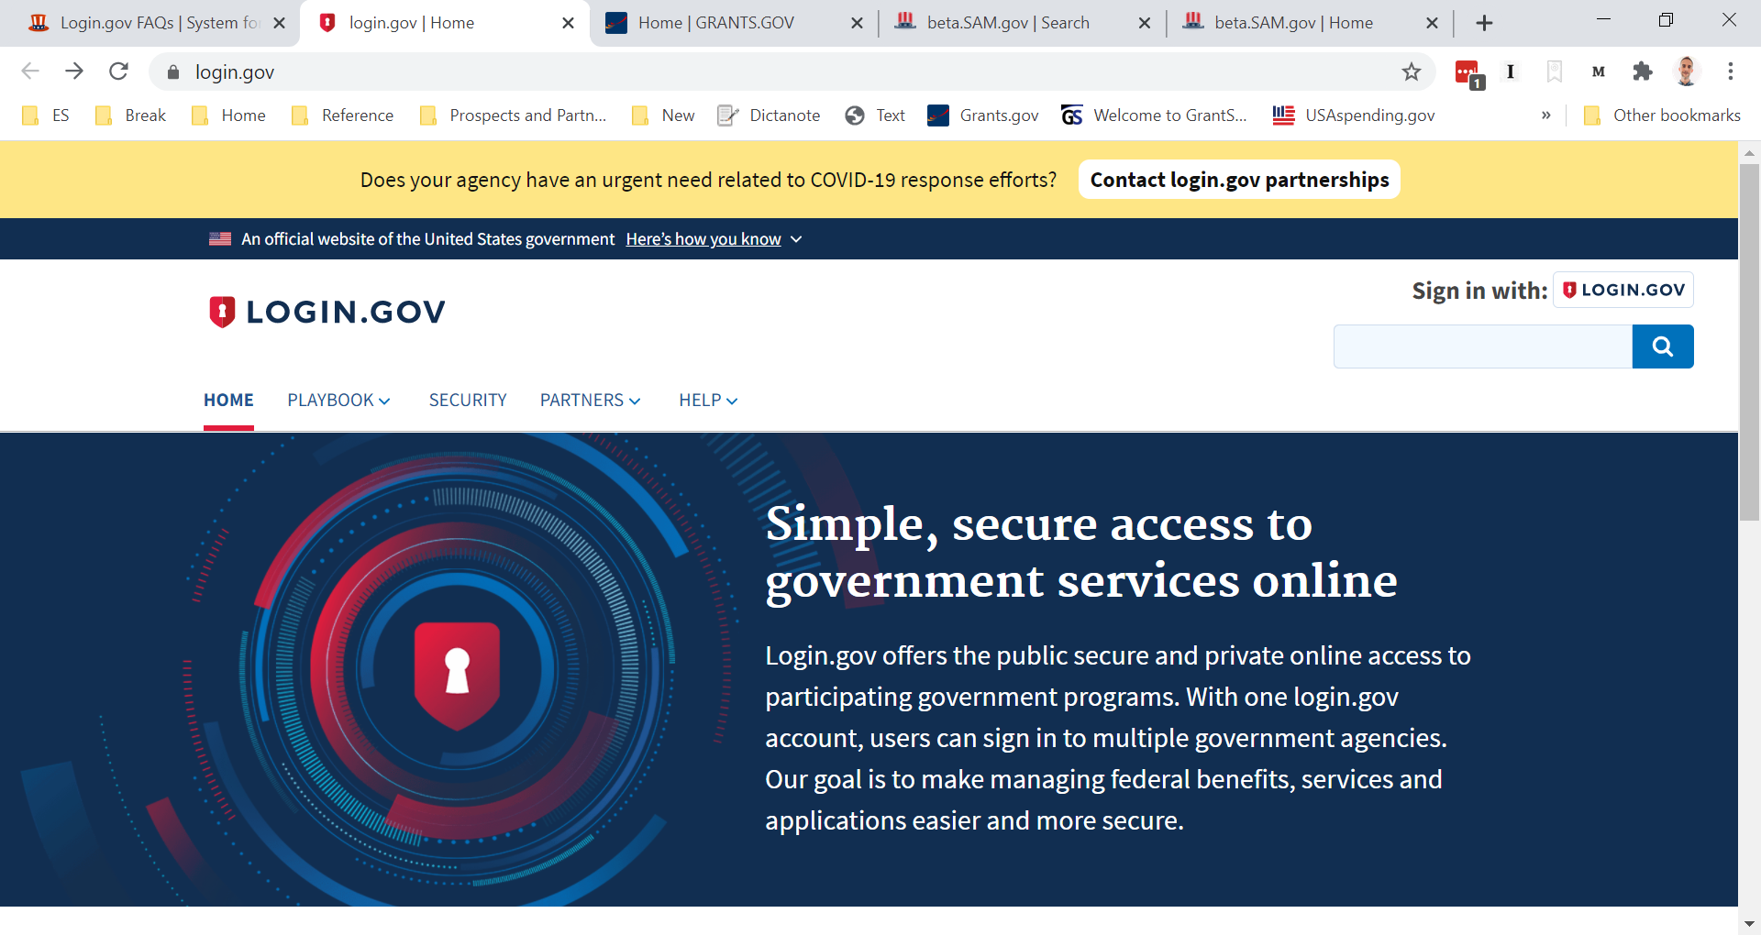
SAM.gov – Individual User Account
Before anything, create a www.login.gov account as an individual user. If you have a SAM.gov account, use this email address to create a login.gov account. If you do not, use the email address associated with your organization.

Slide 6
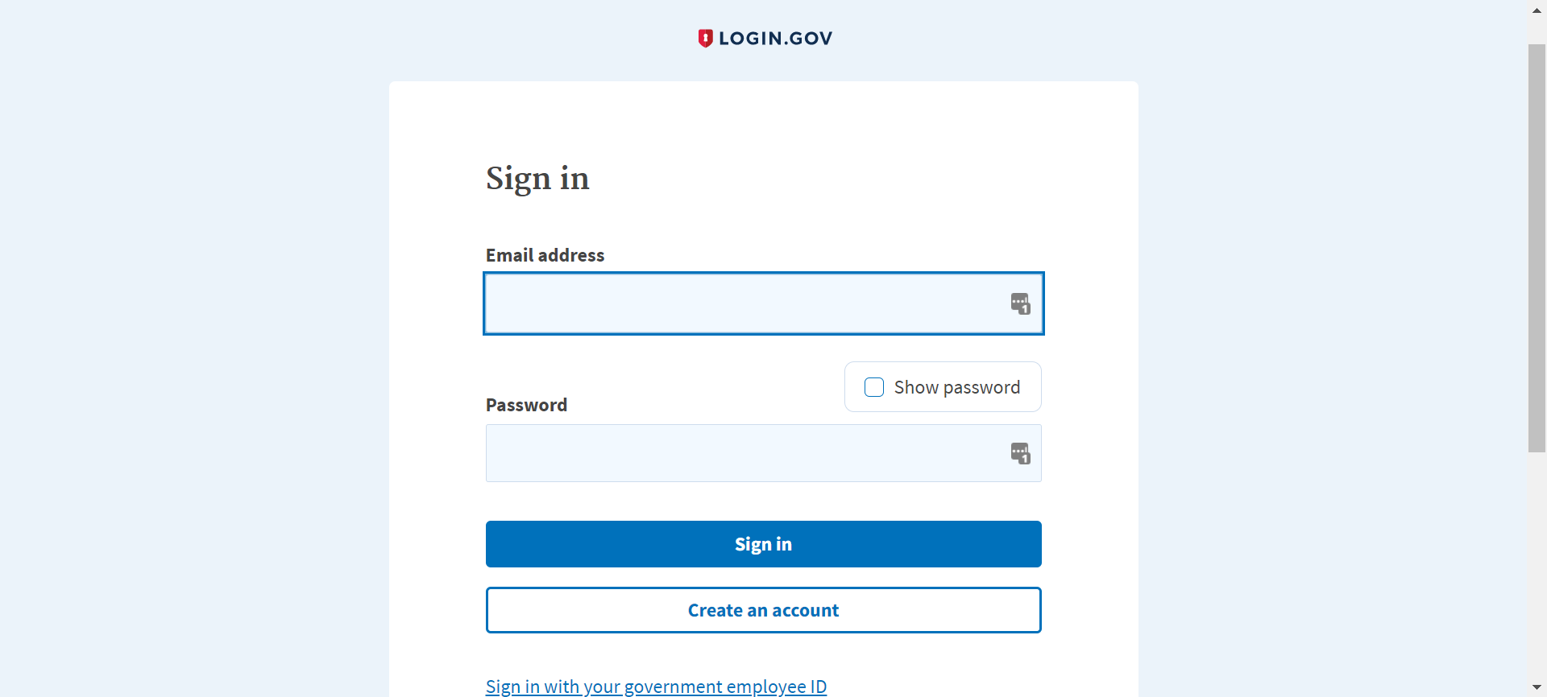
SAM.gov – Individual User Account
Login.gov
Enter your email address and select “Create an account.”

Slide 7
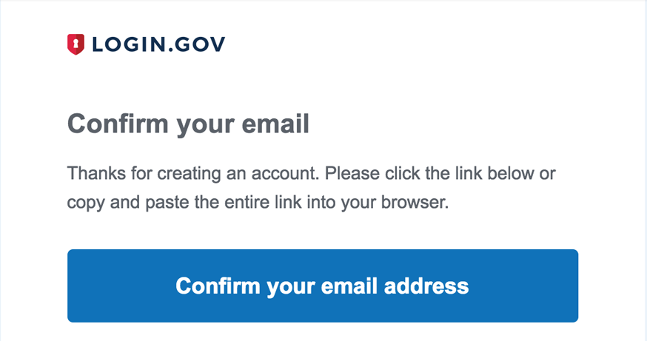
SAM.gov – Individual User Account
Login.gov
You will receive an email with a link to confirm your account.

Slide 8
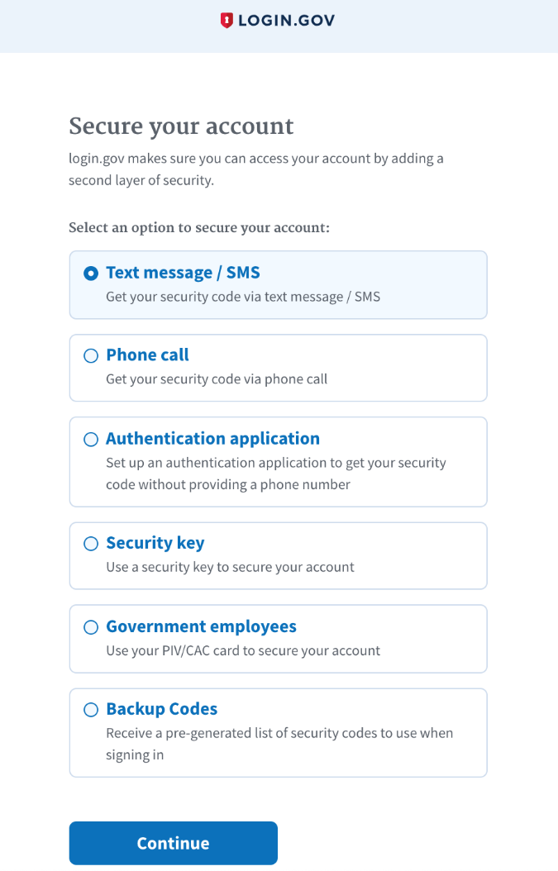
SAM.gov – Individual User Account
Login.gov
Create a strong password.
Then, to make your account secure, you need to select an authentication method. This can be a text message, call, security key, etc.

Slide 9
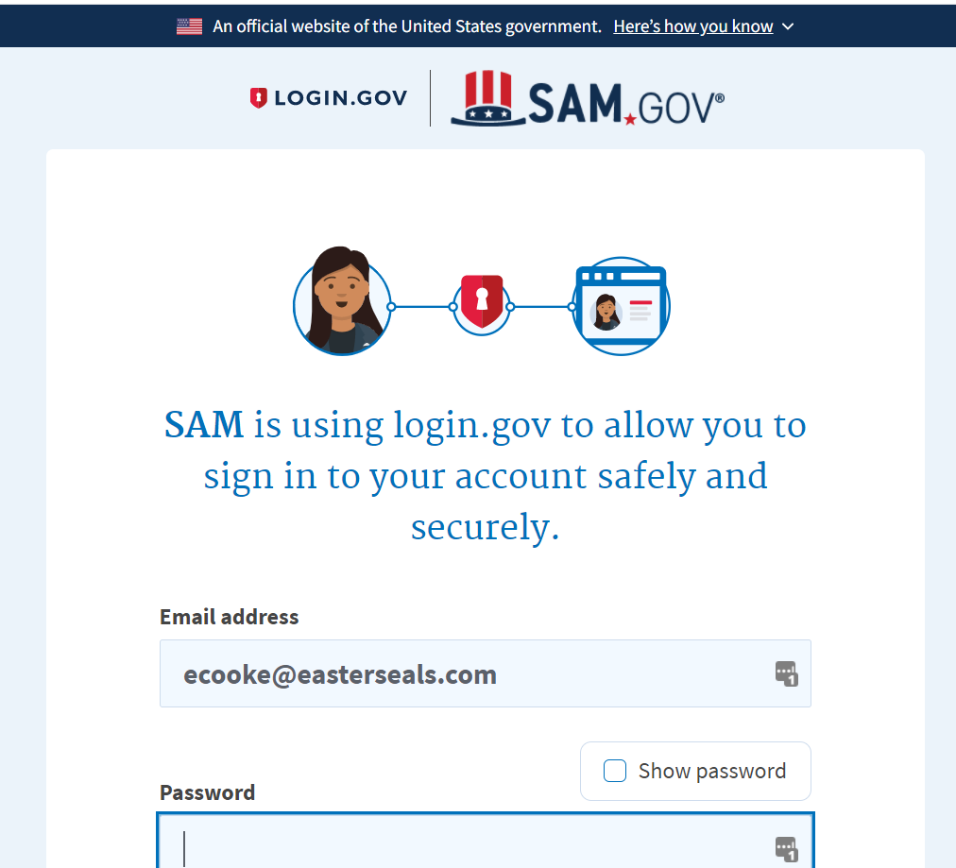
SAM.gov – Individual User Account
Log into SAM.gov using your Login.gov credentials.

Slide 10
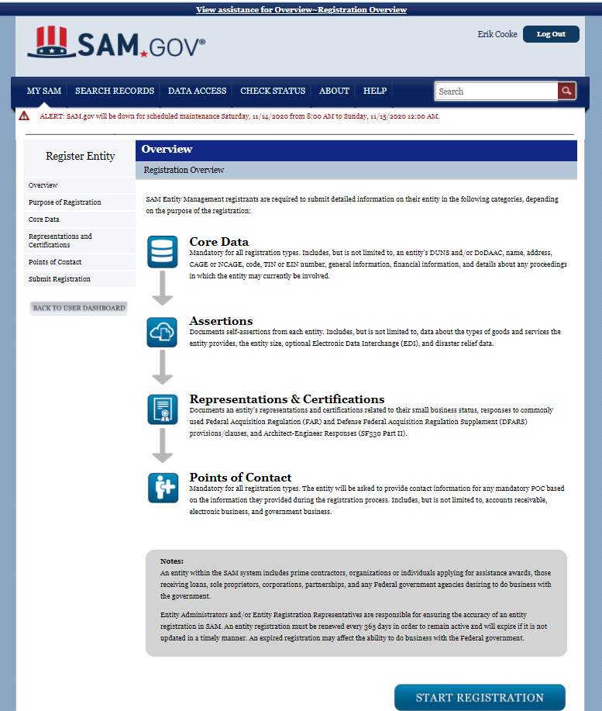
SAM.gov – Entity Registration
With the individual user account of the responsible person in your organization, log into SAM.gov
What you will need:
DUNS number, legal business name and physical address (as recorded in your Dun & Bradstreet record)
TIN/EIN number
Bank routing number, bank account number, and account type (needed for EFT/ACH)

Slide 11
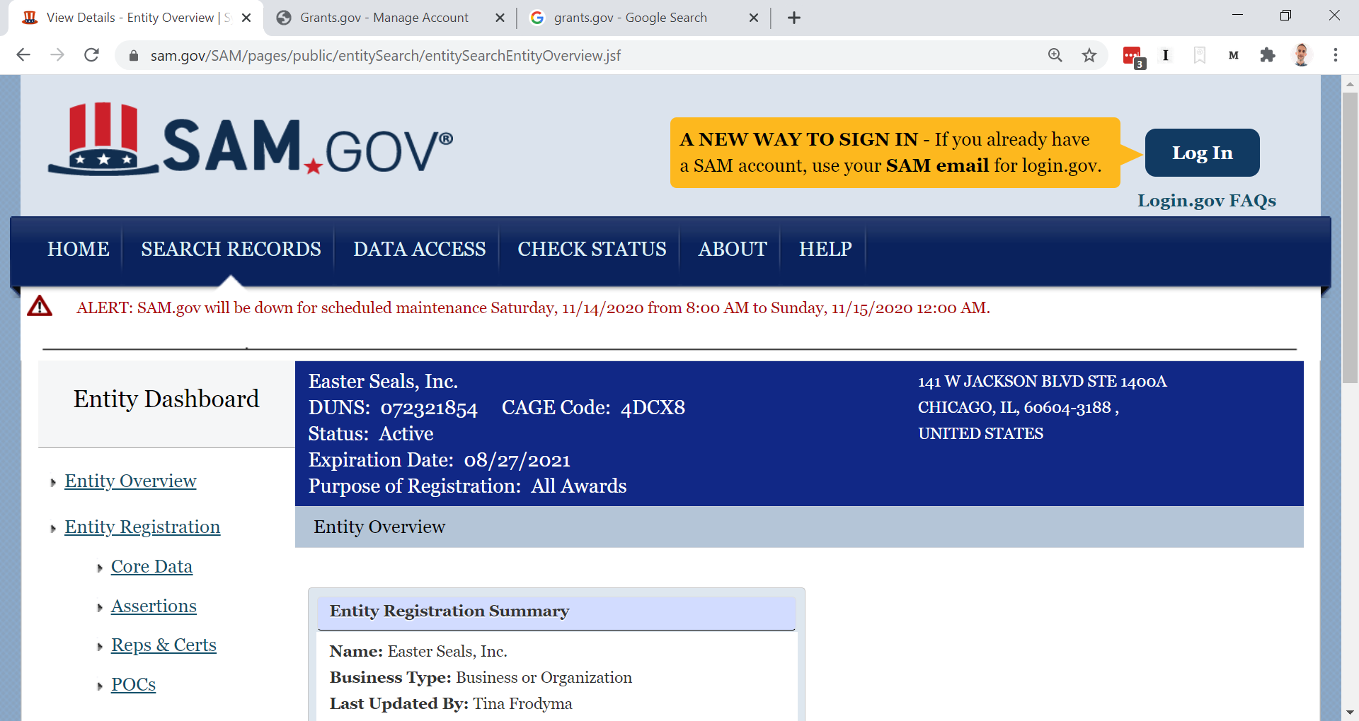
SAM.gov – Entity Registration
Easterseals (National) SAM.gov registration

Slide 12
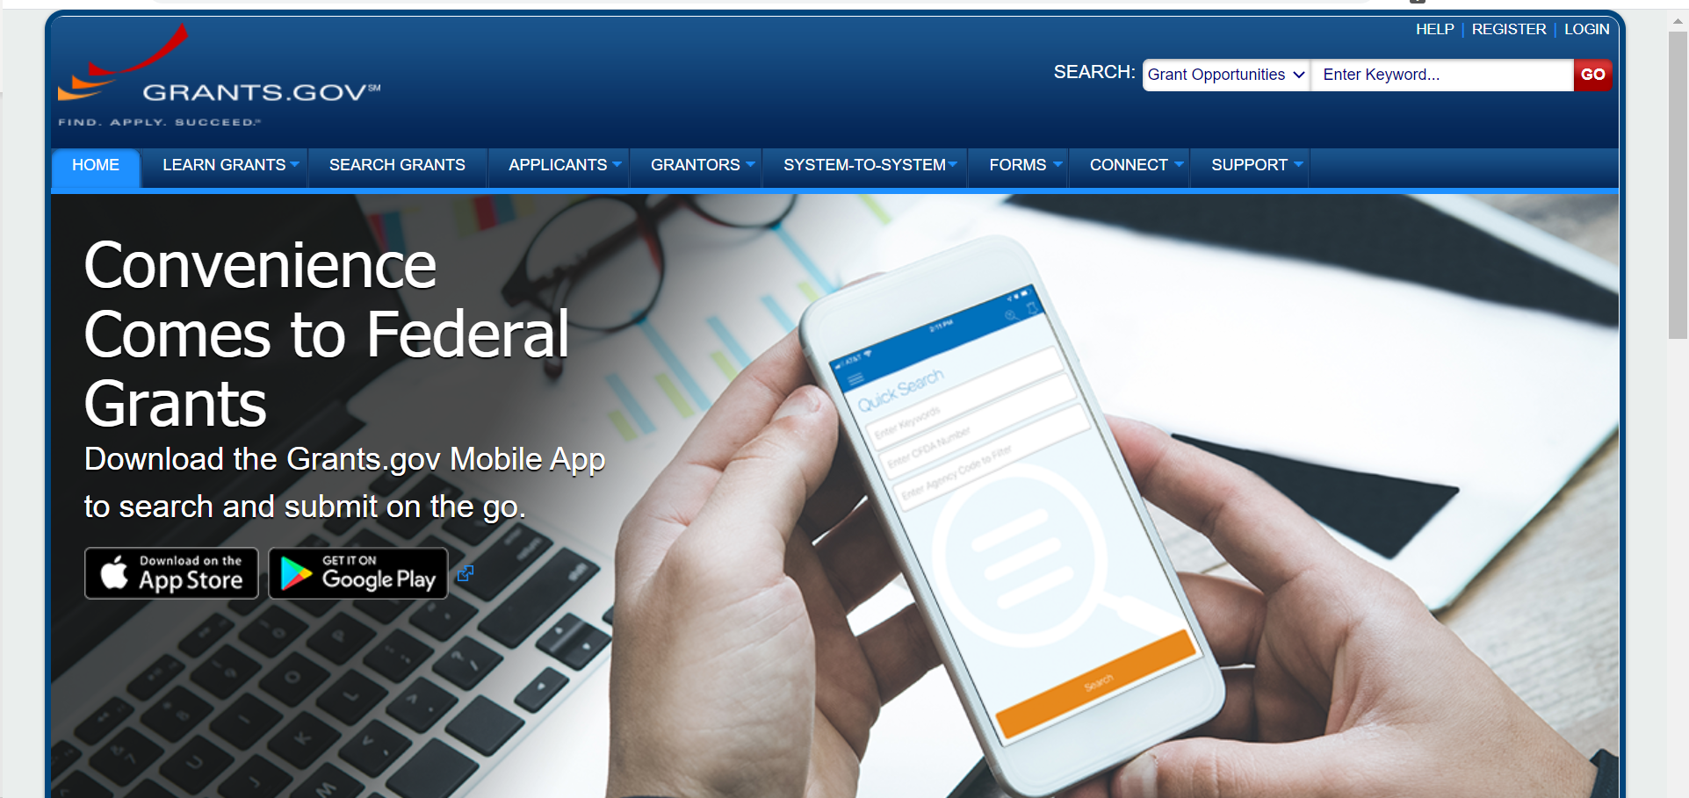
Grants.gov
Find and apply for Federal grant opportunities

Slide 13
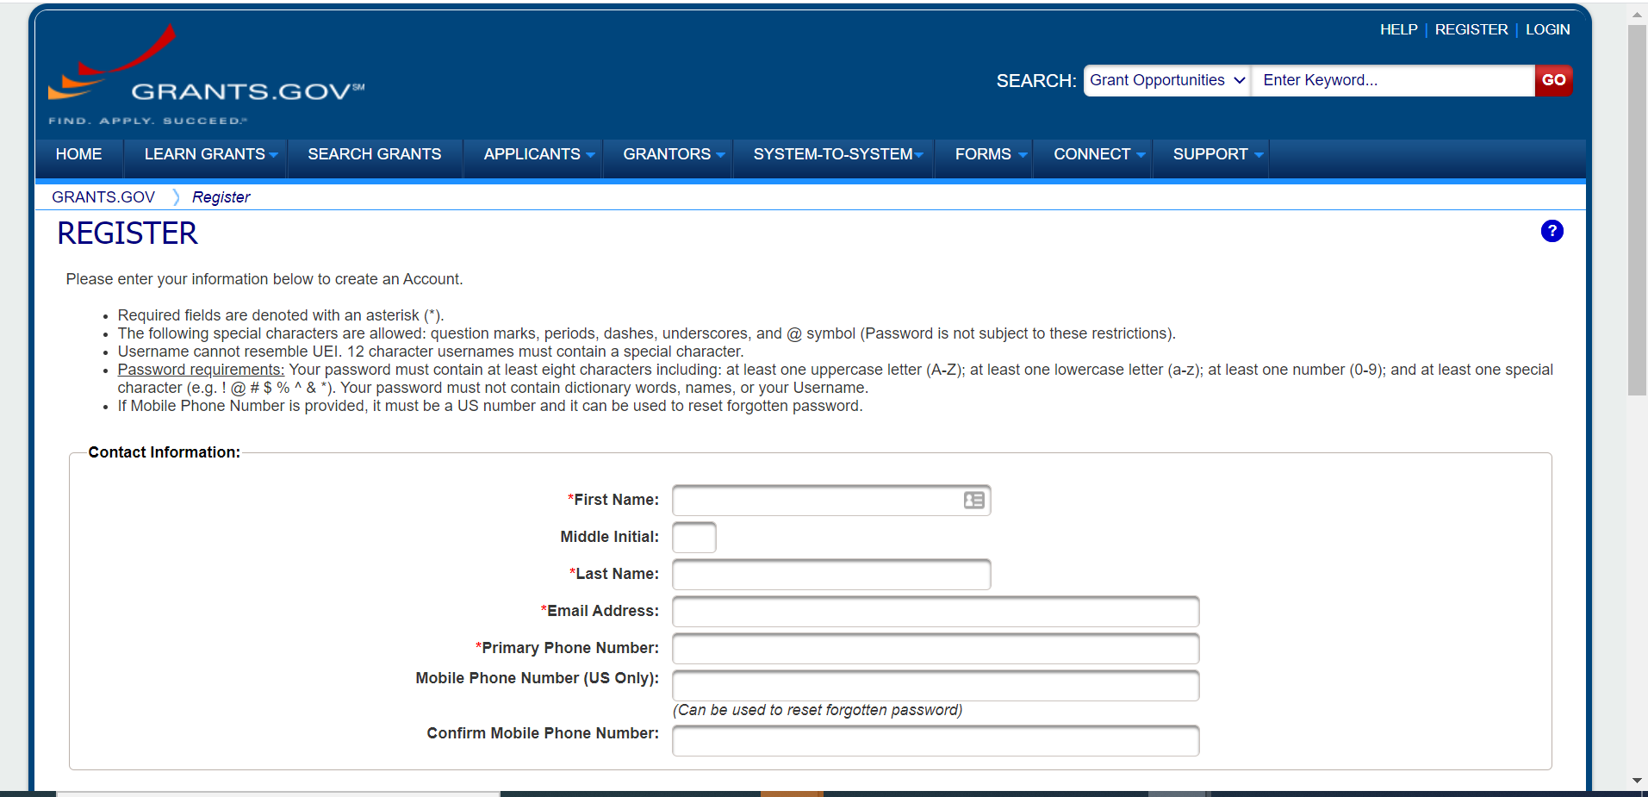
Grants.gov
Register an individual account. Individual accounts can be associated with no organizations (search only), one organization or multiple organizations (develop and submit applications).

Slide 14
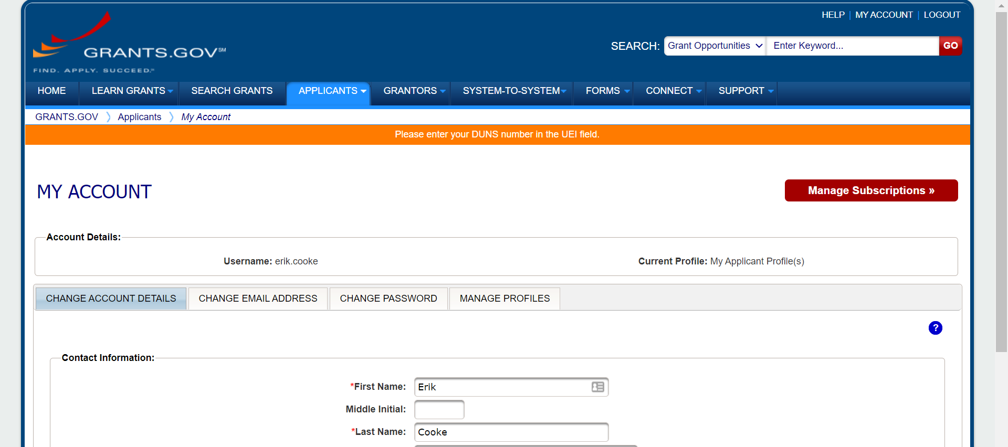
Grants.gov
Log into your Grants.gov account and click on Manage Profiles

Slide 15
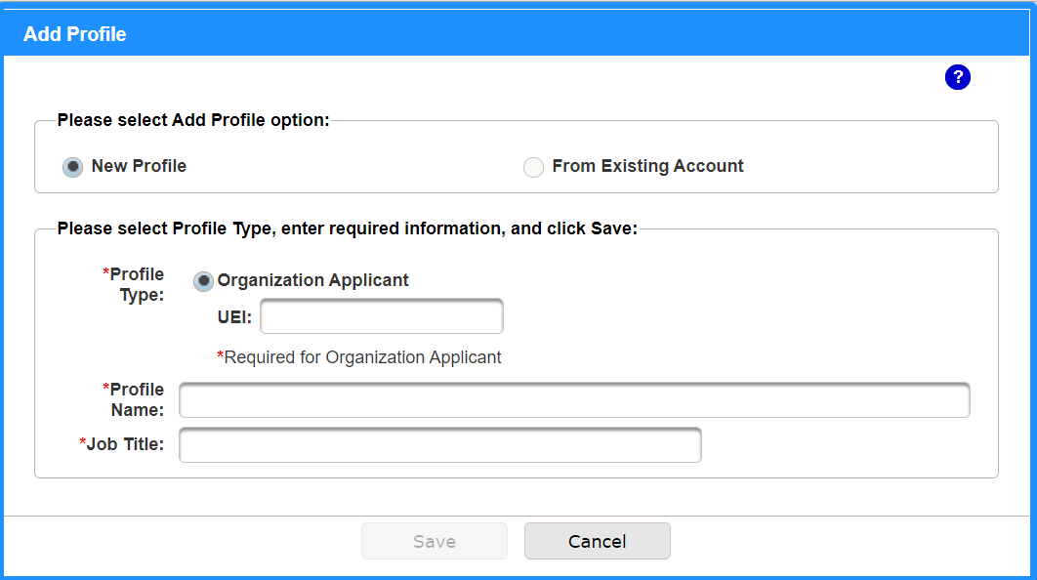
Grants.gov
In the UEI field, enter the DUNS number for your organization.
The SAM.gov account administrator will receive a request to associate your account with the organization.

Slide 16
Keep in Mind
Sam.gov entity registrations need to be updated at least every 365 days.
SAM.gov points of contact are not connected to accounts or registrations. Someone can be identified as a Point of Contact without having a SAM.gov account.
SAM.gov and Grants.gov require different individual accounts. These systems are connected by using SAM.gov administrator to validate Grants.gov individual accounts to associate with the organization.
If the staff member with the SAM.gov administrator account leaves the organization or otherwise is unable to access their account, then it will not be possible to update the entity registration or allow users in Grants.gov to connect to the organization for application purposes.

Slide 17

Resources
System for Award Management – https://SAM.gov
  User Guide: https://sam.gov/SAM/SAM_Guide/SAM_Non_Federal_User_Guide/SAM_Non_Fed_User_Guide.html
Grants.gov – https://www.grants.gov
  Help Guide: https://apply07.grants.gov/help/html/help/index.htm
Login.gov – https://www.login.gov
Dun and Bradstreet - https://fedgov.dnb.com/

